Slide 2
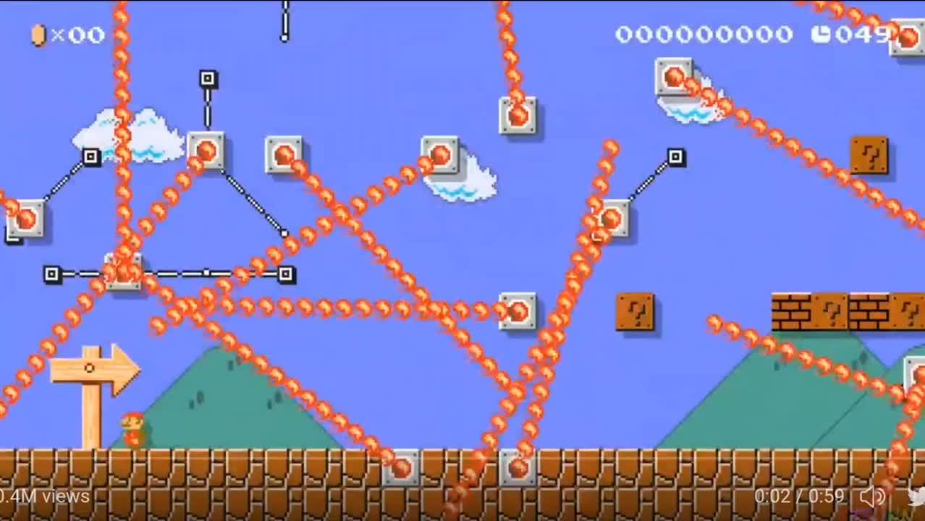
NWIC 2023

Slide 4
Land Acknowledgement
Lakota Scott, ND
Northwest Portland Area Indian Health Board

Slide 5
VISION:
A future where no Oregonian has their enjoyment of life reduced by a disease that could have been prevented by immunization.
About
A network of dedicated community advocates working together to ensure all Oregonians can live free of vaccine-preventable diseases.
MISSION:
Immunize Oregon works to prevent disease through community partnerships, clinical expertise, and immunization policy based on science.
ROLE:
Advise health professionals, policy makers, parents, and the community on the current science and clinical best practices regarding immunizations

Slide 6
The Team
Jessica Coleman
Molly
Sax
PROGRAM MANAGER
PROGRAM COORDINATOR

Slide 7
Immunize Oregon:
A statewide coalition

Slide 8
Hotel Map
Wi-Fi:
“IHG One Rewards”
Password is “PDXSO”
Bathrooms on the North and South side
Lactation room is located in the Oak Room
Exhibitor tables in the Upper and Lower Terrace
Please take personal belongings with you
White lanyards = Experts!

Slide 9
A
B
X
Y
PRESENTATION
CEU'S
LIVE CHAT
Q&A
This presentation will be recorded and uploaded to this session agenda. Once uploaded, “Recorded View” appear under the session overview
Continuing education credits that are offered will have instructions provided during the presentation. Attendees must submit session feedback to receive credits
Use this field to chat with the communicate with the host and moderator during the event. We will keep an eye out for anything you need!
Q&A will be hosted after the presentation as time allows. Enter your questions and vote for your favorites! If possible, please submit each question separately

Slide 10
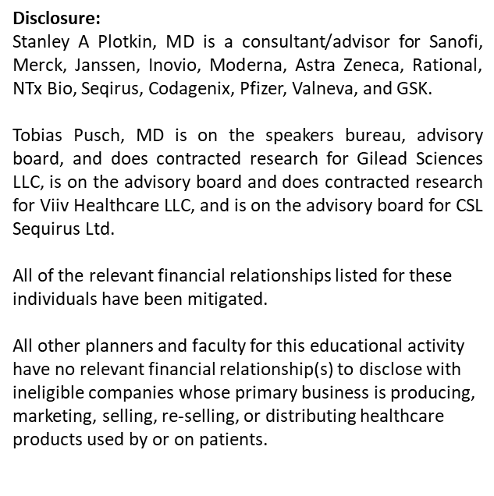

Slide 12
Live Chat
1
Communicate with host and answer speaker questions for the audience
Vote-Up Questions
2
Vote for questions that you are interested in
Ask Questions
3
Submit your questions for the speaker to answer during the dedicated Q&A

Slide 13
Whova Streaming

Slide 14
Visit Exhibitors during breaks
Exhibitor Passport
Collect
12 stamps
Visit the exhibitor tables in the Upper and Lower Terrace during breakfast, lunch, and breaks
Virtual booths can be visited on Whova
Add your name to win prizes!

Slide 15
GAME ON
ARE YOU READY

