Slide 1
Vaccine-Preventable Diseases
The State of the State
Paul R. Cieslak, MD
August 8, 2023

Slide 2

Tetanus
CDC Public Health Image Library #6373
Notes:
PHIL #6373: This hospitalized patient was displaying a bodily posture known as opisthotonos, due to Clostridium tetani exotoxin. Note the extreme muscle spasms involving the neck and back.

Slide 3
Tetanus: about 1 case every other year in Oregon since 1990
n = 17
Cases
Year
*Data as of 1 Aug 2023
Notes:
65 cases in 72 years: 0.9 cases/year

Slide 4
Reported Tetanus, by Age & Sex
Oregon, 1990–2023*
Female
n = 17
Male
*Data as of 1 Aug 2023

Slide 5
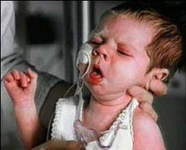
Pertussis

Slide 6
Reported Pertussis, by Year
Oregon, 1915–2023
Tetanus and diphtheria school
requirements
DTP
Tdap 7th-grade
requirement
DTaP
Cases per 100,000
Tdap
PCR
Year
Notes:
910 cases in 2012.
17 in 2022 (3 in infants)
23 in 2023 as of July 31 (3 in infants)
1,554 in 1930
DPT introduction – 1948
Tetanus and diphtheria school requirements 1981
DTaP introduction licensed in 1995
PCR testing for pertussis OSPHL started in 2005
Tdap introduction licensed in 2005
Tdap required for 7th grade: SY 2007-2008
Pertussis school requirement fall of 2008
This link has a summary of DTaP/Tdap licensure and ACIP recommendations https://stacks.cdc.gov/view/cdc/52821

Slide 7
Pertussis, by Age & Sex
Oregon, 2013–2022
Female
Male
n = 3,037
Notes:
53% female
2020: 165
2021: 3
2022: 17
2023 through August 1: 25

Slide 8
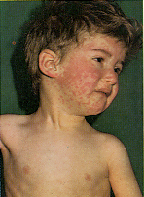
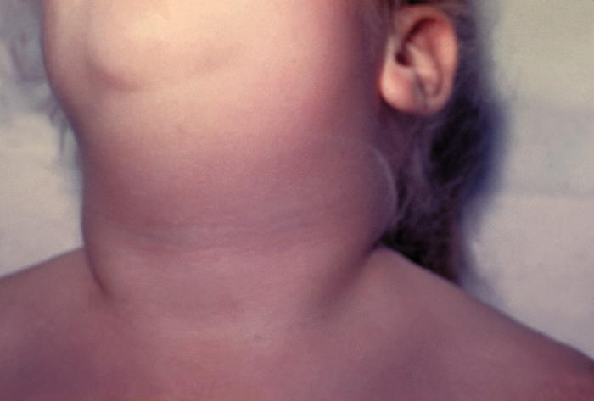
Measles
& Mumps
Notes:
Rubella:
4 cases in 1994
4 cases 1995-2013.

Slide 9
Oregon has had an average of 3 measles cases per year since 1993.
n = 96
Cases
Year
*Data as of 1 Aug 2023.

Slide 10
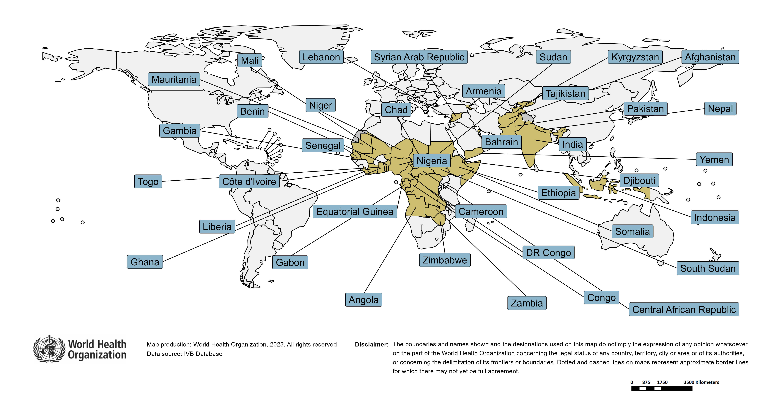
Large or disruptive outbreaks (last 12 months)
Country | Cases | Rate/M
Yemen | 31,285 | 928
Gabon | 2,172 | 909
Somalia | 12,326 | 700
Liberia | 3,072 | 579
Zimbabwe | 4,866 | 298
Central African Republic | 1,132 | 203
Cameroon | 5,304 | 190
Djibouti | 210 | 187
South Sudan | 1,700 | 156
Togo | 860 | 97
Afghanistan | 3,940 | 96
Angola | 3,094 | 87
Bahrain | 111 | 75
Ethiopia | 7,979 | 65
India | 85,480 | 60
Tajikistan | 568 | 57
Congo | 339 | 57
Chad | 907 | 51
Kyrgyzstan | 328 | 49
DR Congo | 4,575 | 46
Armenia | 126 | 45
Senegal | 778 | 45
Pakistan | 9,677 | 41
Benin | 493 | 37
Côte d'Ivoire | 998 | 35
Mauritania | 158 | 33
Zambia | 637 | 32
Lebanon | 173 | 32
Nepal | 949 | 31
Equatorial Guinea | 49 | 29
Indonesia | 7,857 | 29
Syrian Arab Republic | 587 | 27
Sudan | 1,143 | 24
Mali | 509 | 23
Niger | 590 | 23
Ghana | 720 | 22
Nigeria | 4,460 | 20
Gambia | 55 | 20
In the frame of tracking progress towards the goals of Immunization Agenda 2030 (IA2030), an indicator has been developed by a working group in order to represent large and disruptive measles outbreaks. This indicator is defined as an incidence equal or greater than 20 reported measles cases per million population over a period of 12 months. It is important to note that measles outbreak definitions vary between countries and regions according to local context and level of progress towards regional elimination goals. This definition of large and disruptive outbreaks aims to complement and not replace the national and regional definitions, while also providing a degree of global standardization and permitting tracking of progress against a common metric.
Notes: Based on data received 2023-06 and covering the period between 2022-05 and 2023-04 - Incidence: Number of cases / 1M population - Population Data: World population prospects, 2019 revision
Notes:
From the WWHO Global MR update (PowerPoint)

Slide 11
Mumps cases trickling along.
n = 208
Cases
Year
*Data as of 1 Aug 2023.

Slide 12
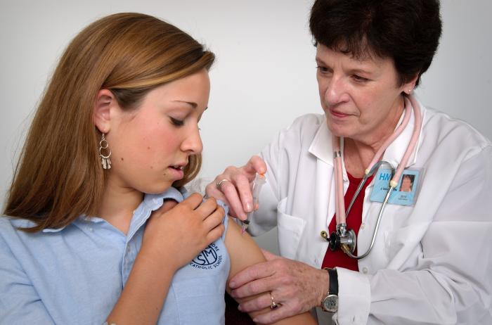
Human Papillomavirus
CDC Public Health Image Library

Slide 13
Pap Screening among 18–39 y.o. Women
Portland Area, 2008–2021
Percentage screened
Year
*Data are provisional and not for publication.
Notes:
This figure shows the percentage of women by age group in the catchment area who received a pap. X-axis is the year and the y-axis is the percentage of women screened
The percentage of women in all age groups screened over time has decreased, which we expect, given changes in pap screening recommendations.
Note: In 2012, ACS pap screening recommendations changed:
Women under 21 shouldn’t have a pap at all
21-29 year old women should have a pap every 3 years(as opposed to every year), HPV Test only if abnormal Pap
30-65 year old women should have a Pap every 5 years with HPV co-test OR a Pap every 3 years with no HPV co-test

Slide 14
CIN2+ Incidence Rate among Screened Women Aged 20–24 Years, Portland Area, 2008–2021
Cases per 1,000
Year
*Data are provisional and not for publication.
Notes:
This figure shows the estimated CIN2+ incidence rate among screened women.
X-axis = incident years
Y= rate per 1,000 population
The blue line shows 18-19 year old women, and the purple line shows 20-24 year old women.
The rate of CIN 2+ decreased from 2008 to 2019 among 18-19 year olds and 20-24 year old women who have been screened.
Consistent with national data (from CID 2019):
-declined in both age groups
The cause of the 2012 peak is unclear.
Possible explanations include the following:
The 2008 economy bust, which may have caused a delay in seeking initial care or follow-up visits
Population growth in our catchment for this particular age group (that may not be correctly captured in the population estimates)
Expanded Medicaid coverage under the Oregon Health Plan
Expanded colposcopy services—there had been very few providers
Planned Parenthood reduced the number of sites performing colposcopies from 4 to 1.
In 2012, ACS pap screening recommendations changed:
women under 21 shouldn’t have a pap at all.
21-29 year old women should have a pap every 3 years(as opposed to every year), HPV Test only if abnormal Pap

Slide 15
CIN 2+ Incidence Rate among Screened Women Aged 25–39 Years, Portland Area, 2008–2021
Cases per 1,000
Year
*Data are provisional and not for publication.
Notes:
This figure is the same as the last slide and shows the incidence CIN 2+ rate among screened women aged 25-39 years old
Green line shows 25 to 29 year olds
Dark blue shows 30-34 year olds
Light blue shows 35 to 39 year olds
Despite changes in screening recommendations and decreases in screening, the incidence of CIN 2 + has increased over time for these three age groups.
It is not clear why, but in the April 2019 MMWR, the CDC suggested “some of the increases in older age groups could be attributable to use of HPV testing, which is more sensitive than cytology, as part of cervical cancer screening, as has been predicted by modeling studies”.
The increase is consistent with national data.
Reference CID April 2019
Consistent with national data (from CID 2019):
“Rates per 100 000 screened women increased significantly over time in women aged 25–29, 30–34, and 35–39 years.”
In 2012, ACS pap screening recommendations changed:
21-29 year old women should have a pap every 3 years(as opposed to every year), HPV Test only if abnormal Pap
30-65 year old women should have a Pap every 5 years with HPV co-test OR a Pap every 3 years no HPV co-test

Slide 16
HPV: Summary
The percentage of women receiving Pap smears declined
For women aged 18–24 years:
  CIN 2+ rate declined
  CIN 2+ rate for screened women declined
For women 25–39 years:
  CIN 2+ rate remained same or increased
  CIN 2+ rate for screened women increased
Rates differ by race & ethnicity
CONCLUSION: CIN 2+ incidence has decreased in the cohorts of women that include vaccine recipients.
Notes:
In summary, the data show
Percentage of women in the catchment area having had one or more Pap smears declined in all age groups
For women aged 18-24 years:
CIN 2+ incidence rate fell
CIN 2+ incidence rate for screened women fell
For women 25-39:
CIN 2+ incidence rate remained same or increased
CIN 2+ incidence rate for screened women increased
There are differences in rates by race/ethnicity groups that need further exploration. Asian women have lower rates of CIN2+, but are diagnosed at a later age and with more severe disease.
Pap smear frequency changes notwithstanding, CIN 2+ diagnoses have been falling in the cohorts of women that include vaccine recipients.

Slide 17
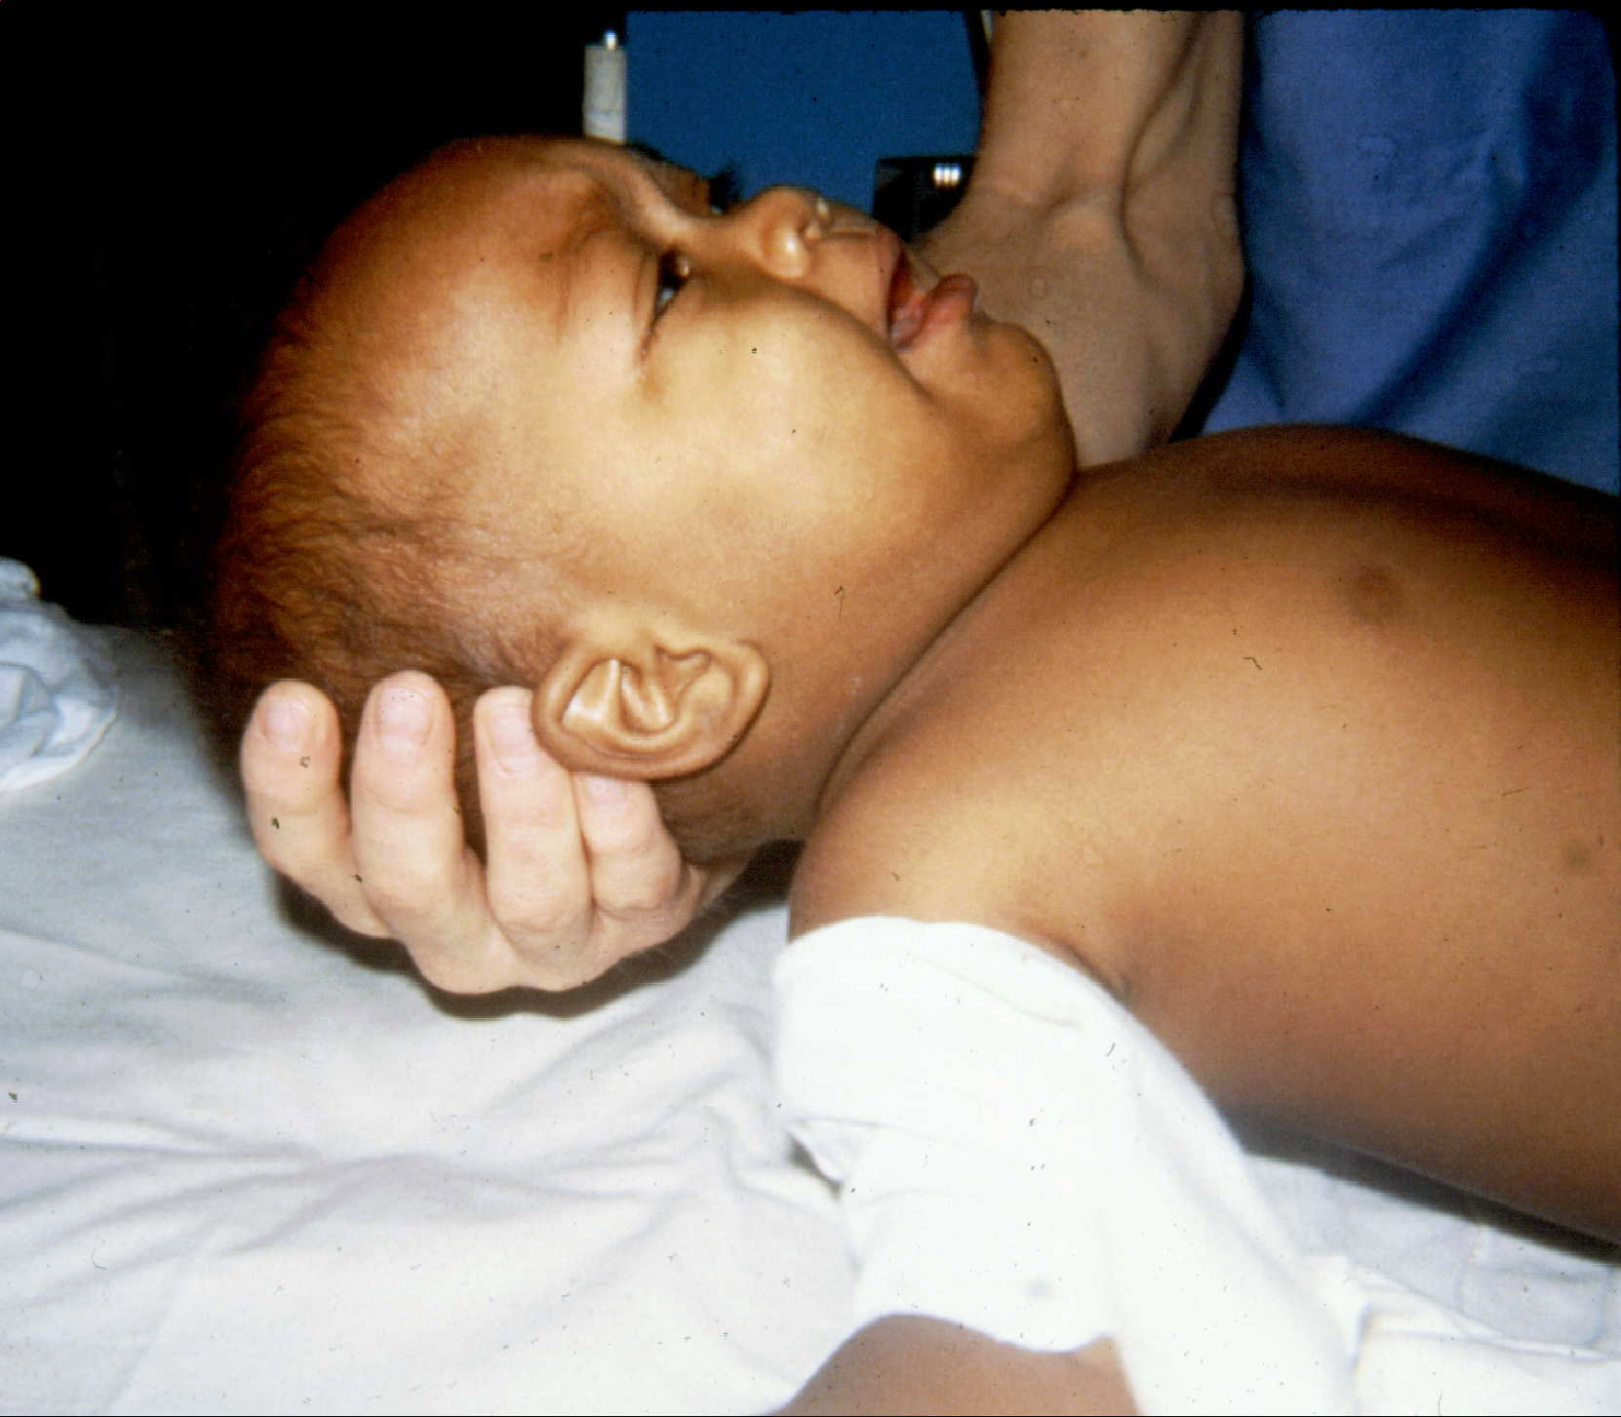
Meningococcal Disease
Courtesy of Dr. Brian Lauer

Slide 18
Meningococcal Disease, by Serogroup
Oregon, 1988–2023*
Serogroup
n = 1,679
Unknown
Other
Y
C
B
Year
*Data through 1 Aug 2023
Notes:
Disease reporting + OSPHL testing of isolates allows us to follow trends in overall disease, and in serotype-specific disease (important for, e.g., vaccine decisions)
0 cases in 2020!
6 in 2021, 8 in 2022, 1 to date in 2023.

Slide 19
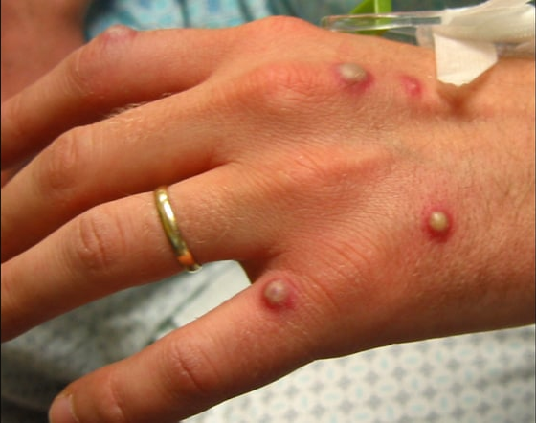
Mpox (Monkeypox)
https://reference.medscape.com/slideshow/monkeypox-6015388?src=wnl_critimg_220603_mscpref

Slide 20
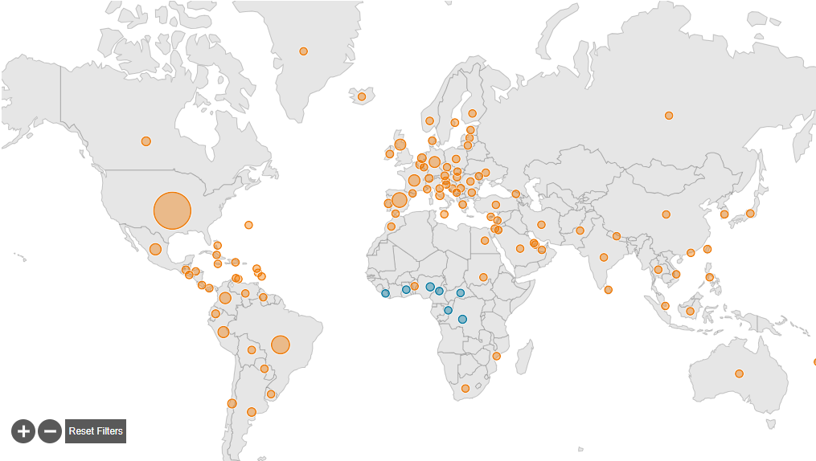
Monkeypox, 2022*
n = 88,122 cases
in 112 countries
U.S: 30,555 cases
*Data as of 5 Jul 2023.
www.cdc.gov/poxvirus/mpox/response/2022/world-map.html
Notes:
U.S. with 35% of cases.

Slide 21
Mpox, by County of Residence
Oregon, 2022–2023*
3
33
181
1
1
16
9
2
1
n = 281 cases
in 12 counties
32
1
1
*data as of 1 Aug 2023
Notes:
Multnomah with 181 (64%) of 281 cases.
Lane County (Population 384,000 = 9% of Oregon) had 11% of cases.

Slide 22
Monkeypox, by Age & Sex
Oregon, 2022–2023*
n = 281
Female
97% male
Male
Age
*data as of 28 Jul 2023
Notes:
272 male, 8 female
4 are <20 y.o.

Slide 23

Jynneos®: Indications
Post-exposure
MSM, transgender, nonbinary who in past 6 months had
  sex with >1 partner or group sex; or
  new diagnosis of a sexually transmitted disease (including HIV)
Anyone who in past 6 months had sex
  at commercial sex venue (e.g., sex club or bathhouse);
  group sex; or
  at event, venue, or in area with mpox transmission
Sex partner of any of the above
Anticipate experiencing any of the above
Persons at risk for occupational exposure
www.cdc.gov/poxvirus/monkeypox/vaccines/vaccine-basics.html
Notes:
CDC estimates 26,255 at-risk people in Oregon (“MSM++”). Of those,
12,883 (49%) have had 1 dose
7,150 (27%) have had 2 doses
Occupational: research lab personnel, clinical lab personnel who test for orthopoxviruses, designated response team members, HCP who administer ACAM2000 or care for patients infected with orthopoxviruses. https://www.cdc.gov/mmwr/volumes/71/wr/mm7122e1.htm#T1_down
Boosters (Jynneos q2years, ACAM2000 q3years) for those with occupational exposure to variola or mpox viruses.
Photo attributed to USAMRDC: www.bing.com/images/search?view=detailV2&ccid=vUk6VMoA&id=CF6A1BA917B86A52CF33F8CD8EF0DF4C1B6FD624&thid=OIP.vUk6VMoAo1krXRRVQDn2ywHaEo&mediaurl=https%3A%2F%2Fmrdc.amedd.army.mil%2Fassets%2Fimages%2Farticles%2F2019%2FJYNNEOS-carton-large.jpg&cdnurl=https%3A%2F%2Fth.bing.com%2Fth%2Fid%2FR.bd493a54ca00a3592b5d14554039f6cb%3Frik%3DJNZvG0zf8I7N%252bA%26pid%3DImgRaw%26r%3D0%26sres%3D1%26sresct%3D1&exph=438&expw=700&q=jynneos&simid=608033886350879716&form=IRPRST&ck=9EB92A06EEC0E8B4D3696E2F62F339EF&selectedindex=1&ajaxhist=0&ajaxserp=0&vt=0&sim=11

Slide 24
Mpox, by Week of Onset
Oregon, 2022–2023*
Vaccination among estimated Oregon at-risk population:
1 dose: 50%
2 doses: 28%
n = 281
2022
2023
Week Ending
*data as of 1 Aug 2023
Notes:
https://public.tableau.com/app/profile/oregon.health.authority.covid.19/viz/OregonCOVID-19CaseDemographicsandDiseaseSeverityStatewide/DemographicDataHosp?publish=yes
Most recent case: week of July 16-
Vaccination data: https://www.cdc.gov/poxvirus/mpox/cases-data/mpx-jynneos-vaccine-coverage.html

Slide 25

COVID-19
www.fda.gov/consumers/consumer-updates/covid-19-test-basics

Slide 26
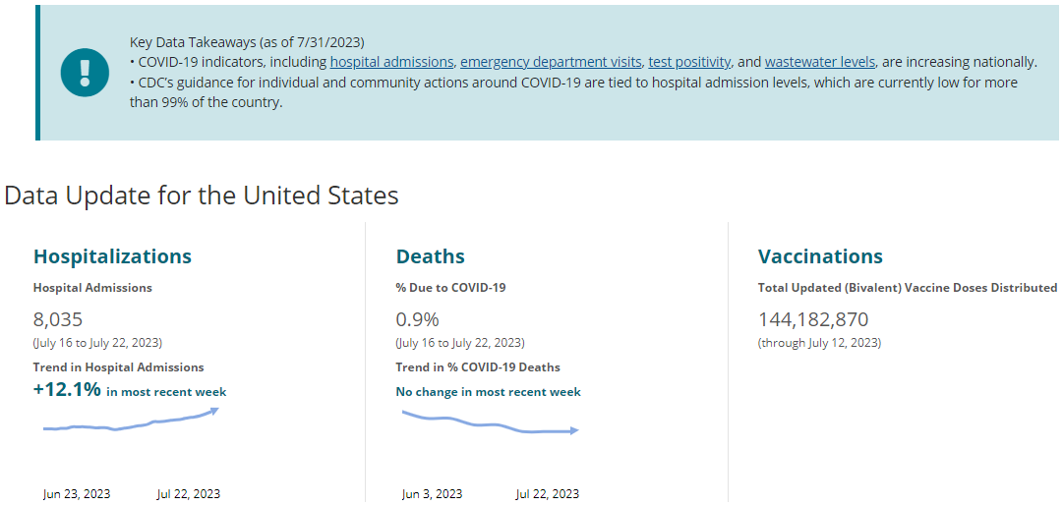
Nationally, COVID is up.

Slide 27
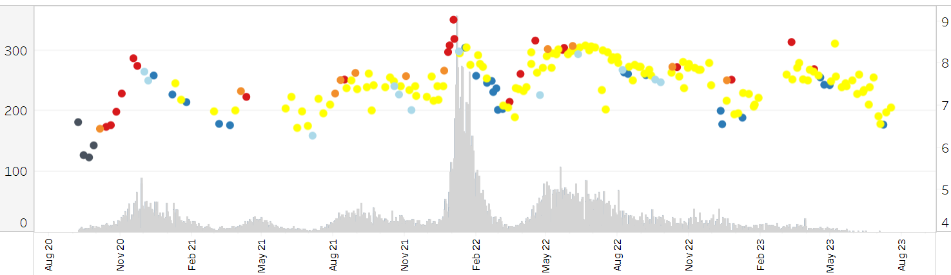
SARS-CoV-2 wastewater trends, Portland*
6.933
Viral Concentration (Log10 Copies/person/day)
Daily case rate per 100,000
Date
*Data as of 19 JuL 2023.
https://public.tableau.com/app/profile/oregon.health.authority.covid.19/viz/OregonsSARS-CoV-2WastewaterMonitoring/Introduction
Notes:
Source: https://public.tableau.com/app/profile/oregon.health.authority.covid.19/viz/OregonsSARS-CoV-2WastewaterMonitoring/Introduction. Data accessed: 7/28/23.
6.933Log₁₀ = 8,570,378

Slide 28
COVID-19 Hospital and ICU Occupancy
Oregon*
1 Sep 2021:
1,178
27 Jan 2022:
1,130
Hospitalized
Patients
30 Nov 2020:
584
17 Jul 2022:
464
3 & 13 May 2021:
351
29 Nov 2022:
370
24 Jul 2020:
168
7 Apr 2020:
157
ICU
113
9
Date
*”COVID-positive patients.” Sources: HosCap through 3/31/2023; then OCS through 1 Aug 2023.
Notes:
https://public.tableau.com/app/profile/oregon.health.authority.covid.19/viz/OregonCOVID-19HospitalCapacity/HospitalizationbySeverity
Note: We began using data from the Oregon Capacity System (OCS) instead of HOSCAP on April 1, 2023. Because OCS categorizes some types of hospital beds differently from HOSCAP, the adult non-ICU bed counts OHA reports from OCS will reflect adult medical/surgical and adult progressive care unit beds. The adult non-ICU beds currently reported reflect the medical/surgical and “other" bed categories in HOSCAP.
Most recent date under 200: 5/10/2022.
Fall 2022 peak:
hospitalizations: 371 (Nov 29)
ICU beds: 47 (Nov 25-26)
Summer 2022 peak:
hospitalizations: 464 (Jul 17)
ICU beds: 71 (Jul 12)
Spring 2022 nadir:
hospitalizations: 84 (Apr 7)
ICU beds: 14 (Apr 17 & 24)
Winter 2022 peak:
hospitalizations: 1,130 (Jan 27)
ICU beds: 197 (Feb 7)
Fall 2021 peak:
hospitalizations: 1,178 (Sept 1)
ICU beds: 358 (Sept 1)
2021 nadirs
December 2021:
hospitalizations: 338 (Dec 21)
ICU beds: 85 (Dec 21)
All of 2021:
hospitalizations: 99 (July 9)
ICU beds: 16 (March 23)
Spring 2021 peak:
hospitalizations: 351 (May 3 & May 13)
ICU beds: 90 (May 6-7)
Fall 2020 peak
hospitalizations: 584 (Nov 30)
ICU beds: 132 (Dec 9)
2020 Nadirs (since data collection began 4/6/2020):
hospitalizations: 46 (6/2/2020)
ICU beds: 16 (5/11/2020)

Slide 29
7.4% of adults hospitalized with COVID-19 are in ICU*
Adult Acute-Care
Patients
Percentage in ICU
Percentage in ICU
ICU
Date
*Sources: HosCap through 3/31/2023; then OCS through 1 Aug 2023.
Notes:
https://public.tableau.com/app/profile/oregon.health.authority.covid.19/viz/OregonCOVID-19HospitalCapacity/HospitalizationbySeverity
Spring 2022 nadir:
hospitalizations: 88 (Apr 17 – Easter Day)
ICU beds: 14 (Apr 17 & 24)
Winter 2022 peak:
hospitalizations: 1,130 (Jan 27)
ICU beds: 197 (Feb 7)
Fall 2021 peak:
hospitalizations: 1,178 (Sept 1)
ICU beds: 358 (Sept 1)
2021 nadirs
December 2021:
hospitalizations: 338 (Dec 21)
ICU beds: 85 (Dec 21)
All of 2021:
hospitalizations: 99 (July 9)
ICU beds: 16 (March 23)
Spring 2021 peak:
hospitalizations: 351 (May 3 & May 13)
ICU beds: 90 (May 6-7)
Fall 2020 peak
hospitalizations: 584 (Nov 30)
ICU beds: 132 (Dec 9)
2020 Nadirs (since data collection began 4/6/2020):
hospitalizations: 46 (6/2/2020)
ICU beds: 16 (5/11/2020)

Slide 30
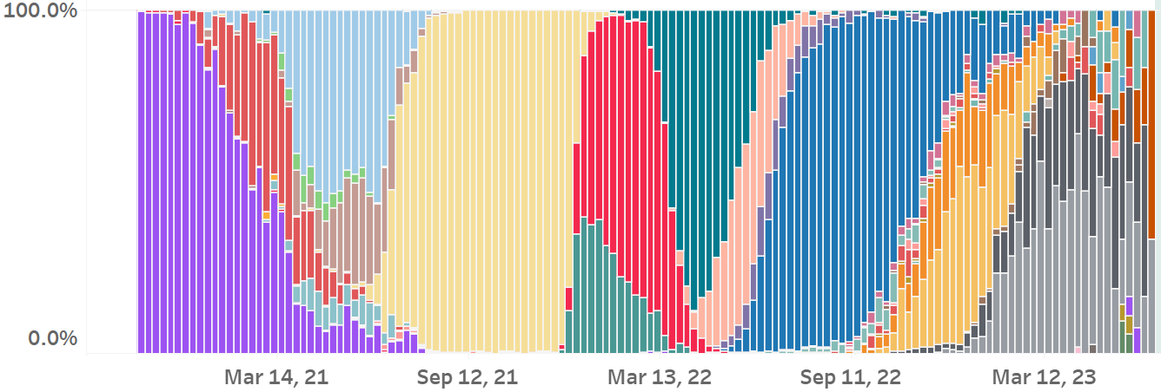
SARS-CoV-2 Variant Circulation by Surveillance Week—Oregon*
α
BA.2
ε
BA.1.1
BA.5
Percent of Sequenced Specimens
δ
BQ
Γ
XBB
Ο
B.1.1.529
BA.2.12.1
ι
Ancestral
Collection Week
*Data as of 28 Jul 2023
Notes:
https://public.tableau.com/app/profile/oregon.health.authority.covid.19/viz/GISAIDVariantDashboardUpdated/OregonVariantDashboard
First, the original Wuhan WA1) strain was prevalent.
Late December: Epsilon (California strain in red) came in
March-June Alpha strain in blue (U.K. strain)
Since mid-February 2023, XBB has been prevalent.

Slide 31
FDA’s Vaccines and Related Biological Products s Advisory Committee
June 15, 2023
“For the 2023–2024 formula
of COVID-19 vaccines in the U.S.,
does the committee recommend an update
of the current vaccine composition
to a monovalent XBB lineage?”
Vote: Yes, 21-0

Slide 32

Influenza

Slide 33
Influenza Hospitalizations, by Age & Week of Report, Oregon, 2022–2023*
Age
n = 1,044
≥65
50–64
18–49
5–17
<5
Week Ending
*Source: FluSurvNet. Data through 29 Apr 2023. www.healthoregon.org/fludata
Notes:
www.healthoregon.org/fludata
539 (52%) in adults≥65
88 (8.4%) in kids<18

Slide 34
Influenza Vaccine Effectiveness
2012–2023 Seasons
Season | Reference | States | Patients | VE (95% CI)
2012–2013 | McLean 2014 | WI, MI, PA, TX, WA | 6,452 | 49 (43, 55)
2013–2014 | Gaglani 2009 | WI, MI, PA, TX, WA | 5,999 | 52 (44, 59)
2014–2015 | Zimmerman 2016 | WI, MI, PA, TX, WA | 9,311 | 19 (10, 27)
2015–2016 | Jackson 2017 | WI, MI, PA, TX, WA | 6,879 | 48 (41, 55)
2016–2017 | Flannery 2019 | WI, MI, PA, TX, WA | 7,410 | 40 (32, 46)
2017–2018 | Rolfes 2019 | WI, MI, PA, TX, WA | 8,436 | 38 (31, 43)
2018–2019 | Flannery 2019 | WI, MI, PA, TX, WA | 10,041 | 29 (21, 35)
2019–2020 | Flannery 2020 | WI, MI, PA, TX, WA | 8,844 | 39 (32, 44)
2020–2021 | n/a | n/a | n/a | n/a
2021–2022 | Chung 2022 | CA, MI, PA, TN, TX, WA, WI | 3,636 | 14 (-17, 37)
2022–2023* | McLean 2023 | WI | 545 | 54 (23, 73)
*Interim estimate. McLean HQ. MMWR 72:201–5.
Notes:
2022–2023 interim: https://www.cdc.gov/mmwr/volumes/72/wr/mm7208a1.htm#T2_down
At the Feb 2023 ACIP meeting, data were presented on kids (New Vaccine Surveillance Network), hospitalizations in adults (VISION) and medically attended illness in adults (IVY & VISION).

Slide 35
Respiratory Syncytial Virus

Slide 36
RSV Hospitalizations, by Age
Portland Tri-County Area, 2022–2023 Season*
n = 645
Age
≥65
50–64
18–49
5–17
<5
Week Ending
*Source: RSV-Net. Data through 25 Mar 2023.
Notes:
Data provided by Arilene Novak.
www.Oregon.gov/rsvdata
328 (51%) of 642 hospitalizations in <5 y.o.
12 (7%) of 175 hospitalizations through 11/19/22 were in 65+
170 (36%) of 470 hospitalizations since then have been in 65+

Slide 37

Questions?

