Slide 1
Clinical Considerations for Reporting on Adult Immunizations for Medicare
London Manor-Petersen
Manager, Population Health
Notes:
I am not a Medicare billing expert, I am not a coding expert. I am a quality improvement consultant who used to support clinicians through their quality reporting and improvement activities. Now I am working across our 6-state region to support activities improving adult vaccine rates for Medicare beneficiaries.

Slide 2
Comagine Health is a national, nonprofit health care consulting firm. We work collaboratively with patients, providers, payers and other stakeholders to reimagine, redesign and implement sustainable improvements in the health care system.
Notes:
I work for Comagine Health, we are a non-profit healthcare consulting firm. We are the Quality Innovation Network-Quality Improvement Organization for Idaho, Nevada, New Mexico, Oregon, Utah, and Washington funded by Medicare to focus on improving the health outcomes for Medicare beneficiaries.

Slide 3
Why Does this Matter?
Who does this matter to?
Eligible clinicians who bill Medicare
Who are not part of an ACO
Who meet the low volume threshold
Who report on either of the influenza or pneumococcal quality measures
What are the 2023 options?
Report adult immunizations with measure 493
Weighted average of these four:
Influenza
Tdap
Shingles
Pneumococcal
and
Choose another quality measure to report on
or
Choose two additional quality measures and do not report on adult immunizations
Notes:
It is early in the morning, why are we here talking about this? Why does this even matter?
This measure change could affect your reimbursement rate from Medicare, if you have been using the influenza and pneumococcal measures as part of your quality reporting measures. You need to submit a minimum of 6 measures to report and Medicare combined those two into one for 2023, so you will need both an additional measure to report on and a closer look at your adult immunizations documentation process

Slide 4
Quality Payment Program Overview
Notes:
The Quality Payment Program was

Slide 5
Quality Payment Program
https://qpp.cms.gov/mips/reporting-options-overview
Notes:
Traditionally The Quality Payment Program had two options for how clinicians could participate.
Through Traditional MIPS- The Merit Based Incentive Payment System or through an Advanced Alternative Payment Model like an Accountable Care Organization or ACO. I’m going to keep this a really high level overview today and assume that most of you know

Slide 6
New for 2023 MVPs
https://qpp.cms.gov/about/qpp-overview
Notes:
MIPS Value Pathways are the newest way to fulfill MIPS reporting requirements. MVPs include a subset of
measures and activities that are related to a given specialty or medical condition. MVPs offer reduced reporting
requirements, allowing MVP participants to report on a smaller, more cohesive subset of measures and activities
There are 12 MVPs available to report for the 2023
performance year.
3 of which include individual immunization measures

Slide 7
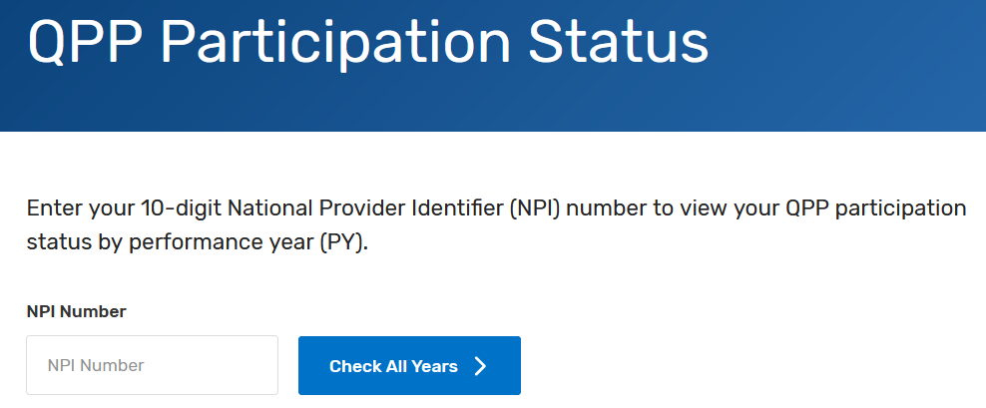
MIPS Eligibility
Check Eligibility Status
https://qpp.cms.gov
Low Volume Threshold
CMS determines a clinician to be MIPS eligible if they:
Bill more than $90,000 a year in allowed charges for professional services under the Medicare Physician Fee Schedule (PFS)
Furnish covered professional services to more than 200 Medicare beneficiaries
Provide more than 200 covered professional services under the PFS
Notes:
CMS conducts two determination periods each year to calculate if a clinician has exceeded the low volume threshold, meaning they bill more than $90,000, see more than 200 Medicare beneficiaries and provide more than 200 Medicare part b services.

Slide 8
MIPS Timeline
https://qpp.cms.gov/mips/mips-eligibility-determination-periods
Notes:
The payment adjustment a clinician receives will be two years after the data is collected.

Slide 9
MIPS Reporting Categories
https://qpp.cms.gov/mips/traditional-mips
Notes:
Your performance across the MIPS performance categories, each with a
specific weight, will result in a MIPS final score of 0 to 100 points.
• Your MIPS final score will determine whether you receive a negative,
neutral, or positive MIPS payment adjustment.
o Positive payment adjustment for clinicians with a 2023 final score
above 75.
o Neutral payment adjustment for clinicians with a 2023 final score of
75.
o Negative payment adjustment for clinicians with a 2023 final score
below 75.
• Your MIPS payment adjustment is based on your performance during
the 2023 performance year and applied to payments for your Medicare
Part B-covered professional services beginning on January 1, 2025

Slide 10
Quality Reporting
Sign in to the QPP website and upload a file of your quality measure data.
Work with a third-party intermediary to submit data on your behalf.
Report quality measures via Medicare Part B claims throughout the performance year (small practices only)
Submit data yourself or with the help of a third-party intermediary, such as a Qualified Clinical Data Registry (QCDR) or Qualified Registry, between January 2 and April 1, 2024. (Note: Medicare Part B claims quality measures are submitted throughout the performance year.)

Slide 11
Changes to Immunizations Quality Measures in 2023
New Quality Measure 493: Adult Immunization Status
Percentage of patients who are up-to-date on recommended routine vaccines:
Influenza
Pneumococcal
Zoster
(Tdap) or (Td); Tetanus, diptheria and acellular pertussis
Changes to Quality Measures 110 & 111
Influenza and Pneumococcal Measures
NOT reportable through traditional MIPS
Individually reported through some MVPs
110 (Flu) still reported through some ACOs

Slide 12
Measure 493: calculated by 4 performance rates
Influenza
Percentage of patients (19 years of age and older on the date of the encounter) who received an influenza vaccine on or between July 1 of the year prior to the measurement period and June 30 of the measurement period.
Tdap
Percentage of patients (19 years of age and older on the date of the encounter) who received at least 1 tetanus and diphtheria (Td) vaccine or 1 tetanus, diphtheria, and pertussis (Tdap) vaccine between 9 years prior to the encounter and the end of the measurement period.
Shingles
Percentage of patients (50 years of age and older on the date of the encounter) who received at least 1 dose of the herpes zoster live vaccine or 2 doses of the herpes zoster recombinant vaccine anytime on or after the patients’ 50th birthday.
Pneumococcal
Percentage of patients (66 years of age or older on the date of the encounter) who were administered any pneumococcal conjugate vaccine or polysaccharide vaccine, on or after their 60th birthday and before the end of the measurement period.

Slide 13
Measure 493: Adult Immunization Status
NOTE: Submission of all 4 performance rates is required for this measure.
A weighted average, which is the sum of the performance numerator values divided by the sum of performance denominator values, will be used for performance.
Performance Met: Patient Received the Vaccine
Performance Not Met: Patient Did Not Receive Vaccine
Denominator Exception: Documented medical reason for not administering
Notes:
Submission of all four performance rates is required for this measure, and a 70% data completeness is needed for each.

Slide 14
Submission Criteria 1 (Influenza)
Denominator
Patients 19 years of age or older on date of the encounter with a visit during the measurement period.
Numerator
Patients in Denominator 1 who received an influenza vaccine on or between July of the year prior to the measurement period and June 30 of the measurement period.
Note: Patient reported vaccine receipt, when recorded in the medical record, is acceptable for meeting the numerator.
Performance Met (M1168)
Denominator Exception (M1169)
Performance not Met (M1170)
Notes:
Denominator Exception: Documentation of medical reason(s) for not administering influenza vaccine (e.g., prior anaphylaxis due to the vaccine

Slide 15
Submission Criteria 2 (Tdap)
Denominator
Patients 19 years of age or older on date of the encounter.
Numerator
Patients in Denominator 2 who received at least one Td vaccine or 1 Tdap vaccine between nine years prior to the encounter and the end of the measurement period.
Note: Patient reported vaccine receipt, when recorded in the medical record, is acceptable for meeting the numerator.
Performance Met (M1171)
Denominator Exception (M1172)
Performance not Met (M1173)
Notes:
Denominator Exception: Documentation of medical reason(s) for not administering the Tdap vaccine (e.g., prior anaphylaxis due to the vaccine

Slide 16
Submission Criteria 3 (Shingles)
Denominator
Patients 50 years of age or older on date of the encounter.
Numerator
Patients in Denominator 3 who received at least one dose of the herpes zoster live vaccine or 2 doses of the herpes zoster recombinant vaccine anytime after the patient’s 50th birthday.
Note: Patient reported vaccine receipt, when recorded in the medical record, is acceptable for meeting the numerator.
Performance Met (M1174)
Denominator Exception (M1175)
Performance not Met (M1176)
Notes:
Denominator Exception: Documentation of medical reason(s) for not administering pneumococcal vaccine (e.g., prior anaphylaxis due to the pneumococcal vaccine

Slide 17
Submission Criteria 4 (Pneumococcal)
Denominator
Patients 66 years of age or older on date of the encounter.
Numerator
Patients in Denominator 4 who were administered any pneumococcal conjugate vaccine or polysaccharide vaccine, on of after their 60th birthday.
Note: Patient reported vaccine receipt, when recorded in the medical record, is acceptable for meeting the numerator.
Performance Met (M1177)
Denominator Exception (M1178)
Performance not Met (M1179)
Notes:
Denominator Exception: Documentation of medical reason(s) for not administering pneumococcal vaccine (e.g., prior anaphylaxis due to the pneumococcal vaccine

Slide 18
Denominator Exclusions
Patients during the measurement period who have had:
Active Chemotherapy
Bone Marrow transplant
History of immunocompromising conditions
Cochlear implants, anatomic or functional asplenia, sickle cell anemia & HB-S disease or cerebrospinal fluid leaks any time during a patient’s history
In Hospice or using hospice services
Full measure specification available here: https://qpp.cms.gov/mips/explore-measures

Slide 19
Reporting Methods for Measure 493
MIPS Clinical Quality Measure
Submitted through EHR
Submitted through Registry
Not reportable through claims
Not reportable through APMs

Slide 20
Evidence Based Best Practices for Improving Adult Immunization Rates
Health Care providers can routinely assess patients’ vaccination history
Implement reminder-recall systems
Use standing order programs
Analyze practice or provider specific vaccination rates
Provide easy access for adult vaccinations
Walk-in visits
Extended hours
Leveraging health information technology to share immunization data among patients, providers, pharmacies, retail clinics and public health agencies and registries is also a key strategy for tracking patients’ immunization history and keeping them up to date on vaccines.

Slide 21
Adult Immunizations Protocols for Your Clinic
Train Staff
Check with your State Immunizations Registry
https://comagine.org/program/partnership/immunizations#irp
Update patient records
Identify patients overdue for vaccines
Get them in for a visit and a shot (or two)
No Missed Opportunities

Slide 22
Comagine Resources
1:1 Technical Assistance
Adult Immunizations Toolkit
More Resources On Our Page

Slide 23
Vaccination Station 2.0
Monthly workshop series for implementing vaccination campaigns
Second Tuesdays of the month
Monthly office hours for immunization questions
Third Thursdays of the month
Registration Link
For more information contact
partnership@comagine.org

Slide 24
Questions? Comments?

Slide 25
Contact us!
London Manor-Petersen (OR) lmanor-petersen@comagine.org
Carolyn Brill (WA) cbrill@comagine.org
Jenny Lingle (ID) jlingle@comagine.org
Lilly Mazmanyan (NV) lmazmanyan@comagine.org
Edy Taylor (NM) etaylor@comagine.org
Alex Topper (WA) atopper@comagine.org
Riley Voss (UT) rvoss@comagine.org
Notes:
**Include another plea to fill out survey**

Slide 26
This material was prepared by Comagine Health, a Medicare Quality Innovation Network-Quality Improvement Organization under contract with the Centers for Medicare & Medicaid Services (CMS), an agency of the U.S. Department of Health and Human Services. Views expressed in this material do not necessarily reflect the official views or policy of CMS or HHS, and any reference to a specific product or entity herein does not constitute endorsement of that product or entity by CMS or HHS. 12-SOW-GEN-23-QIN-251

