Slide 1
Vaccine Jeopardy
When Winning Fairly Isn’t Enough
Marjorie Attis-Josias, Ph.D, RN, CNL

Slide 2
Land Acknowledgement I acknowledge the land on I which I occupy as a speaker at this conference, located in Wilsonville Oregon, is so named as a result of the forced removal of the Indigenous people of this land. This site rests on traditional village sites of the Cayuse, Umatilla, Walla Walla, Kalapuya, Atfalati, the Confederated Tribes of Grande Rhonde, the Confederate Tribes of Siletz Indians, and many other tribes who made their homes and communities here. I take this opportunity to thank the original caretakers of this land. I invite you to take action to address the systemic issues facing Indigenous people. You can learn some ways to show your support by going to www.sicangucdc.org.

Slide 3
Objectives
To discuss the intersectionality of vaccine hesitancy in diverse populations.
To provide some guidance for addressing vaccine hesitancy in diverse populations.

Slide 4
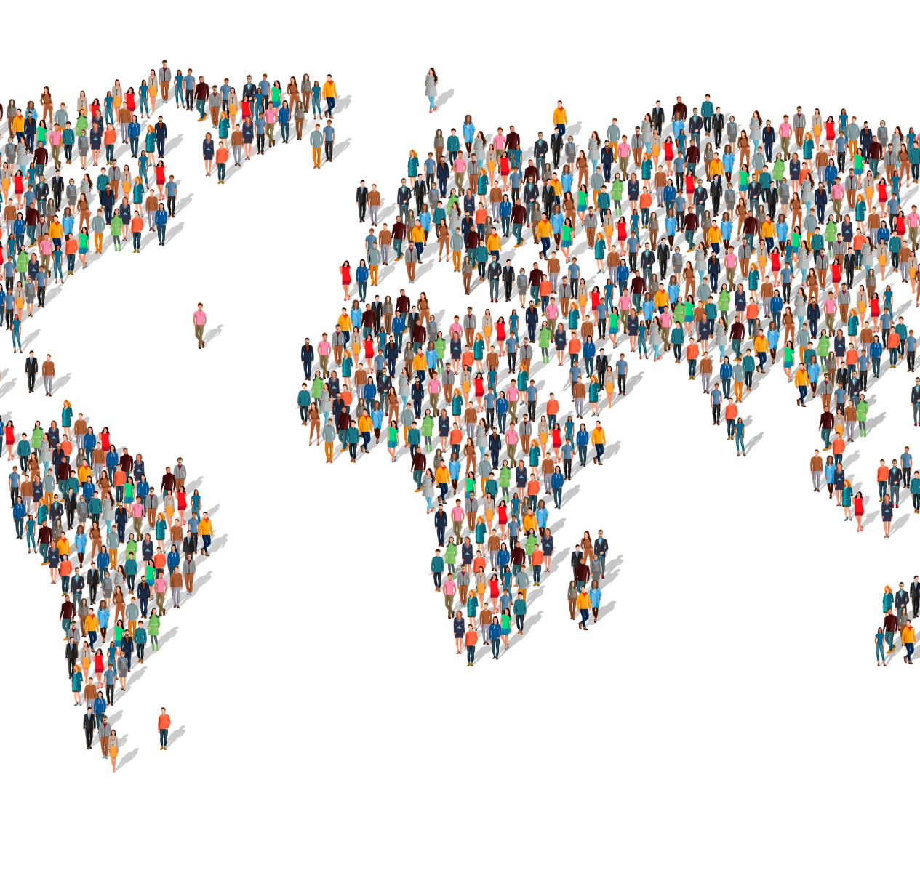
COVID Booster
White people 61%
Hispanic people 15%
Black people 8%
Asian people 8%
American Indian and Alaskan Native (AIAN) 0.7%
Native Hawaiian and Pacific Islander (NHOPI) 0.3%

Slide 5
Why?
Hesitancy
Health literacy
Trust
Cost-based concerns
Complacency
(Lieu & Li, 2021; Morales et. al, 2022)

Slide 6
Intersectionality
Socioeconomic background
Gender
Race/ethnicity

Slide 7
Socioeconomic status
lower income and
less education
Working status

Slide 8
Gender
64% men vs 57% woman
+ socioeconomics
Woman without college degree 98%
Men without a college degree 173%
Woman and poverty 30%
Men and poverty
(Morales et. al., 2022; WHO 2014)

Slide 9
Race/Ethnicity
Asian woman 78%
Black woman 46%
Hispanic woman 39%
Non-White men 73%
(Morales et. al., 2022)

Slide 10
Approach
3Cs Model: WHO Strategic Advisory Group (SAGE)
Confidence
Complacency
Convenience
(Liu & Li, 2021)

Slide 11
Messaging
Governments
Scientists
Medical professionals
Murphey, et a., 2021

Slide 12
Messaging
Misconceptions
Fear
https://jeopardylabs.com/play/immunizations-facts-vs-myth-trivia-4
https://jeopardylabs.com/play/immunization-175

Slide 13
Questions

Slide 14
References
Basch, C. H. Zybert, P. R. & Basch, C. E. (2017) What do YouTubeTM videos say about vaccines? Child: care, health, and development, 43(4), 499-503. doi:10.1111/cch.12442
Callaghan, T., Moghtaderi, A., Lueck, J. A., Hotez, P., Strych, U., Dor, A., Fowler, E. F., & Motta, M. (2021). Correlates and disparities of intention to vaccinate against COVID-19. Social Science & Medicine, 272, 113638 https://doi.org/10.1016/j.socscimed.2020.113638
de Albuquerque Veloso Machado, M., Roberts, B., Wong, B. L. H., van Kessel, R., & Mossialos, E. (2021). The relationship between the COVID-19 pandemic and vaccine hesitancy: a scoping review of literature until August 2021. Frontiers in public health, 9, 1370. https://doi.org/10.3389/fpubh.2021.747787
Epperson, A. E., Carson, S. L., Garcia, A. N., Casillas, A., Castellon-Lopez, Y., Brown, A. F., & Garrison, N. A. (2022). A qualitative study of COVID-19 vaccine decision making among urban Native Americans. Vaccine: X, 12, 100212. https://doi.org/10.1016/j.jvacx.2022.100212
Liu, R., & Li, G. M. (2021). Hesitancy in the time of coronavirus: Temporal, spatial, and sociodemographic variations in COVID-19 vaccine hesitancy. SSM-population health, 15, 100896.
Murphy, J., Vallieres, F., Bentall, R. P., Shevlin, M. McBride, O., Hartman, T.K., …& Hyland,, P. (2021) . Psychological characteristics associated with COVID-19 vaccine hesitancy and resistance in Ireland and the United Kingdom. Nature commu ications, 12(1), 29. https://doi.org/10.1038/s41467-020-20226-9
Ngugga, N, Hill, L. Artiga, S, & Haldar, S. Lattest Data on COVID-19 Vaccine by Race/Ethnicity. (July 12, 2022). www.kff.org accessed; April, 2023.
WHO Strategic Advisory Group of Experts on Immunization. Report of the SAGE Working Group on Vaccine Hesitancy. WHO Strategic Advisory Group of Experts on Immunization; (2014).

