Slide 1
The State of the Vaccine World
Stanley A. Plotkin, MD
1
Oregon 2023 August 3, 2023

Slide 2
Conflicts of Interest
I am a consultant to numerous vaccine developers, including Sanofi, Merck, Janssen, Inovio, Moderna, Astra Zeneca, Rational, NTx Bio, Seqirus, Codagenix, Pfizer, Valneva, and GSK

Slide 3
“The impact of vaccination on the health
of the world’s peoples is hard to exaggerate.
With the exception of safe water, no other
modality has had such a major effect on
mortality reduction and population growth.”
Susan and Stanley Plotkin
A Short History of Vaccination, in Vaccines 1st Edition, 1988

Slide 4
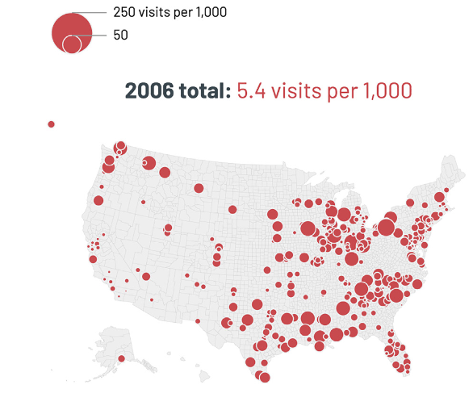
Time-based heatmap.
Rotavirus
Mast, T., et al, Vaccine 2021
4

Slide 5
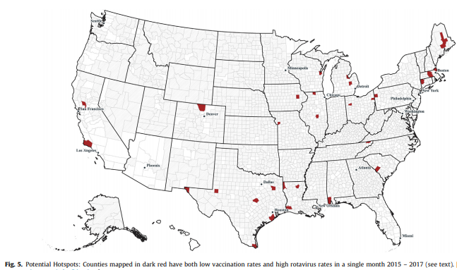
Potential hotspots: Counties mapped in dark red have both low vaccination rates and high rotavirus rates in a single month, 2015-2017
Mast, T., et al, Vaccine 2021
5

Slide 6
New Strategies for Vaccine Discovery
Attenuated vaccines:
Temperature-sensitive mutations and reassortment
Viral recombinants and deletion mutants
Codon de-optimization
Vectors that present genes from pathogens
6
Plotkin S, Plotkin S, Nature Rev Micro, 2011
6

Slide 7
New Strategies for Vaccine Discovery
Inactivated vaccines:
Protein conjugated capsular polysaccharides
Reverse vaccinology
Antigen identification by transcriptomics and proteomics
Structural analysis
Development of new adjuvants (including cytokines)
DNA plasmids
mRNA and Self-Amplifying RNA
7
7

Slide 8
Additional Protective
Immune Mechanisms Besides
Neutralization and Cytoxic T Lymphocytes
Binding antibodies that prevent attachment (Ebola)
Th17 cells that attract PMN’s and prevent carriage (pneumococcal, TB?)
Antibody Dependent Cellular Cytotoxic antibody (HIV)
Stimulation of CD4+ T helper cells that secrete cytokines (pertussis)

Slide 9
New Adjuvants (Selected)
Type | Example
Oil in water | MF-59
Water in oil | Montanide
Saponins | QS-21
Liposomes | ASO1
Bacterial Toxins | CT, LT
Cytokines | IL-12, GM-CSF
9

Slide 10
Influenza Vaccines
Both live and inactivated vaccines are available, but inactivated is less effective in children and the elderly. Live is ineffective in the elderly.
Both types less effective if circulating virus changed from previous year.
Vaccine efficacy is only moderate at best.
10
10

Slide 11
Influenza Vaccines as Examples
of Complexity of Correlates
HAI titer is usually used as correlate of protection
but
Microneutralization may be better
Antibodies to neuraminidase contribute
ADCC antibodies also contribute
Mucosal lgA helps, at least for LAIV
CD8+ T cell function important
in the elderly

Slide 12
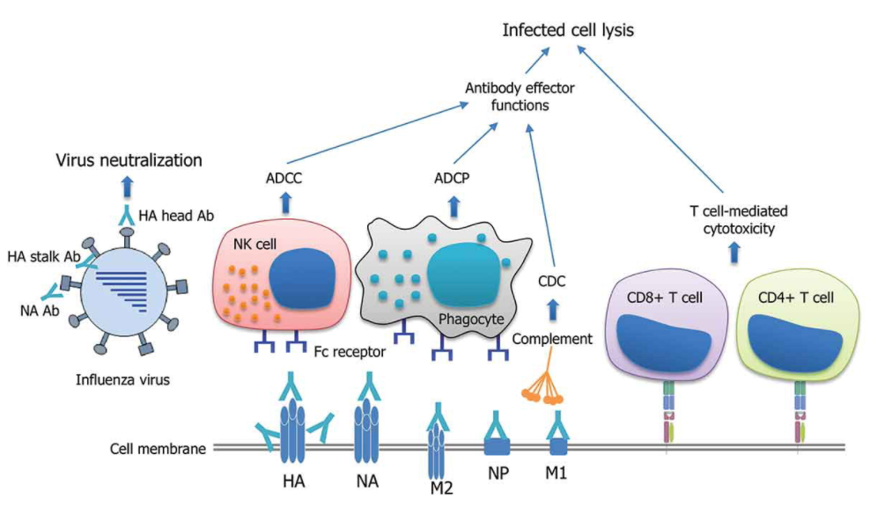
Correlates of protection for broad protection against influenza viruses.
Jang et al., Exp Op Drug Disc. 2020:15
12

Slide 13
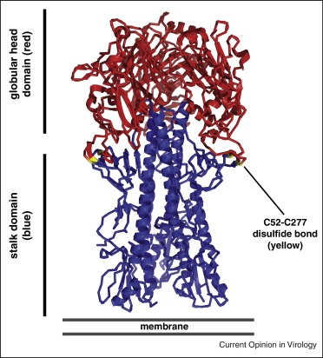
13
13

Slide 14
Stalk-based Approaches
or prime-boost, peptides, VLPs
14
14

Slide 15
Value of Structural Biology:
RSV
15

Slide 16
Respiratory Syncytial Virus
Number one respiratory infection of infants (0-2 yrs)
Also important in elderly second to influenza
Prior inactivated vaccine worsened disease because Fusion antigen of virus was altered, leading to formation of immune complexes
Live viruses insufficiently attenuated
16

Slide 17
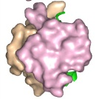
Stabilizing prefusion RSV F results in a candidate vaccine
Triggering
Stabilization
Postfusion F
Prefusion F
Candidate RSV Vaccine
17

Slide 18
Vaccines Against F Protein of Respiratory Syncytial Virus for the Elderly
Pfizer – Efficacy: serious disease 86%; overall 67%
GSK – Efficacy: serious disease 94%; overall 83%
For pregnant women (to protect against postnatal infection): Pfizer Vaccine Astra Zeneca monoclonal antibody – Nirsevimab

Slide 19
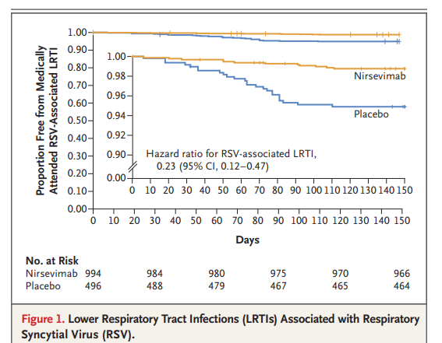
Hammitt, L. et al. N Engl J Med 286 2022

Slide 20
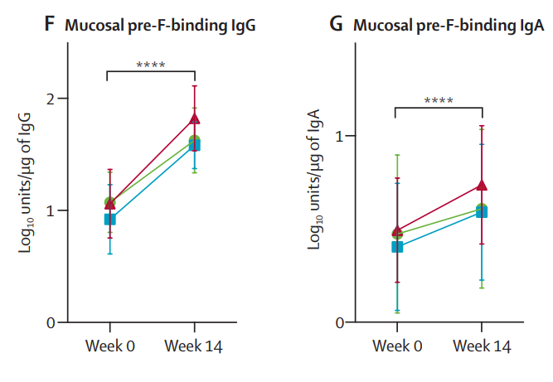
Mucosal antibody binding profile after
RSV immunization
Ruckwardt, T., et al, Lancet Respir Med 2021

Slide 21
Multiple Protective Responses:
Cytomegalovirus
21
21

Slide 22
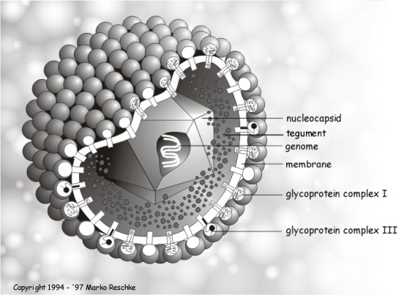
Cytomegalovirus
non-structural protein: IE1
pp65, pp150
gB
gH/gL/
UL128-131

Slide 23
Proposed scheme for CMV infection in pregnancy. Women are often exposed to toddlers excreting CMV. Both seronegative and seropositive women can be exposed, particularly the latter if they live in countries where children are often infected. The CMV infection in both cases rapidly becomes intracellular, although first infections in seronegative women are likely to include cell-free virus in the serum. In both types of women, CMV spreads to multiple organs. In seronegative women, spread to the placenta cells and on to the fetus is likely, whereas in seropositive women who are repeatedly infected the placenta usually but not always remains virus-free. Thus, seropositivity is a relative protective factor.

Slide 24
Protective Factors Against
Fetal CMV Transmission
(Work of D. Lilleri et al in Pavia)
Higher pentamer Ab
Lower viral load
Higher CD4+ IFN’s
Higher CD8+ CD45RA+ IMRA
24

Slide 25
Candidate CMV Vaccines in Development
Sponsor | Type | Stage | Target
Moderna | gB, pentamer mRNA | Phase 1 | Cong
Sanofi | gB, pentamer subunit | Preclinical | Cong
City of Hope | MVA presenting pp65,IE1, IE2, | Phase 2 | Txp
GSK | gB, pentamer subunit, adjuvant | Preclinical | Cong
Merck | Live, replication-defective | Phase 2 | Cong
Hookipa | LCMV Vector gB, p65 | Phase 1 | Txp
Variations Bio | gB | Phase 1 | Cong
Serum Inst. India | Dense bodies | Preclinical | Txp
Queensland Inst/ Dynavax | gB, pp65, p50 Polypeptide with TLR-9 adjuvant | Preclinical | Cong
Novartis | gB Nanoparticle | Preclinical | Cong
25

Slide 26
SARS-2 VIRUS: Cause of COVID-19
Shah, VK et al. Front. Immunol. 2020

Slide 27
What is New About
Vaccination for Covid-19
Desire of public for vaccination
Multiple strategies used for vaccine development
Financial support by governments
Importance of mutations, as in influenza
Multiple manufacturers, including in LMIC
Covid_2_12_21.pptx

Slide 28
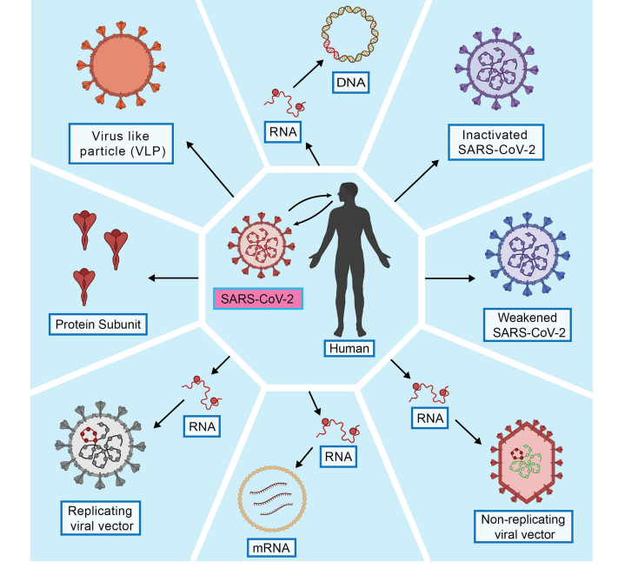
Fig. 1
Types of different COVID-19 vaccines and their manufacturing features.
Rahman, M., et al, VirusDis. Feb. 2022

Slide 29
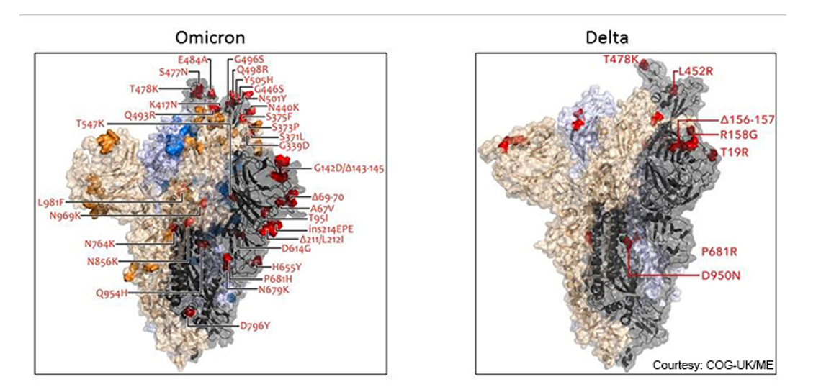
Mutations in SARS-2 Variants
Krammer, F., WHO Meeting Dec. 2021

Slide 31
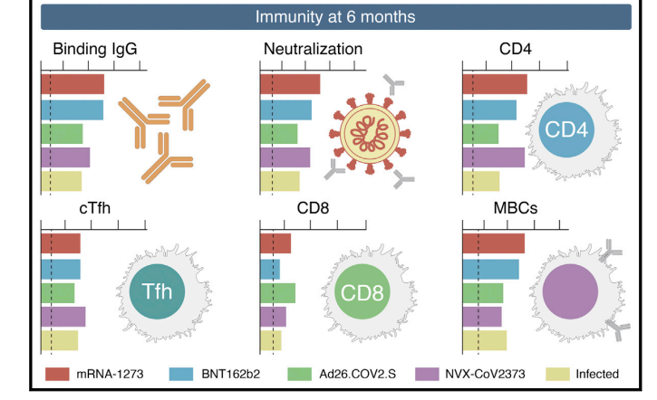
Zhang et al., 2022, Cell 185

Slide 32
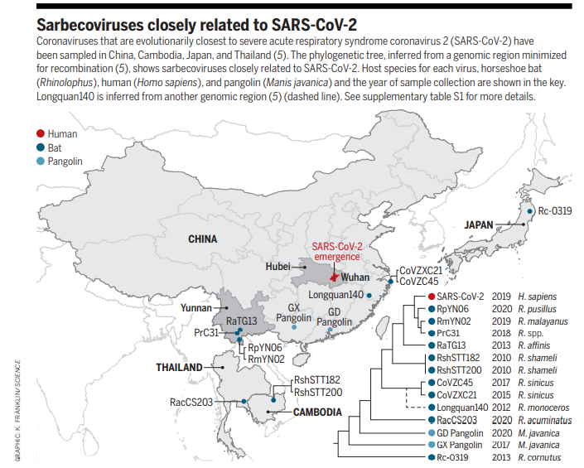
Lytras, S., et al, Science 373 2021

Slide 33
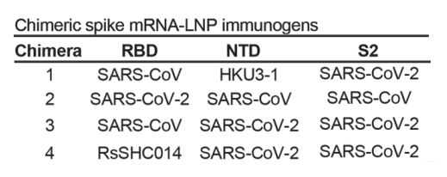
Genetic design of chimeric Sarbecovirus spike vaccines
Martinez, DR, et al, Science 373 2021

Slide 34
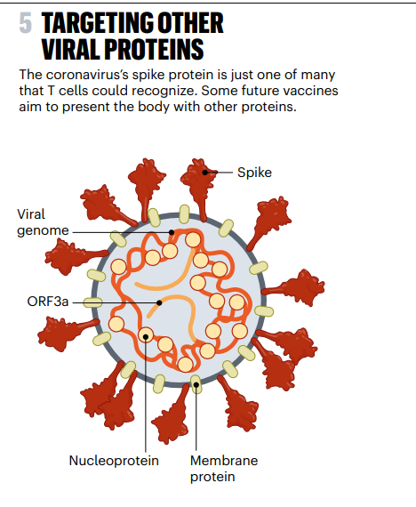
Callaway, E., Nature; 614. 2023

Slide 35
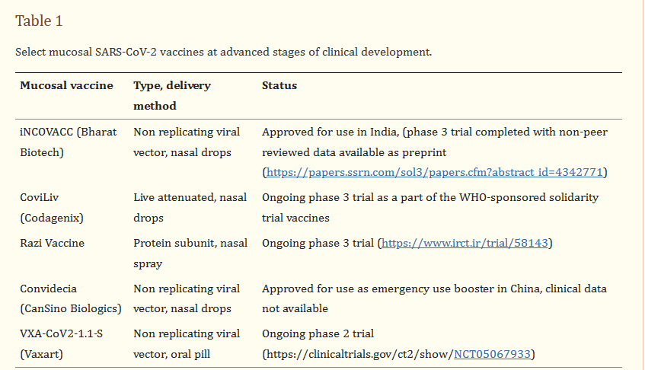
Rathore, A., et al. Vaccine 41 2023

Slide 36
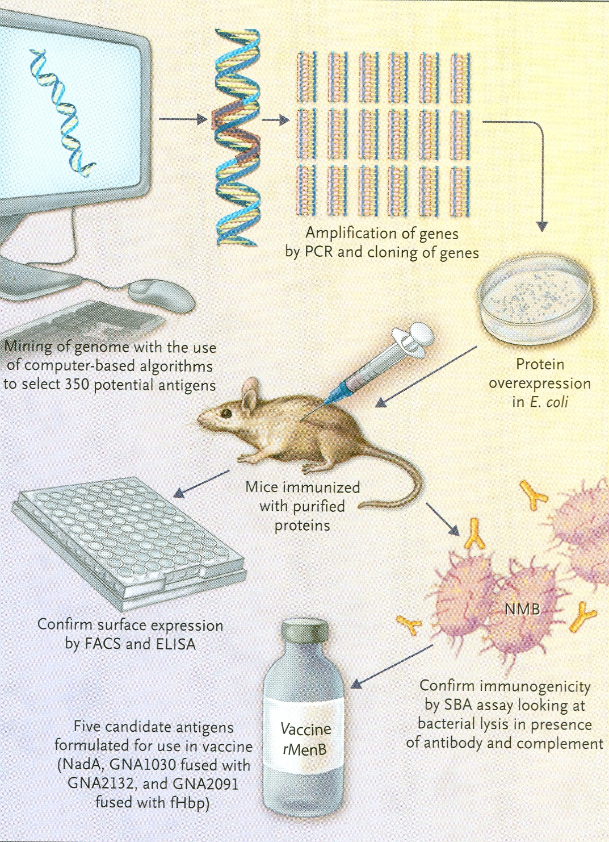
Reverse
Vaccinology
For
Bacteria
Tan LK, et al.,NEJM
362;16, 1511-20, 2010
36

Slide 37
Examples of Vaccines that have been Developed
Using Reverse Vaccinology-based Approaches
Status of
Disease
Pathogen
Neisseria meningitidis B
Streptococcus sgalactiae
Streptococcus pneumoniae
Bacillus anthracis
Chlamydia pneumoniae
Porphyromonas gingivalis
Meningitis and septicemia
Septicemia, pneumonia
and meningitis
Pneumonia
Anthrax
Pharyngitis, bronchitis
and pneumonitis
Periodontitis
37

Slide 38
Additional Protective
Immune Mechanisms Besides
Neutralization and Cytoxic T Lymphocytes
Binding antibodies that prevent attachment (Ebola)
Th17 cells that attract PMN’s and prevent carriage (pneumococcal, TB?)
Antibody Dependent Cellular Cytotoxic antibody (HIV)
Stimulation of CD4+ T helper cells that secrete cytokines (pertussis)
Ab Dependent Cellular Phagocytesis

Slide 40
Current CEPI Targets
Main: Lassa
Nipah
MERS
COVID-19
Partial: Chikungunya
Rift Valley Fever
Ebola
40

Slide 41
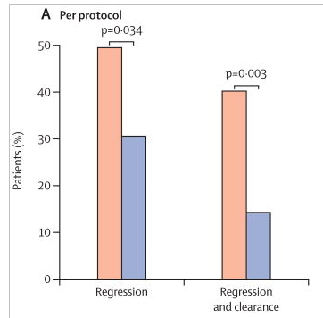
Regression of Cervical Cancer
After E6/E7 DNA Vaccination
Trimble et al, Lancet 2015
41

Slide 42
The Big Scientific Problems in Vaccinology of the 21st Century
Immaturity and post-maturity of the immune system
Maintenance of immune memory, both central
and effector
Adjuvants capable of selectively stimulating cell types: Dendritic, B, Th1, Th2, Th17, CD4+, CD8+ or Tregs
More protective antigens against complex bacteria
Mucosal immunization with non-replicating antigens
Conserved antigens to cope with antigenic variability
42

