Slide 1
Covid-19 Vaccines:
Lessons from the Last Three Years
Paul A. Offit, MD
Division of Infectious Diseases
Vaccine Education Center
The Children’s Hospital of Philadelphia
Perelman School of Medicine
The University of Pennsylvania
August 8, 2023

Slide 2
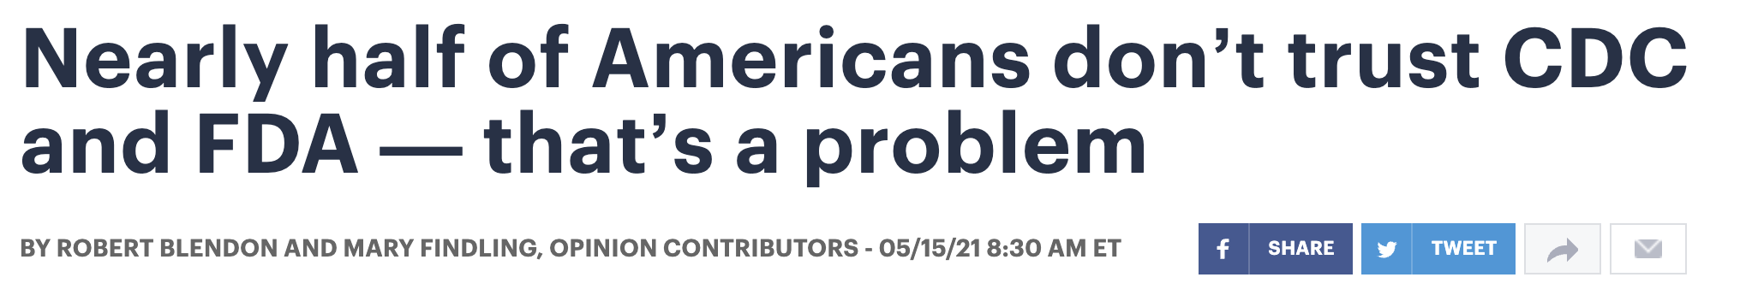
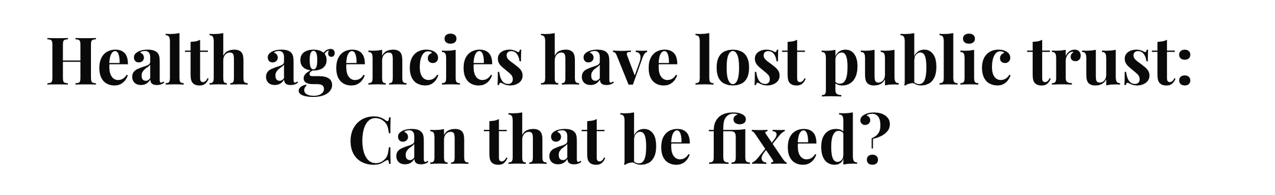
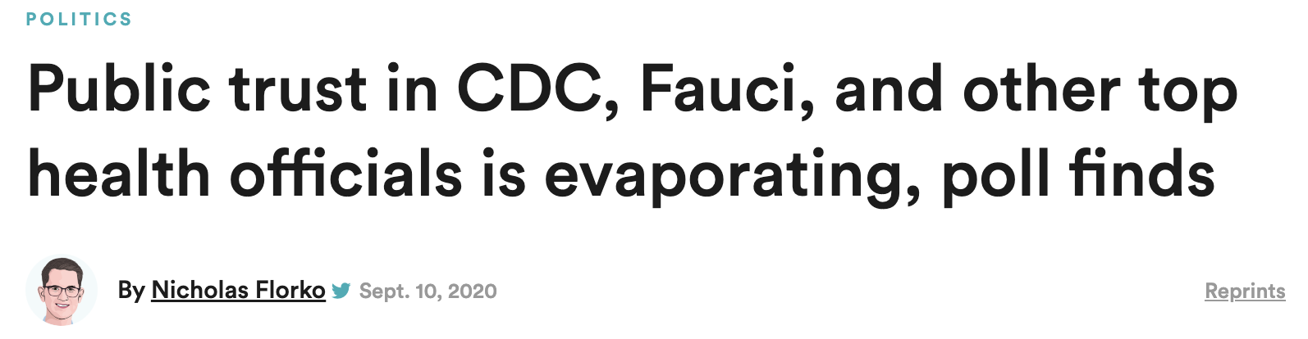

Slide 3
What happened?

Slide 4
Reason # 1:
A failure to explain what Covid-19 vaccines can and can’t do

Slide 5
The Wuhan-1 Strain
January 11, 2020

Slide 6
The mRNA vaccines made by Pfizer and Moderna, the vectored virus vaccines made by J&J and AstraZeneca, and the purified protein vaccine made by Novavax were all designed to prevent the Wuhan-1 (or ancestral) strain

Slide 7
December 10 and 17, 2020:
FDA reviewed phase 3 trials for mRNA vaccines

Slide 8
mRNA vaccines:
Pfizer

Slide 9
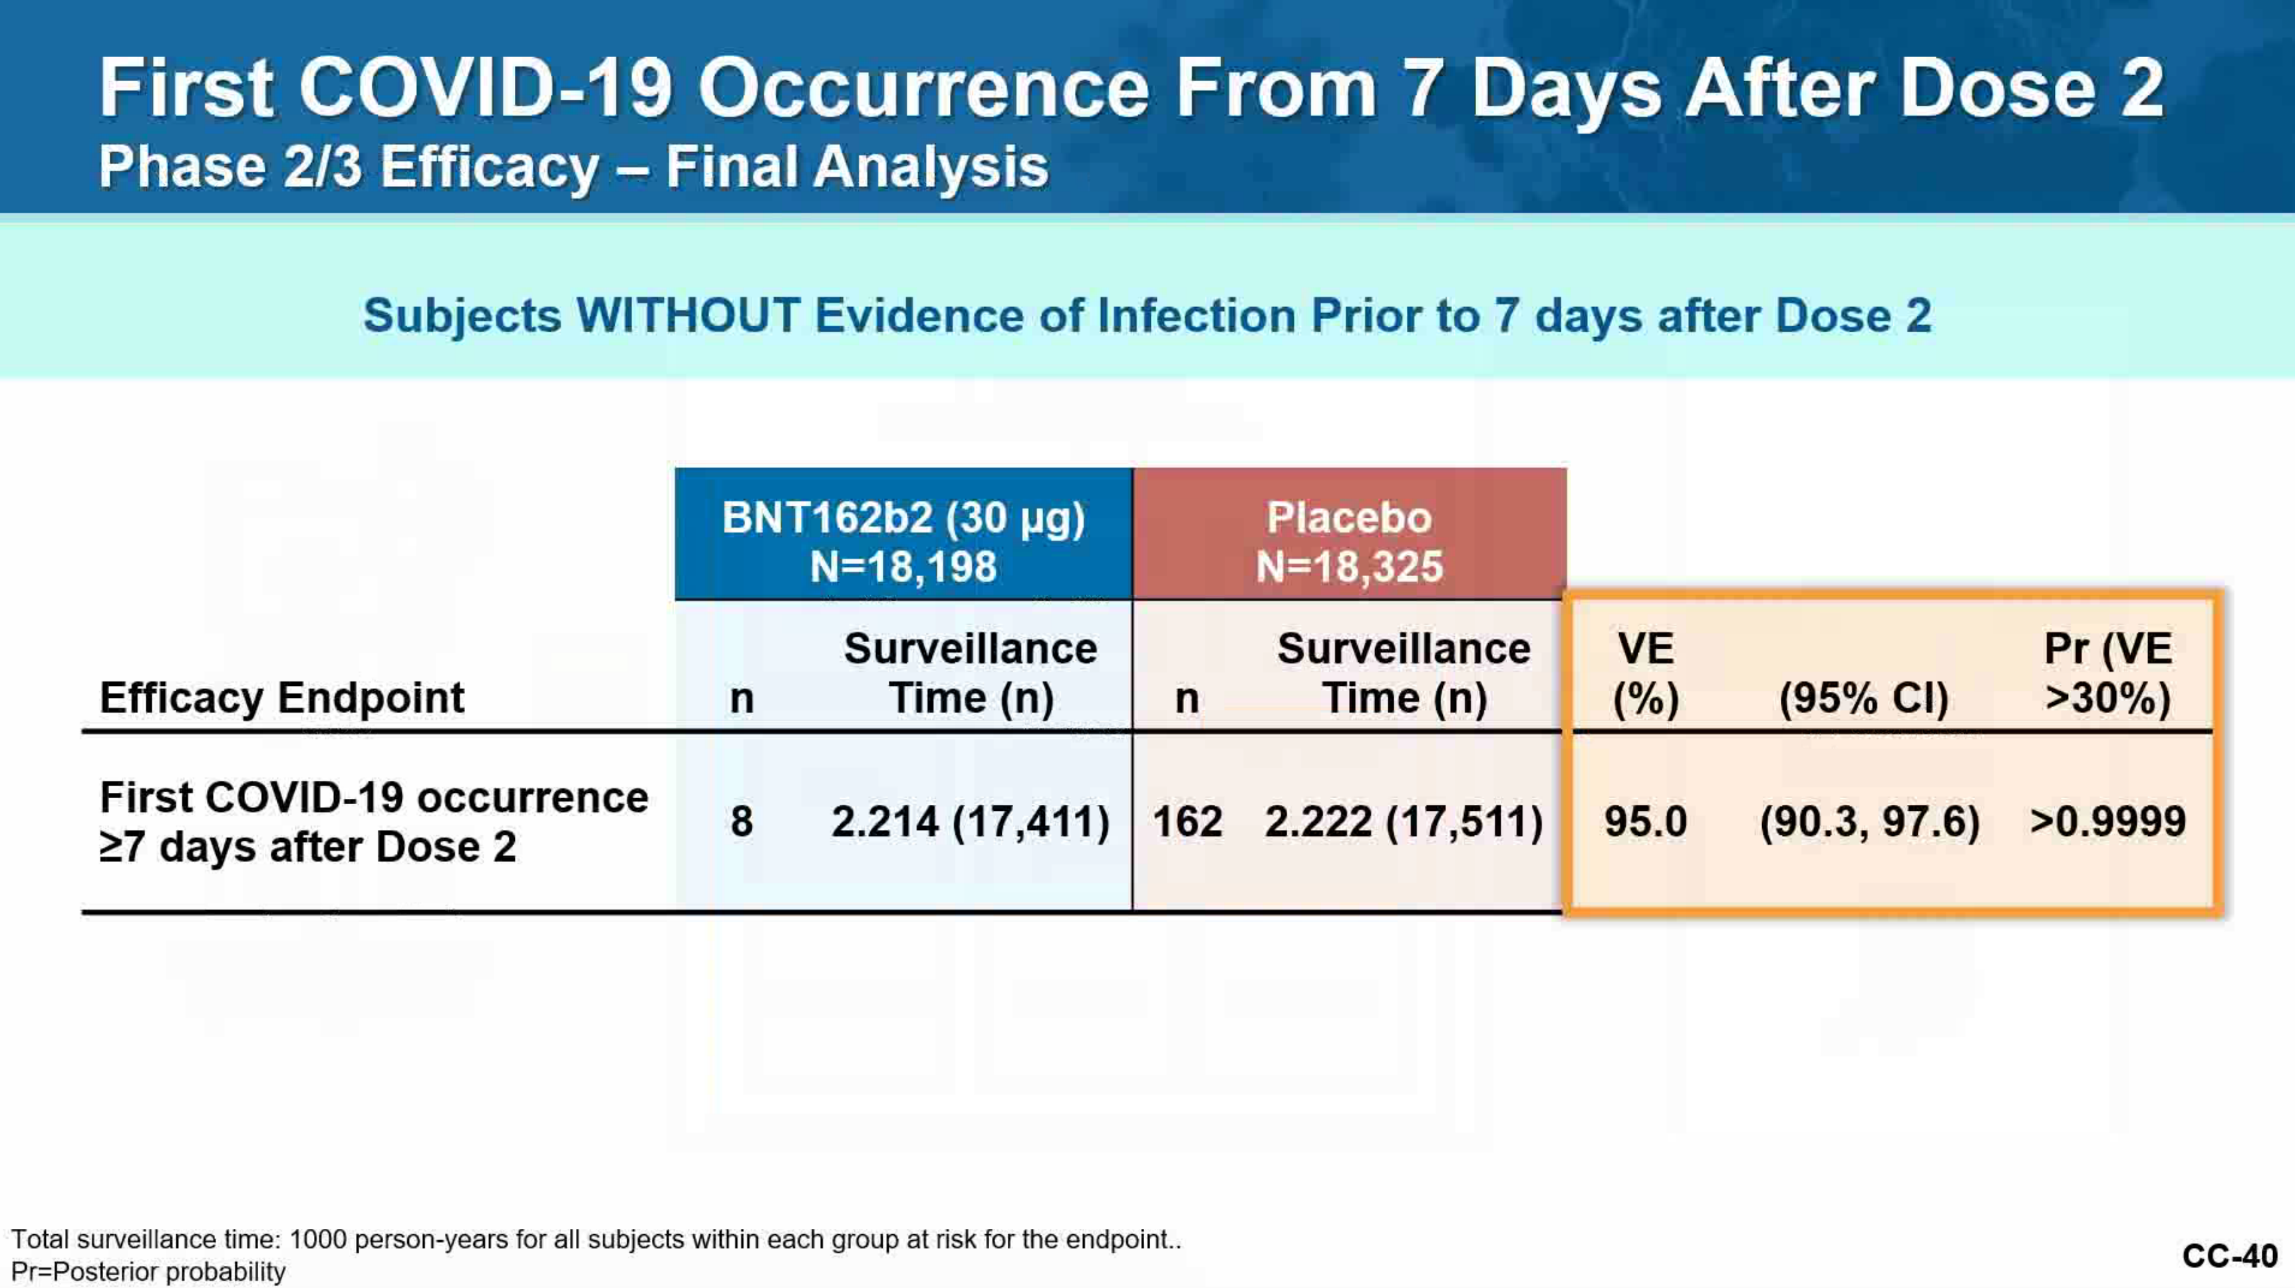

Slide 10
mRNA vaccines:
Moderna

Slide 11
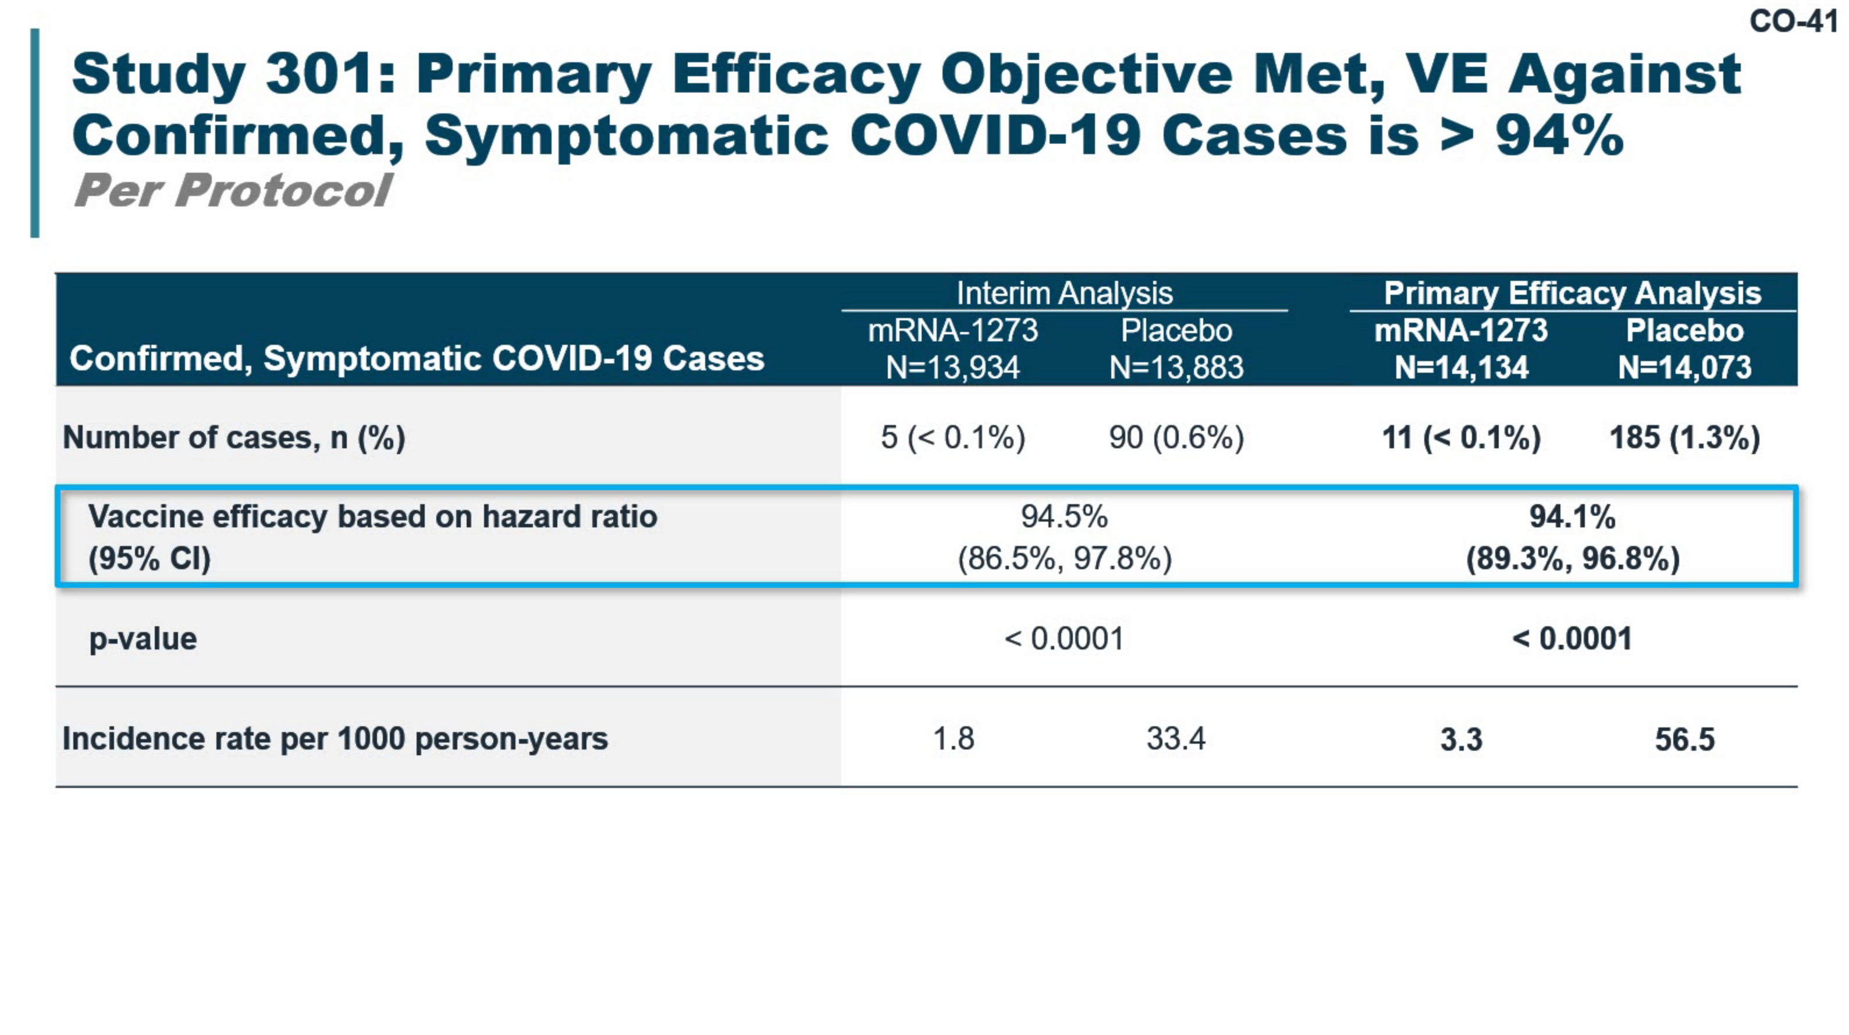

Slide 12
Six months later:
Protection against severe illness was holding up

Slide 13
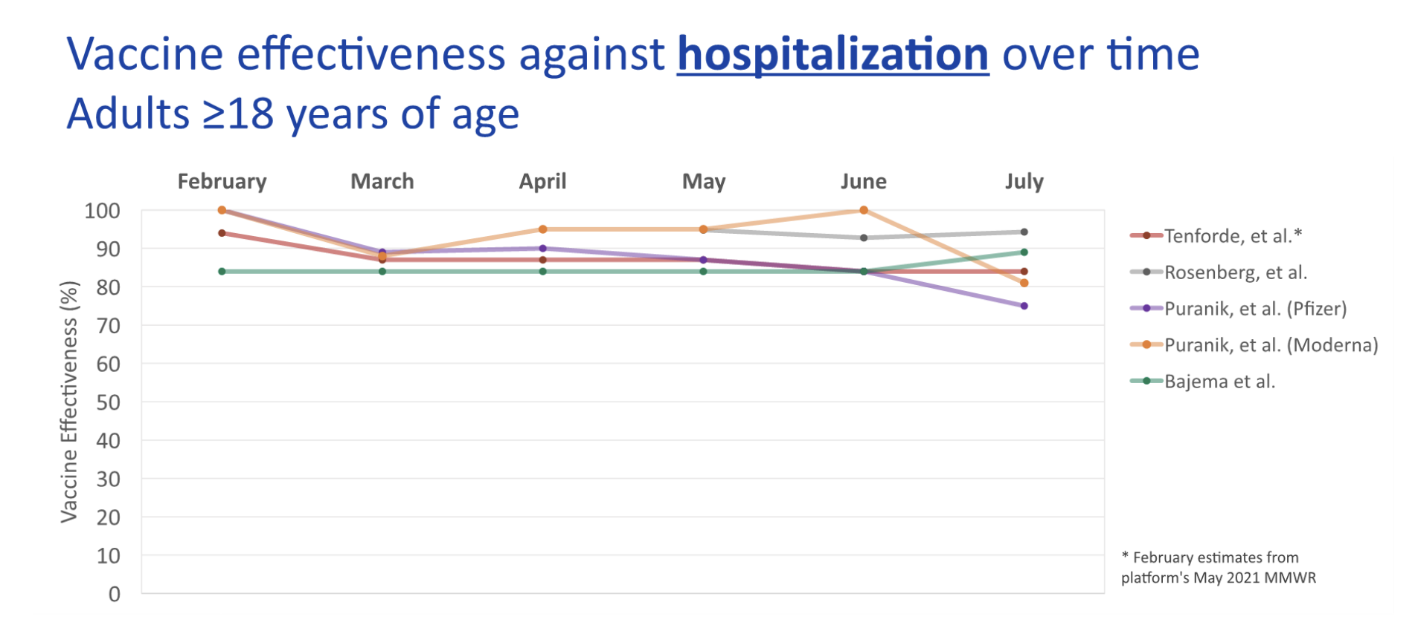

Slide 14
Protection against severe illness is mediated in large part by memory B and T cells, which are long-lived

Slide 15
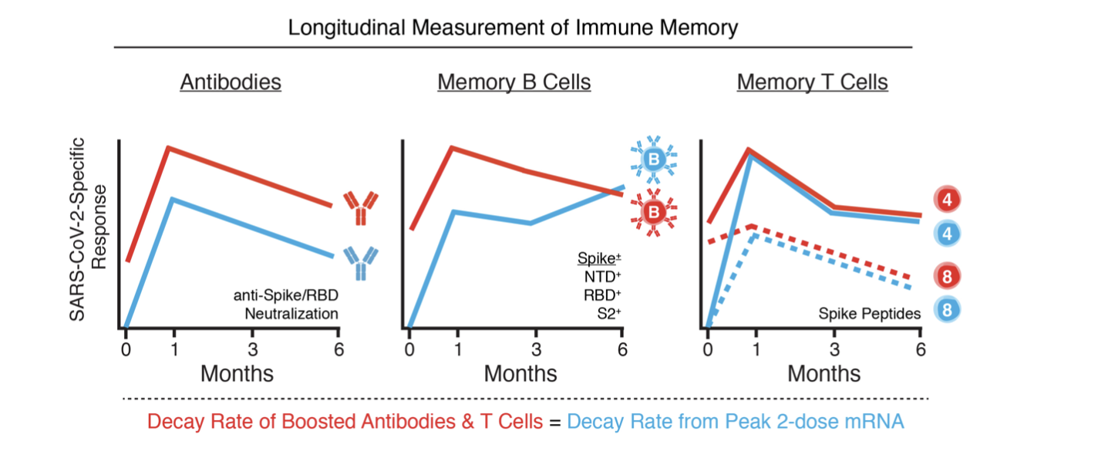

Slide 16
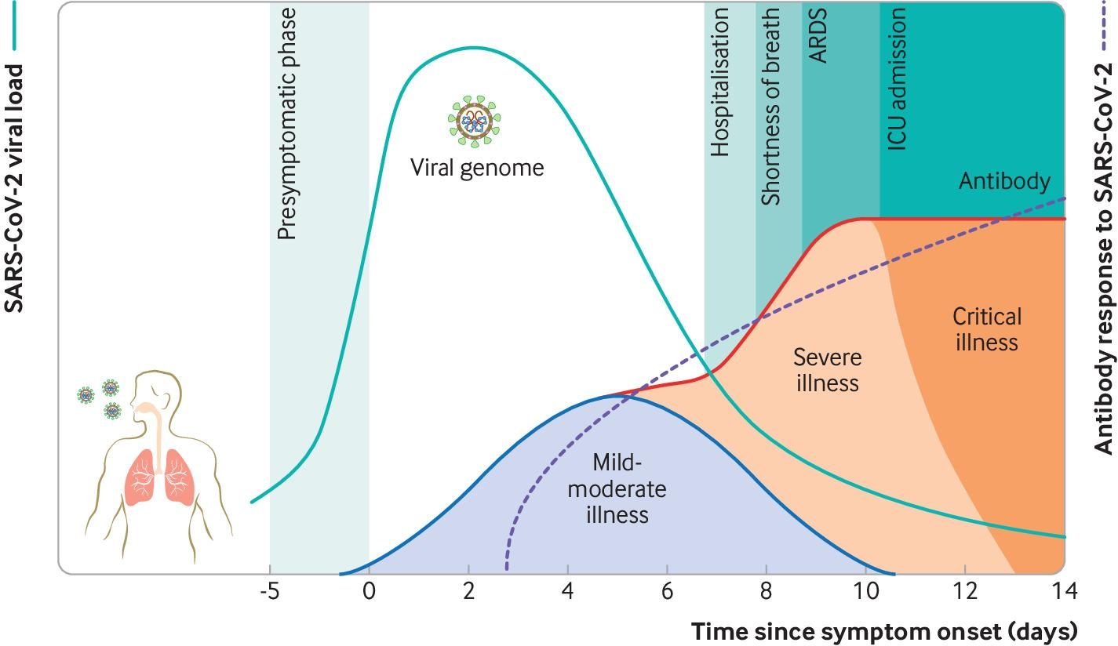

Slide 17
Six months later:
Protection against mild illness wasn’t holding up

Slide 18
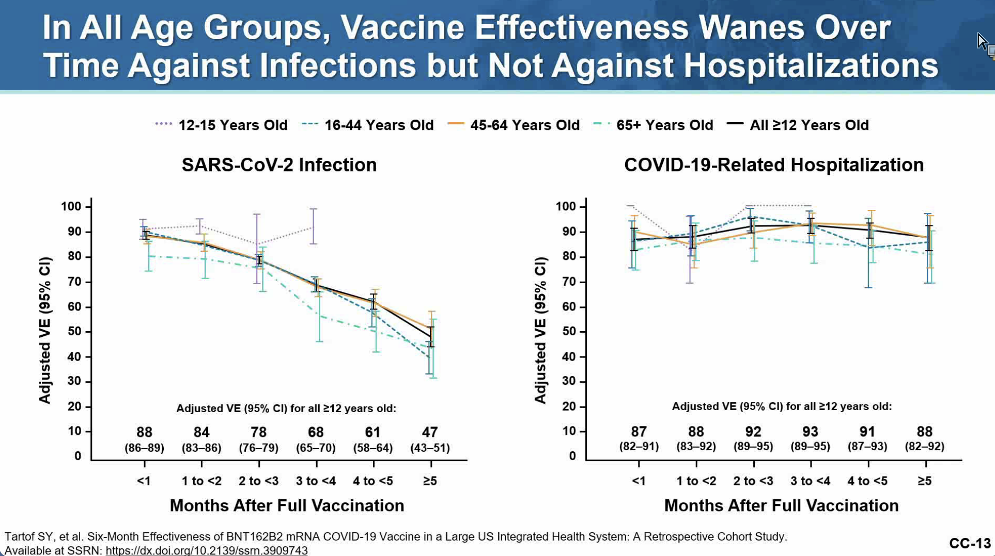

Slide 19
Protection against mild or asymptomatic infection is mediated by high-titers of circulating, virus neutralizing antibodies

Slide 20
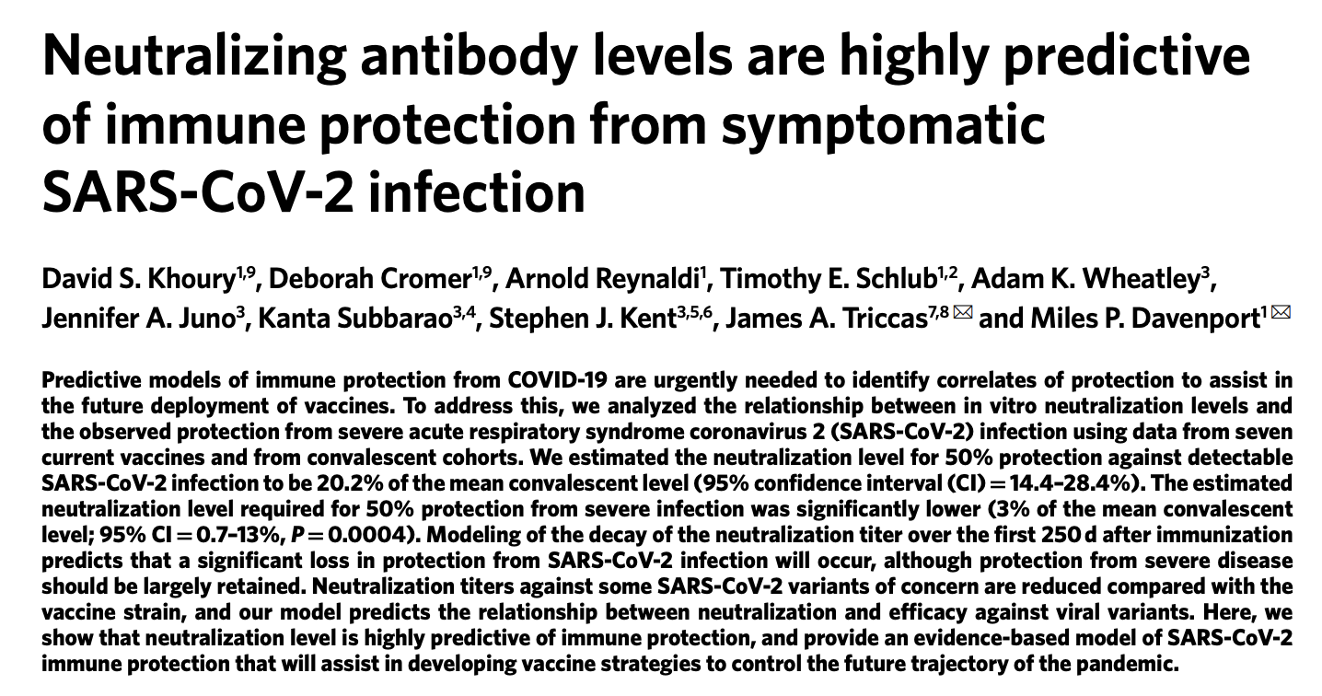
Khoury, D.S., D. Cromer, A. Reynaldi, et al., “Neutralizing antibody levels are highly predictive of immune protection from symptomatic SARS-CoV-2 infection,” Nature Medicine (2021) 27: 1205-1211.

Slide 21
Unfortunately, virus neutralizing antibodies are short-lived. Therefore, protection against all symptomatic illness will be short-lived.

Slide 22
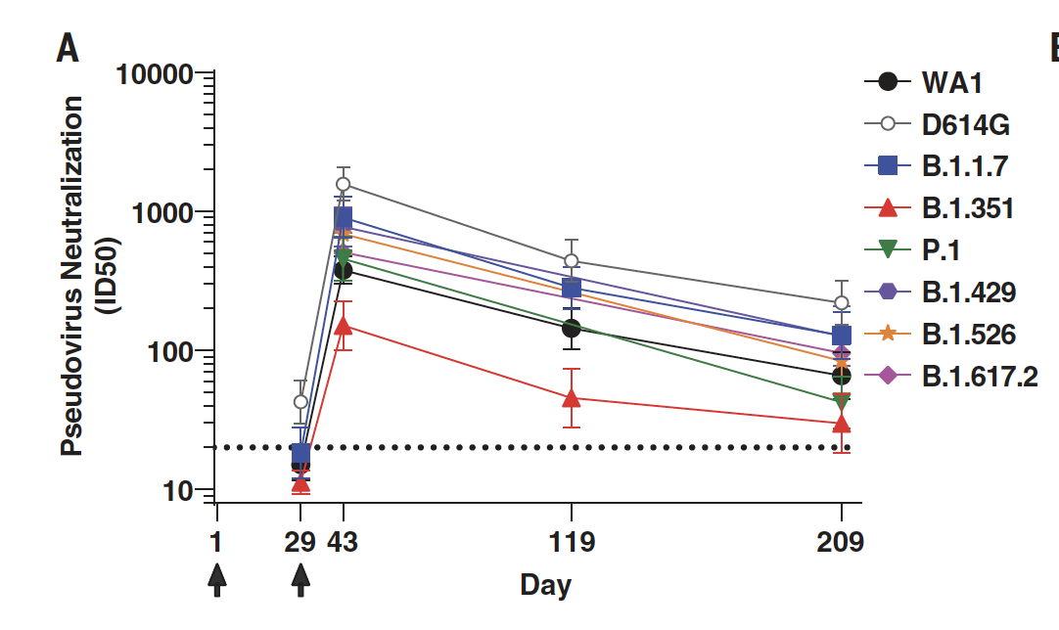

Slide 23
Why did the phase 3 trials of mRNA vaccines show a high level of protection against mild illness?

Slide 24
Phase 3 trials of mRNA vaccines had created an unrealistic expectation that protection against all symptomatic illness would be long-lived

Slide 25
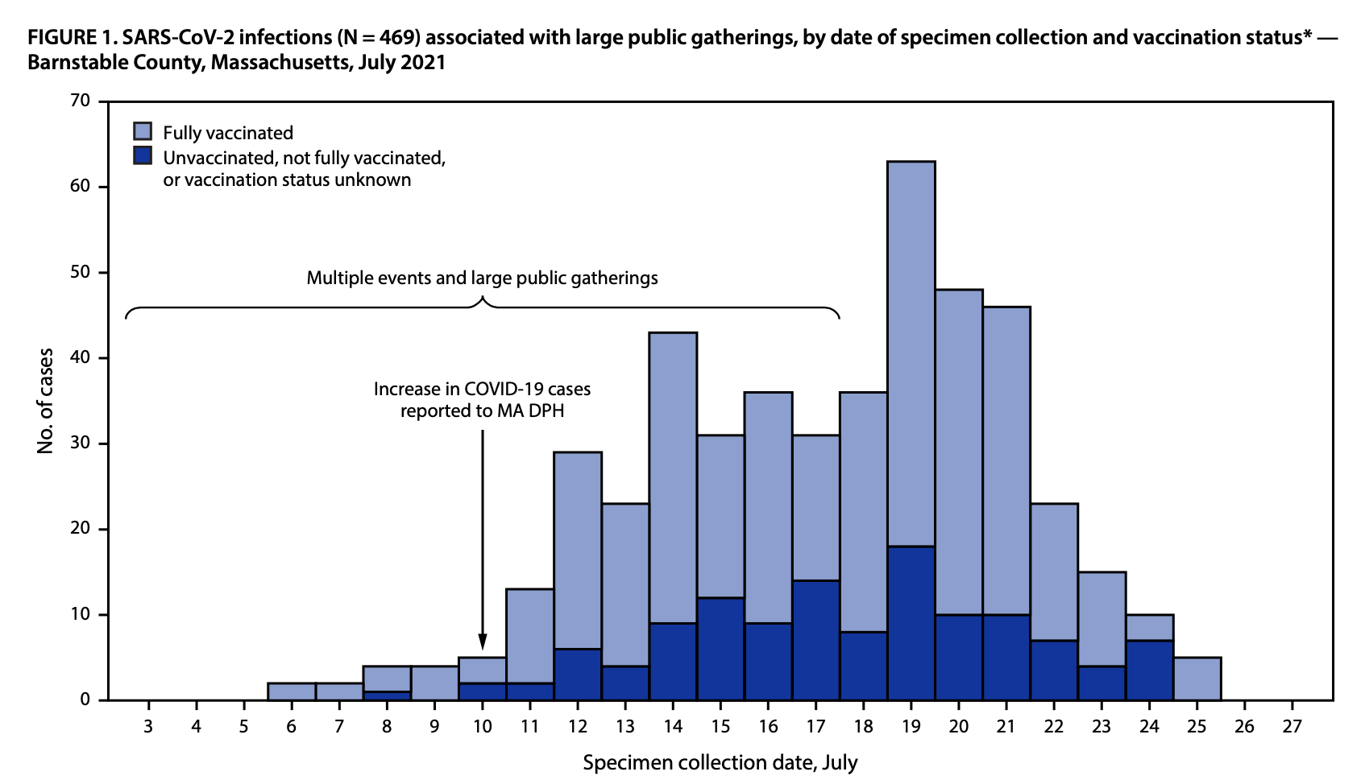

Slide 26
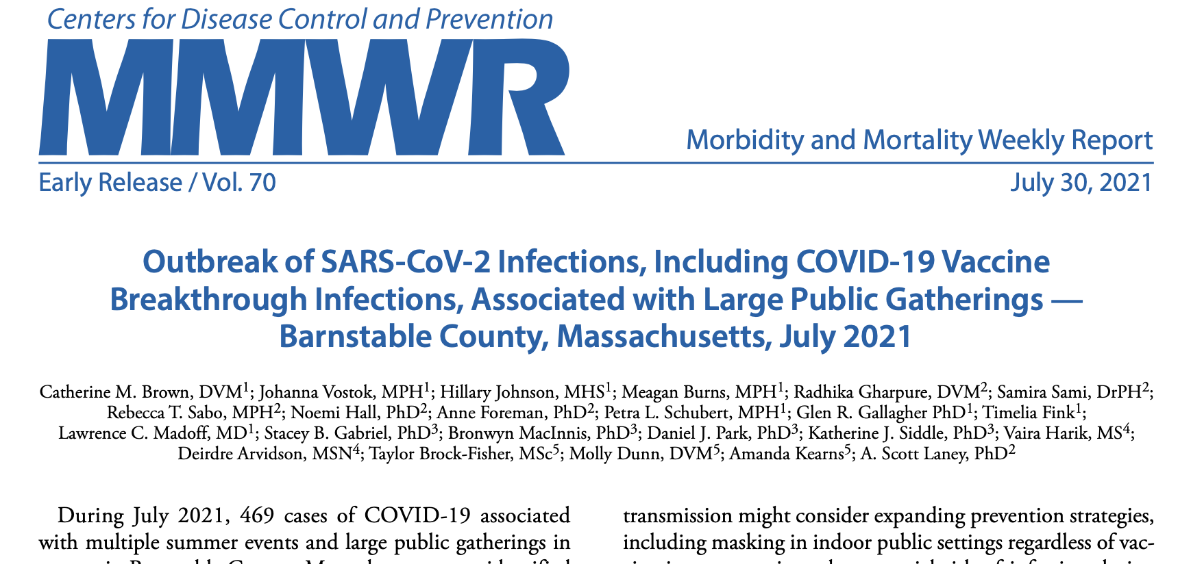

Slide 27
Reason # 2:
Confusing the public about who most benefits from booster dosing

Slide 29
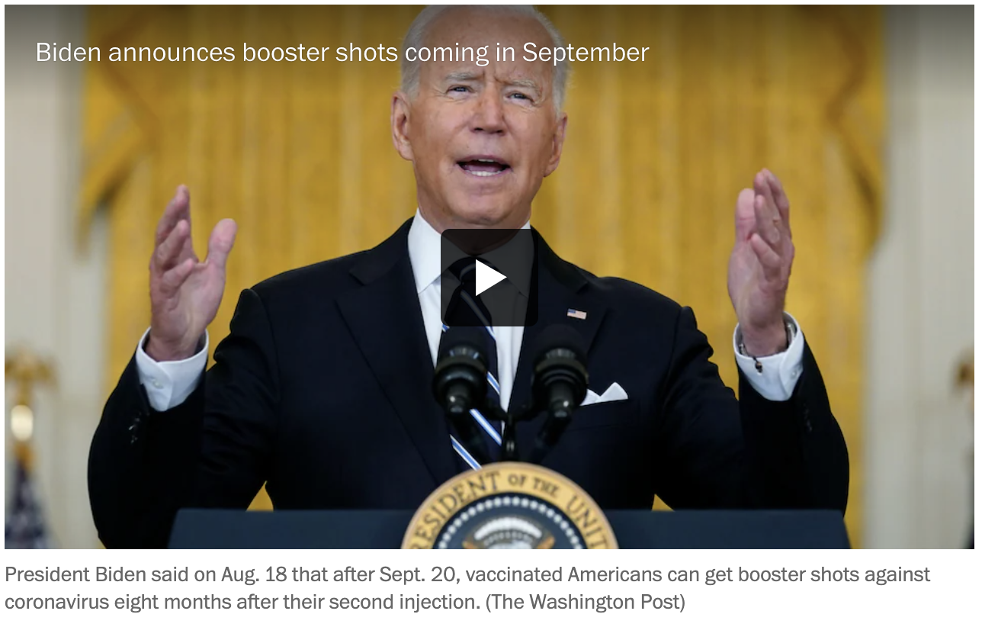

Slide 30
September 17, 2021:
FDA Vaccine Advisory Committee rejects booster dosing for everyone over 12

Slide 31
December 2021:
One year after vaccines were available, protection against severe disease was holding up

Slide 32
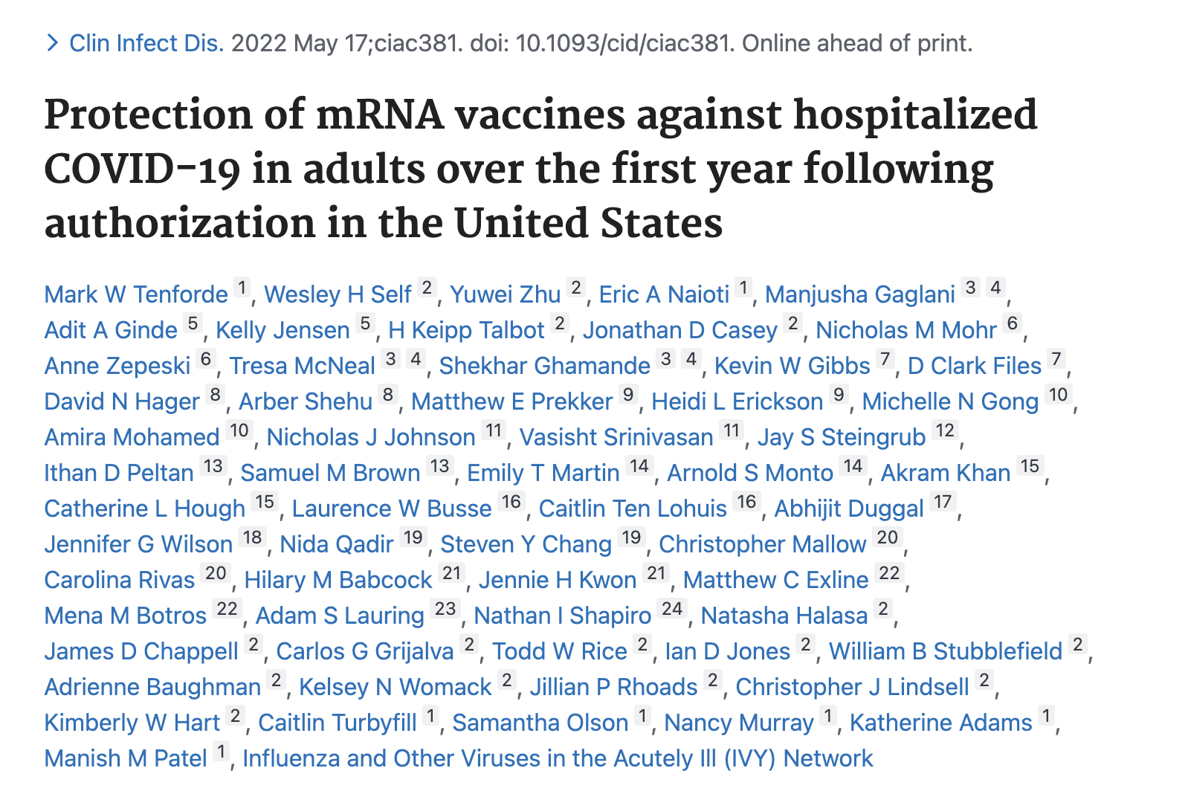

Slide 33
Tenforde study
Study of protection against hospitalization in 8,000 immunocompetent adults between March-December 2021 who received two doses of mRNA vaccine vs. unvaccinated; median age was 60; 81% had more than one medical condition; delta variant predominant.
Overall: 90% at 3 months and 82% at 9 months.
Pfizer: 88% at 3 months and 79% at 9 months.
Moderna: 93% at 3 months and 87% at 9 months.
18-64: 91% at 3 months and 87% at 9 months.
>65: 87% at 3 months and 78% at 9 months.

Slide 34
Again, immunological studies supported epidemiological observations

Slide 35
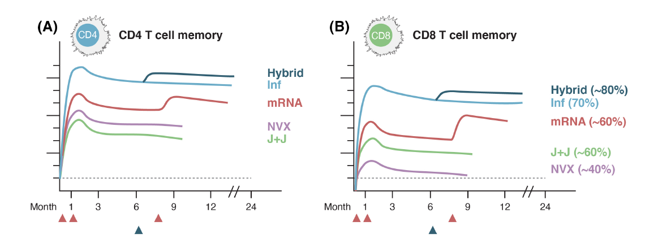

Slide 36
Then, the pandemic entered a new phase

Slide 37
December 1, 2021:
Omicron variant

Slide 38
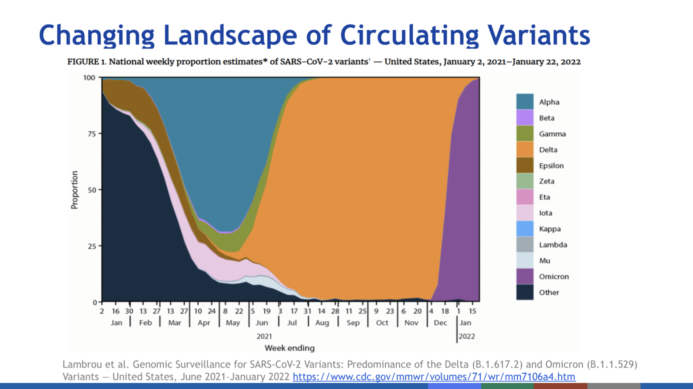

Slide 39
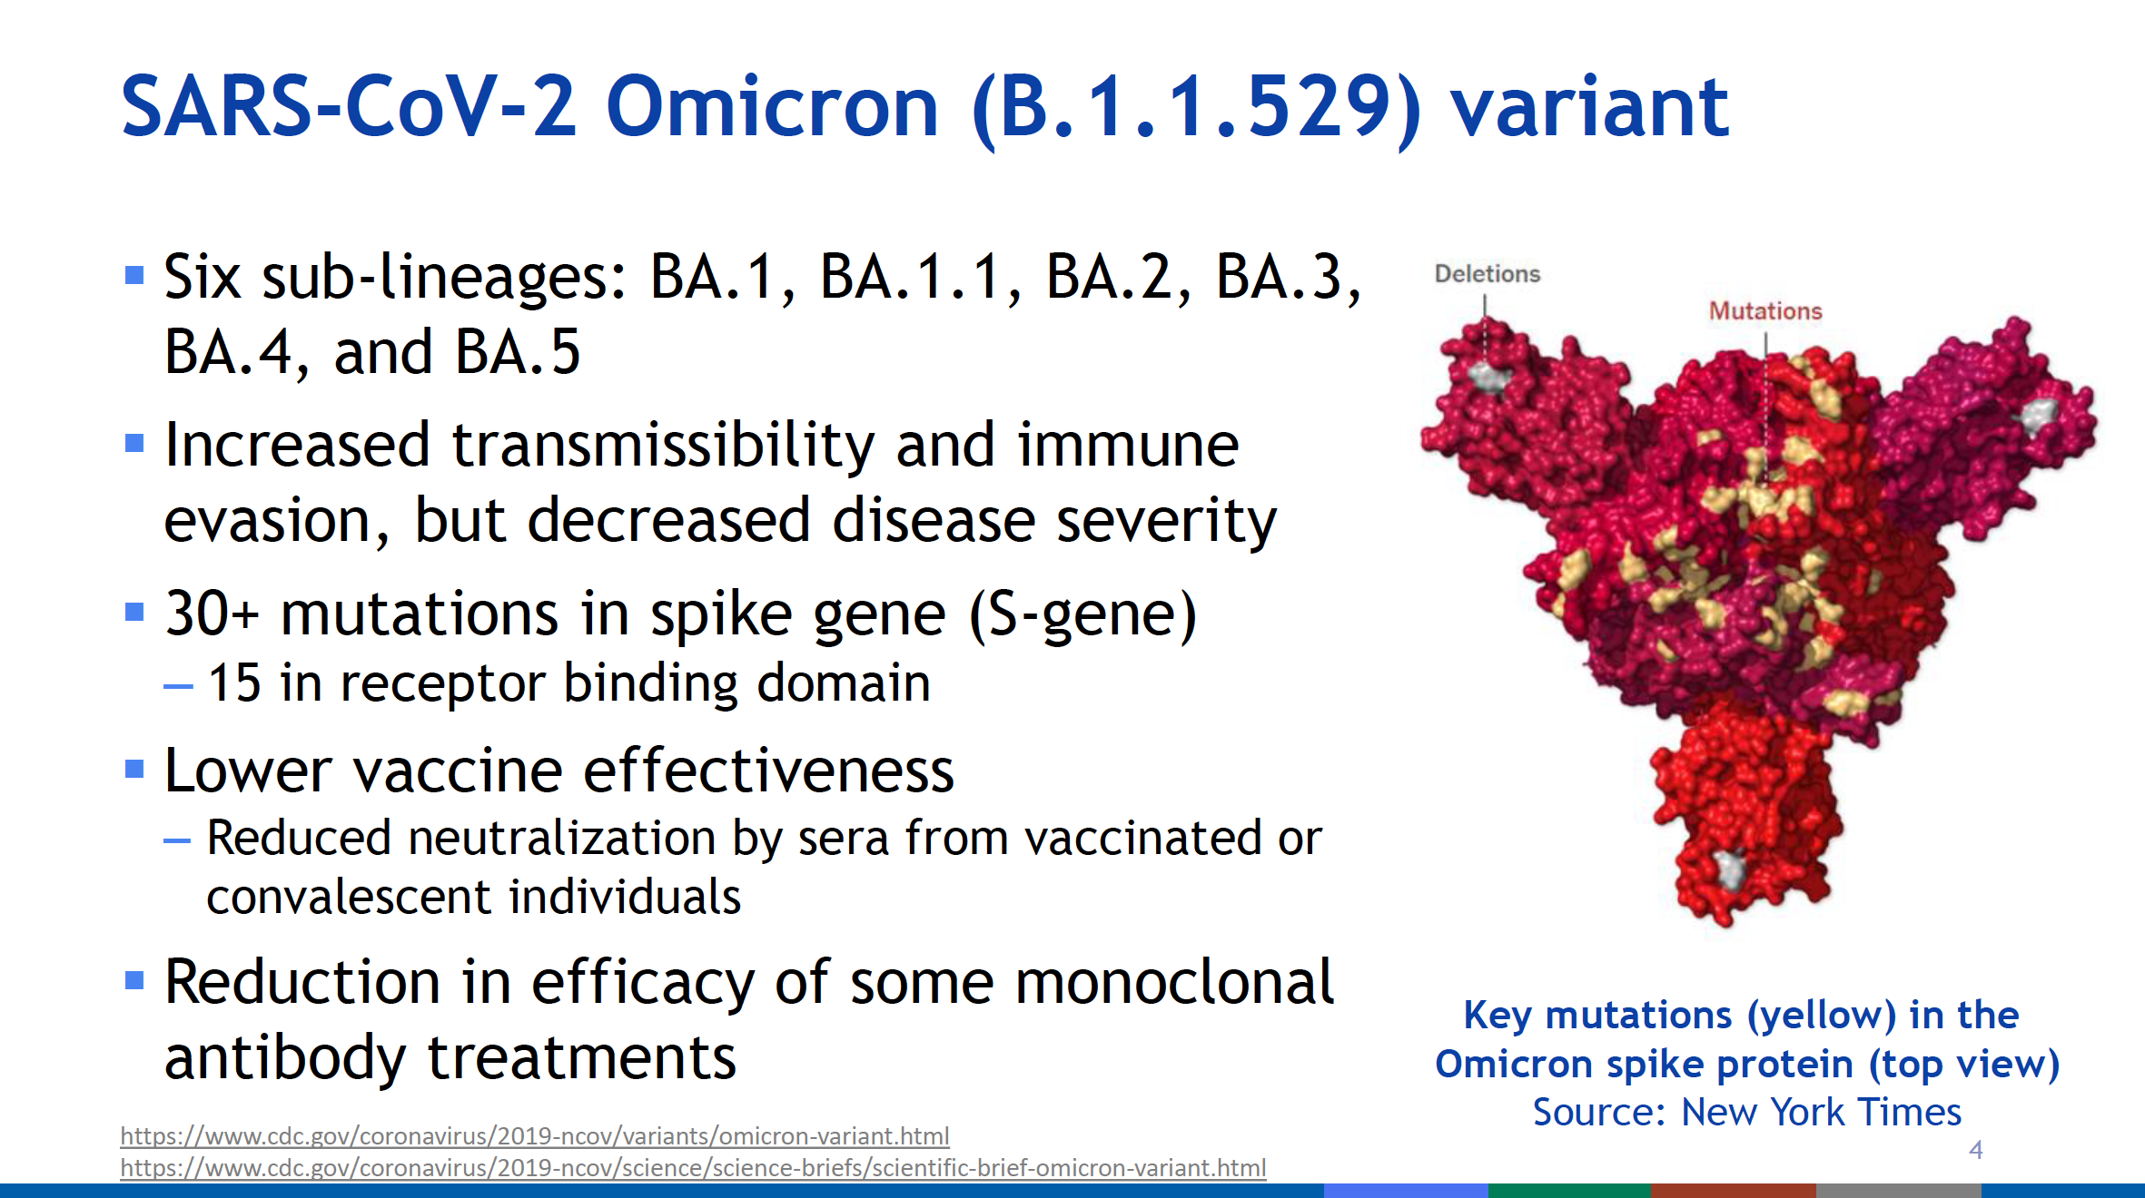

Slide 40
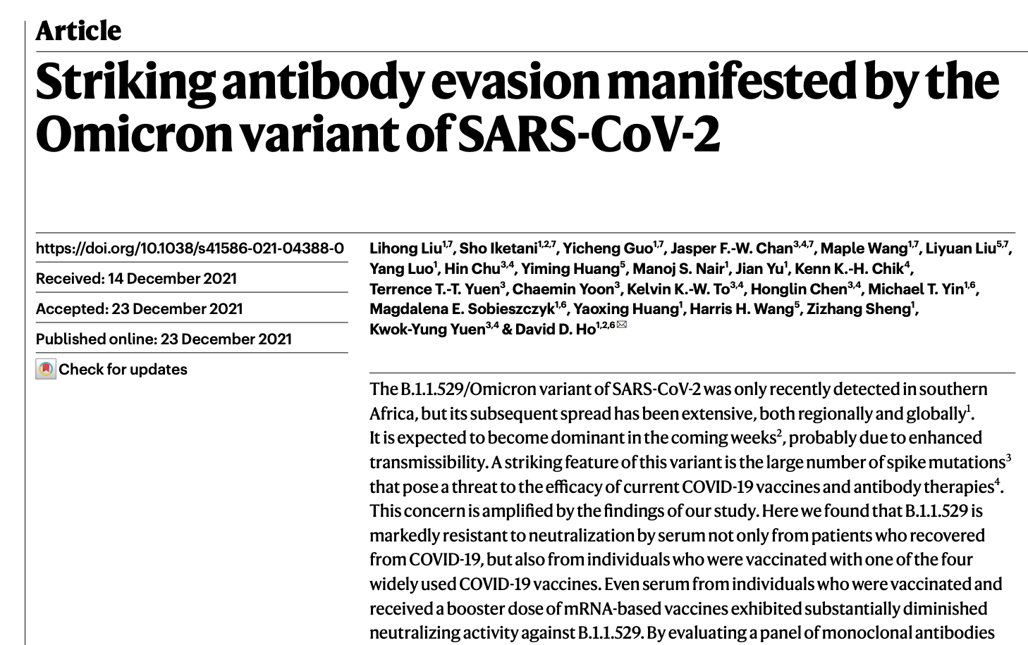
Liu, et al., Striking antibody evasion manifested by the Omicron variant of SARS-CoV-2, Nature (2022) 602: 676-681

Slide 41
Omicron
Because of mutations in the RBD of the spike protein, vaccination or previous infection offered little protection against mild disease

Slide 42
Omicron
However, in otherwise healthy people, vaccination or previous infection were still highly effective at preventing severe disease

Slide 43
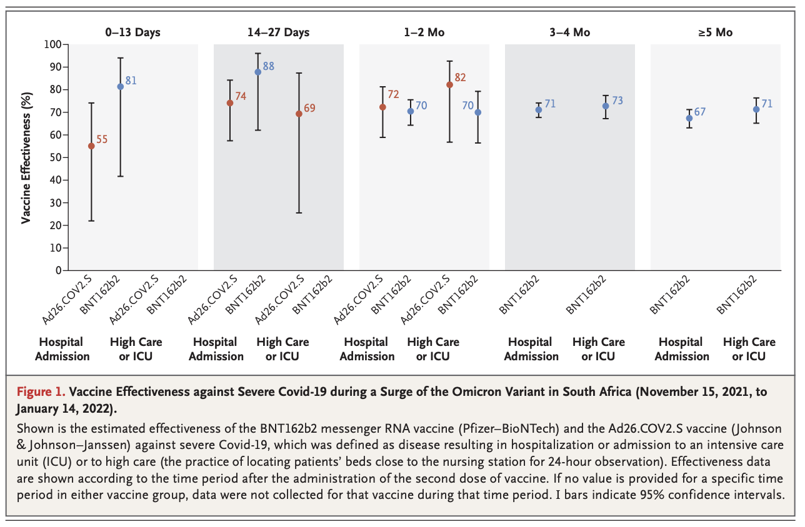

Slide 44
Why?

Slide 45
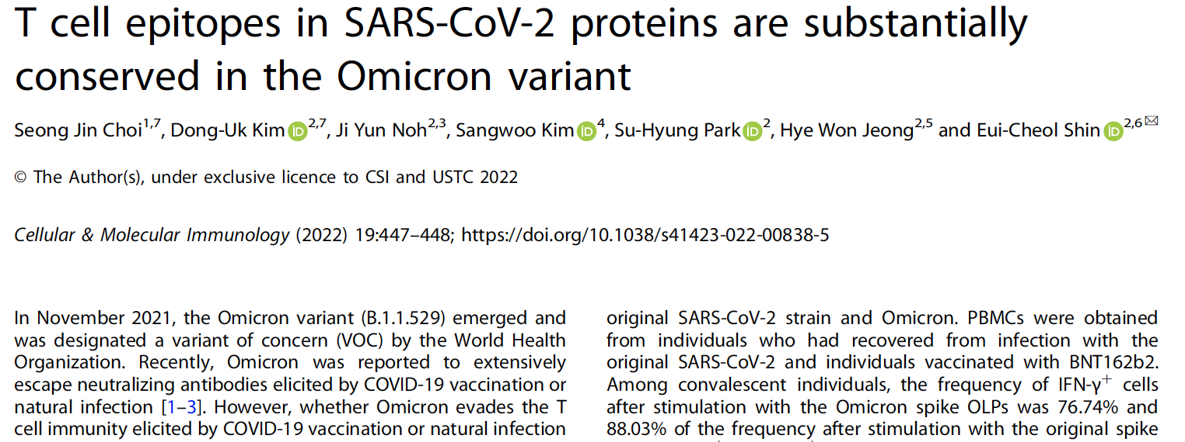

Slide 46
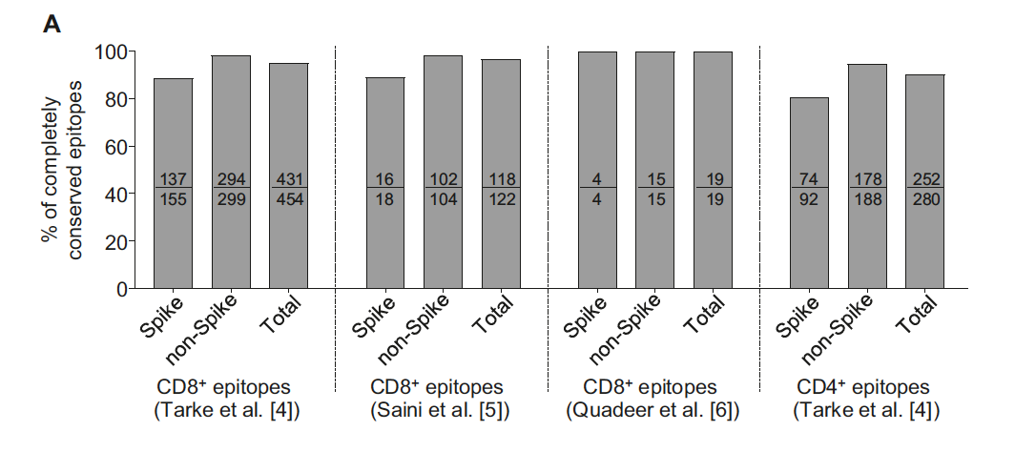
Epitopes recognized by CD4⁺ and CD8⁺ T cells are conserved between Wuhan-1 and Omicron strains

Slide 47
Birth of the First Booster Dose

Slide 48
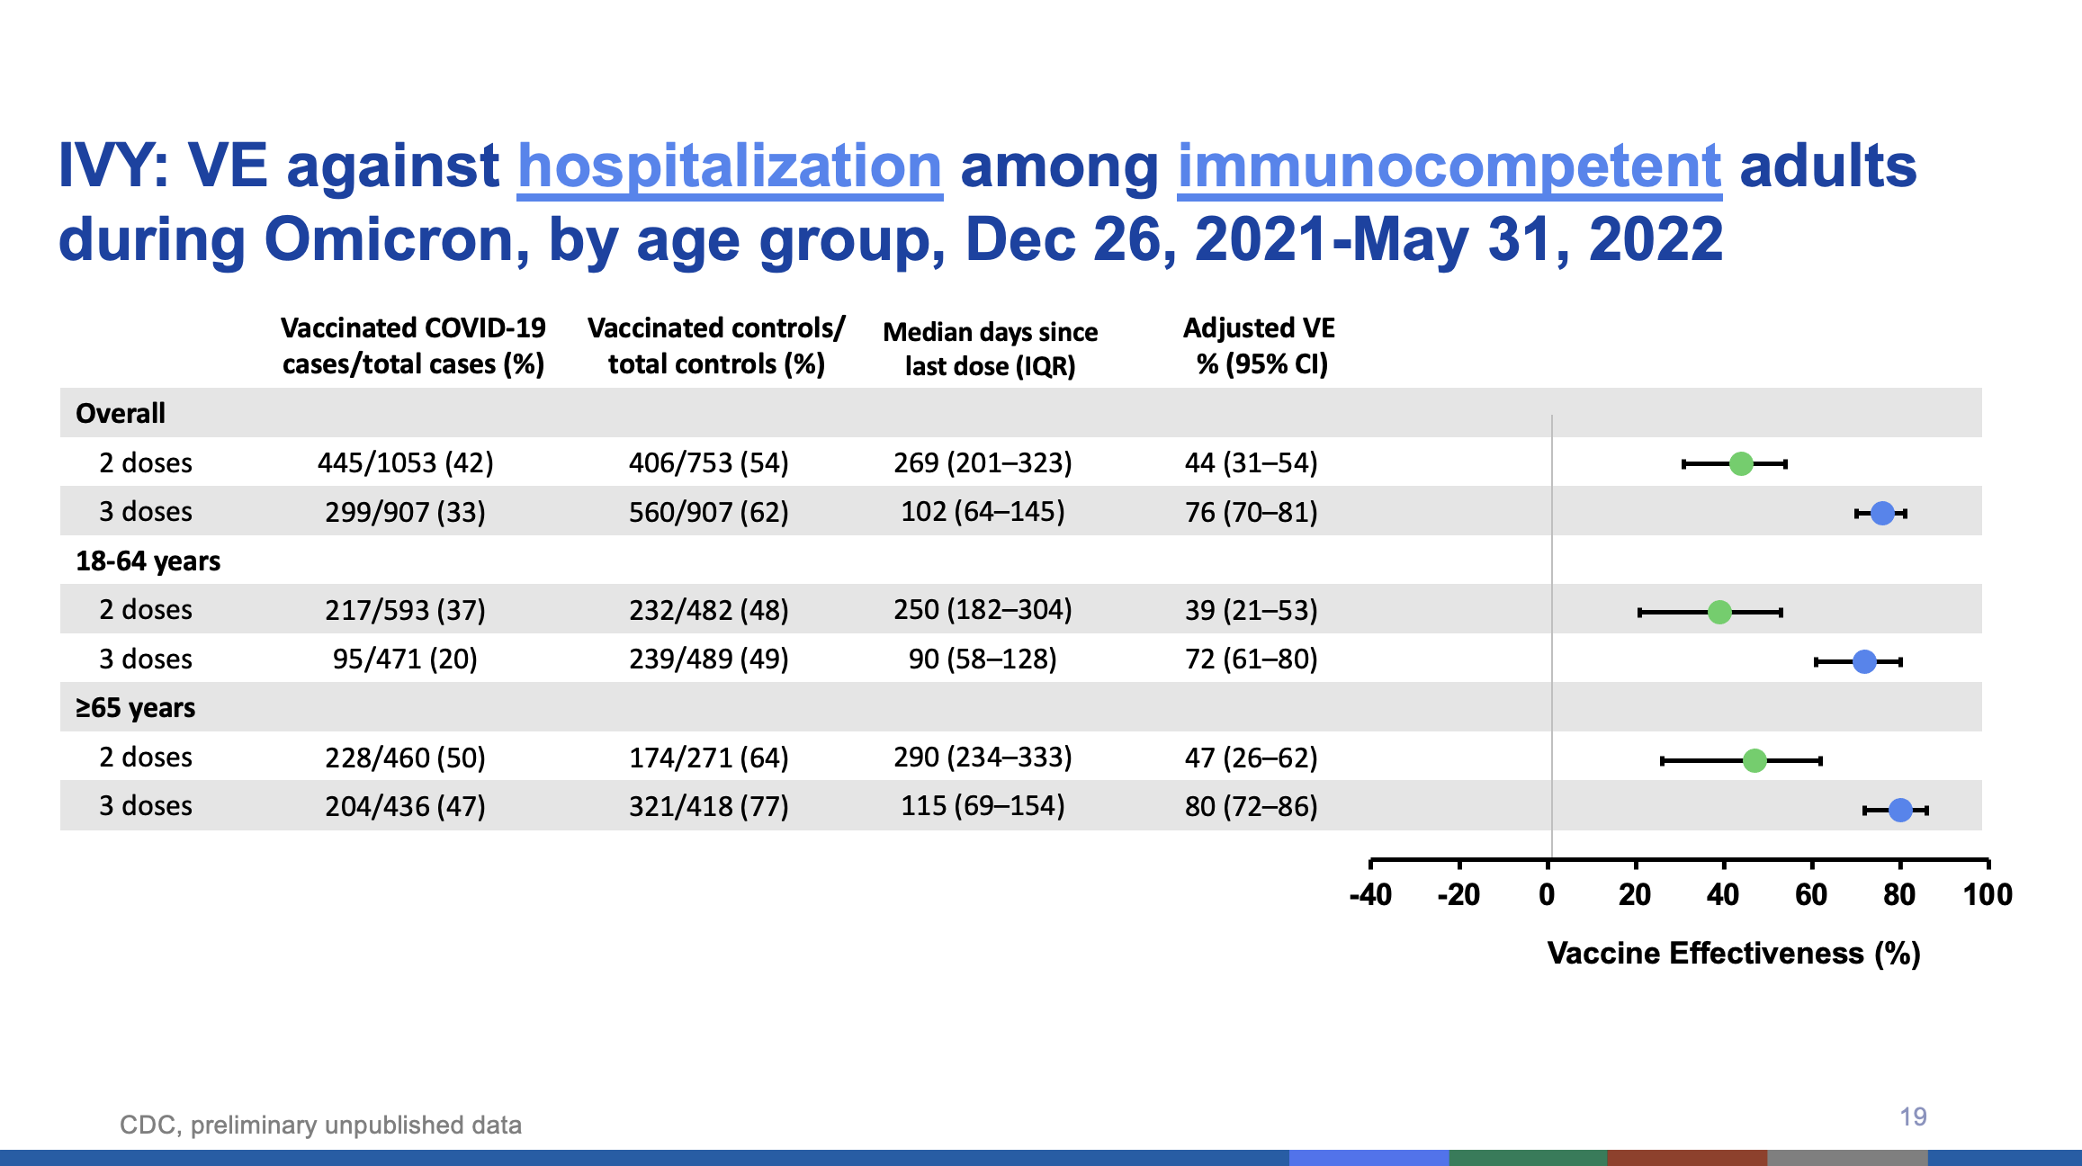

Slide 49
Birth of the Second Booster Dose

Slide 50
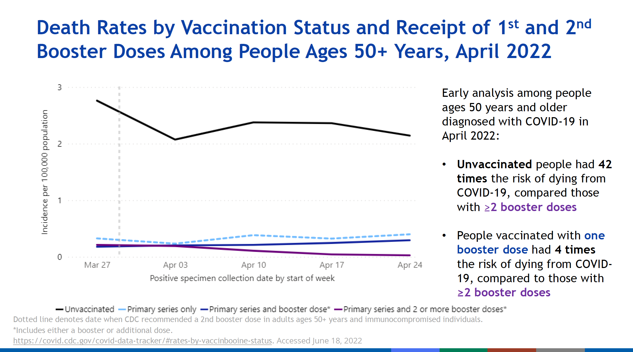

Slide 51
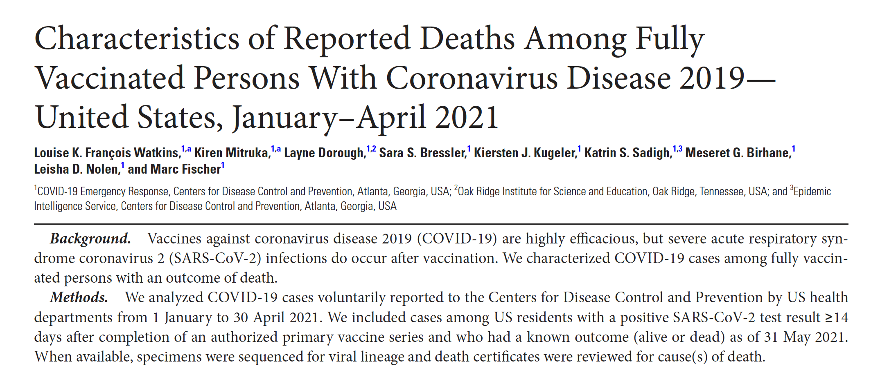
Watkins, L.K.F., et al., Clinical Infectious Diseases (2022) 75: e645-652.

Slide 52
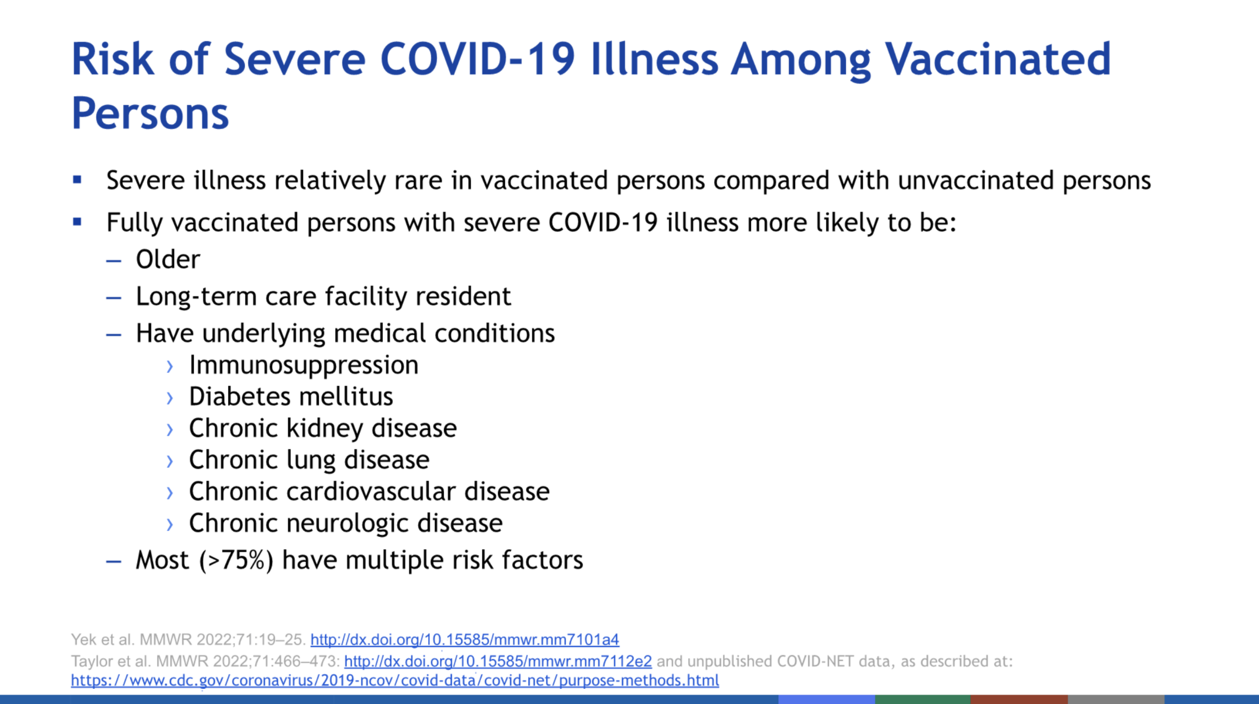

Slide 53

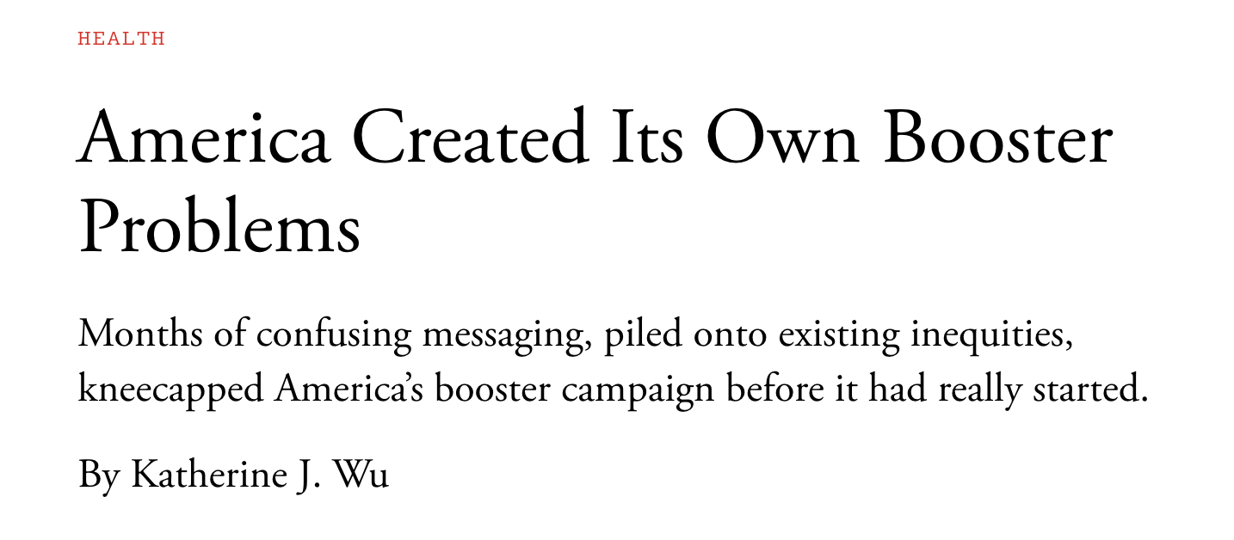
April 12, 2022

Slide 54
Reason # 3:
The misrepresentation of the value of bivalent vaccines also caused some scientists and clinicians to lose faith in the FDA and CDC

Slide 55
June 28, 2022:
FDA Vaccine Advisory Committee considers including an omicron variant in a bivalent vaccine

Slide 56
Moderna’s bivalent vaccine

Slide 57
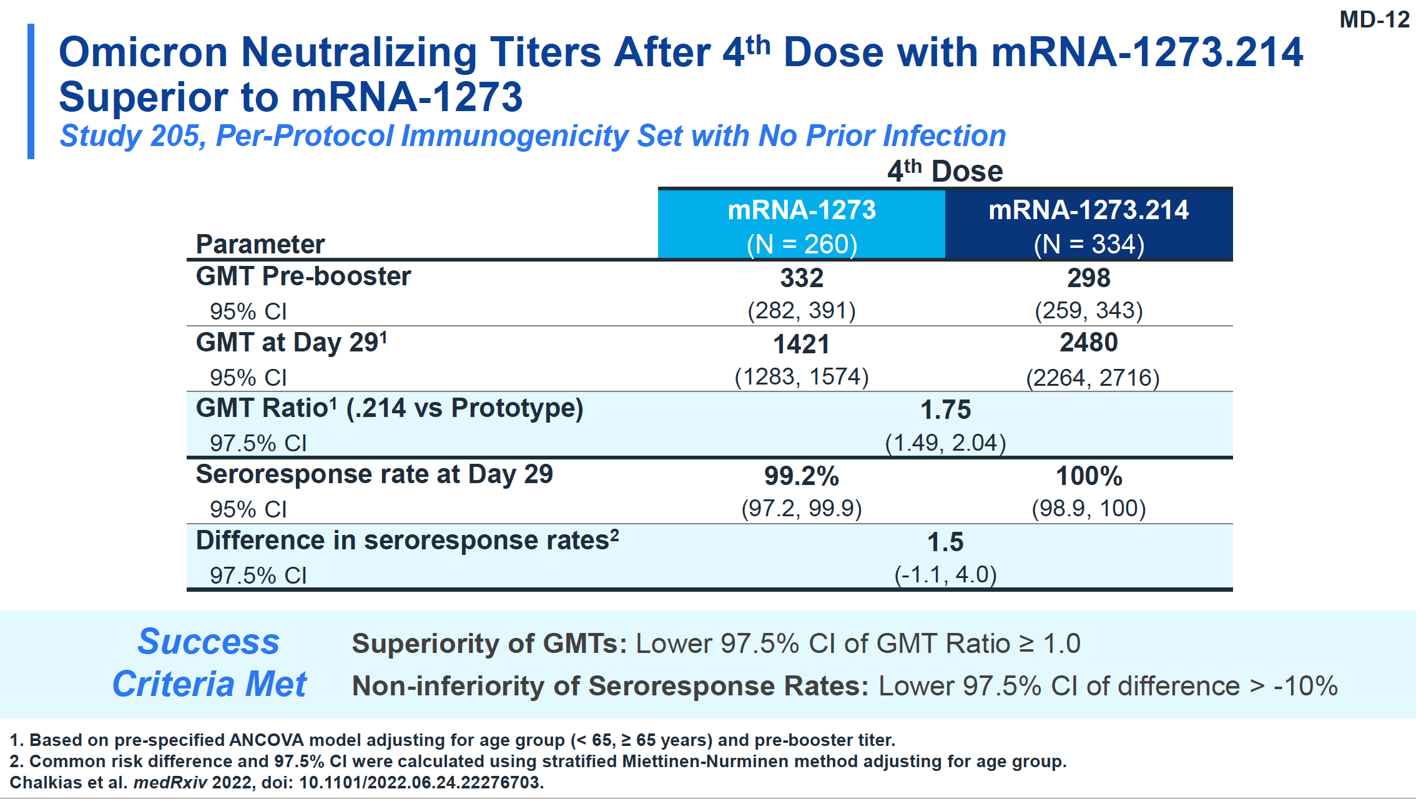

Slide 58
Pfizer’s bivalent vaccine

Slide 59
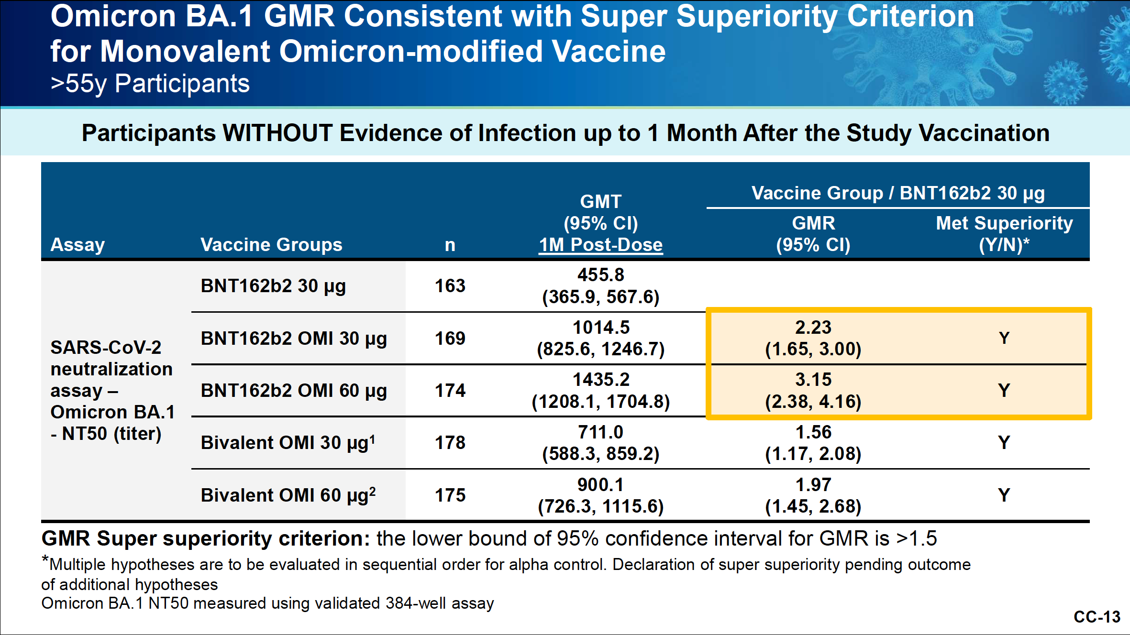

Slide 60
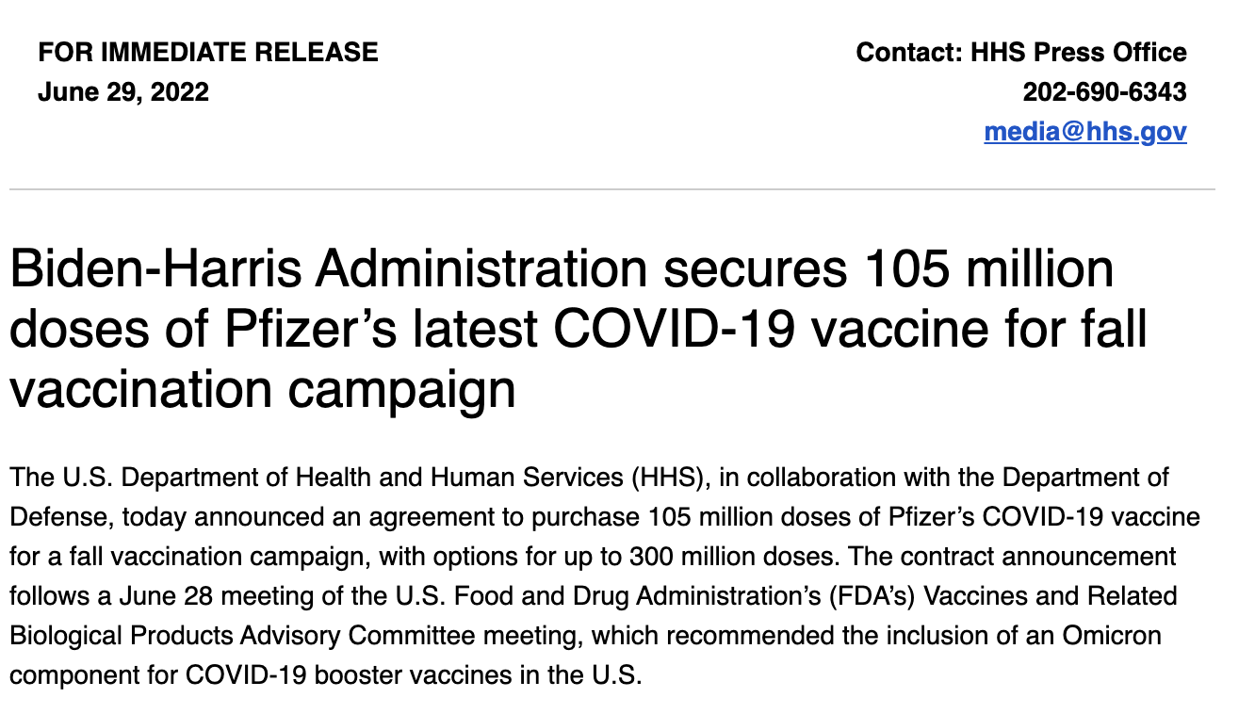

Slide 61
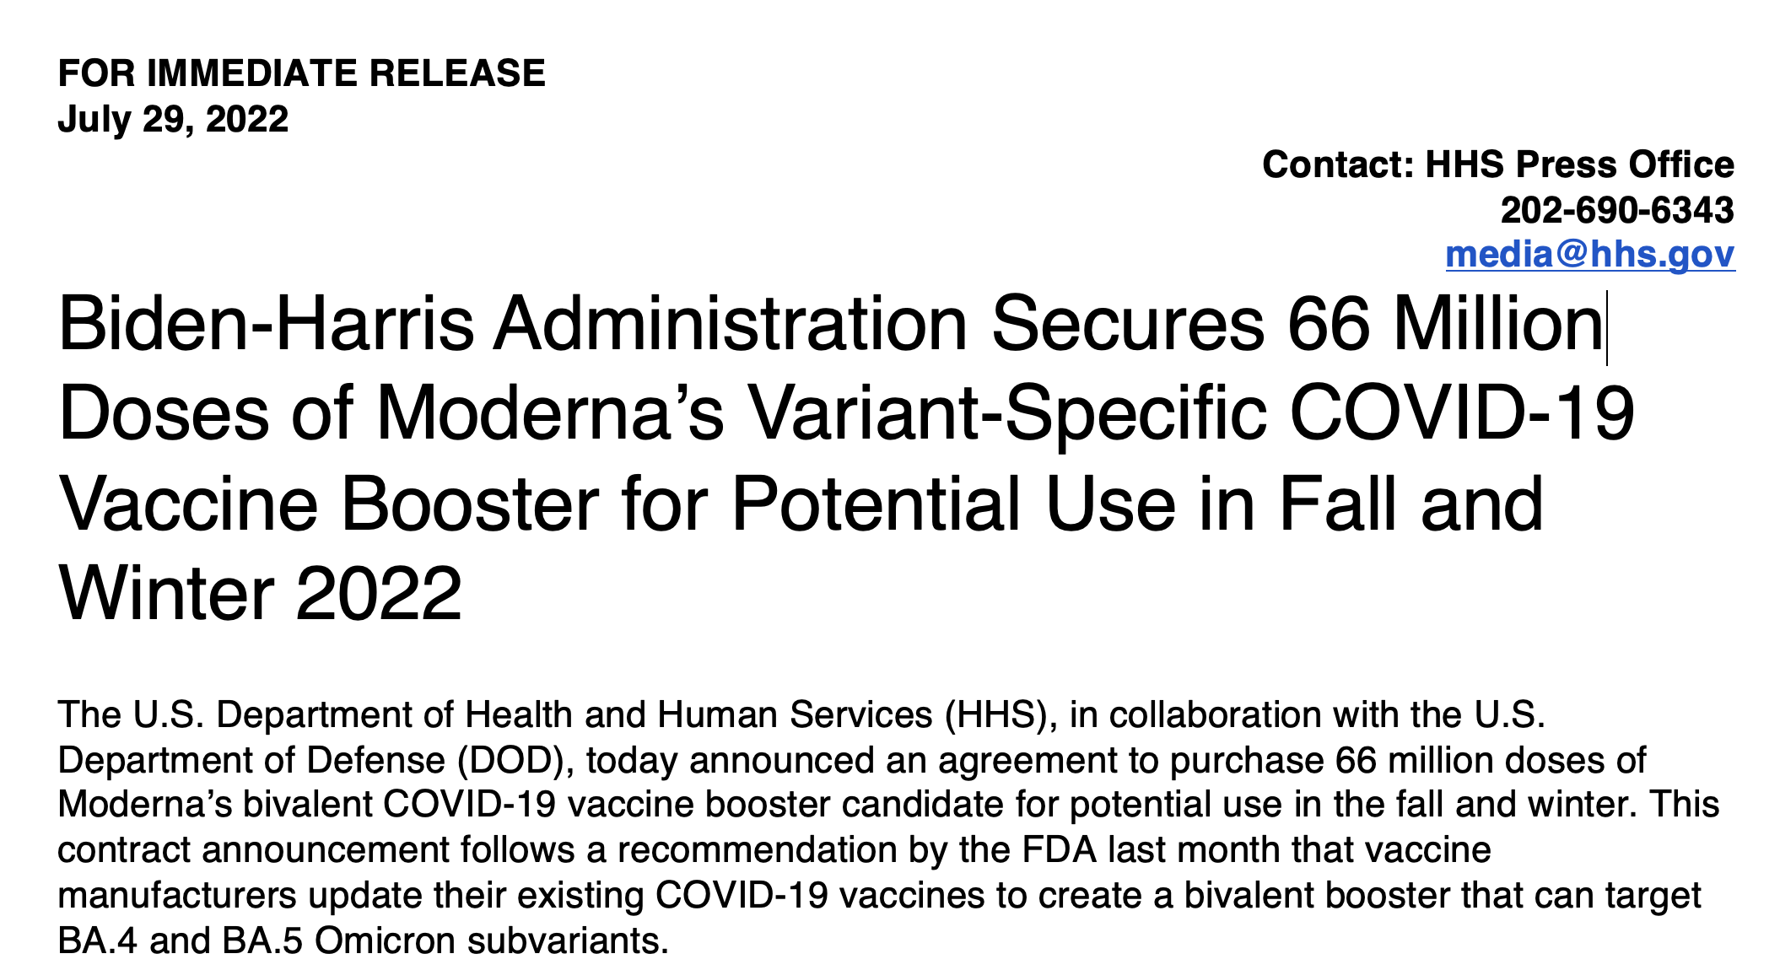

Slide 62
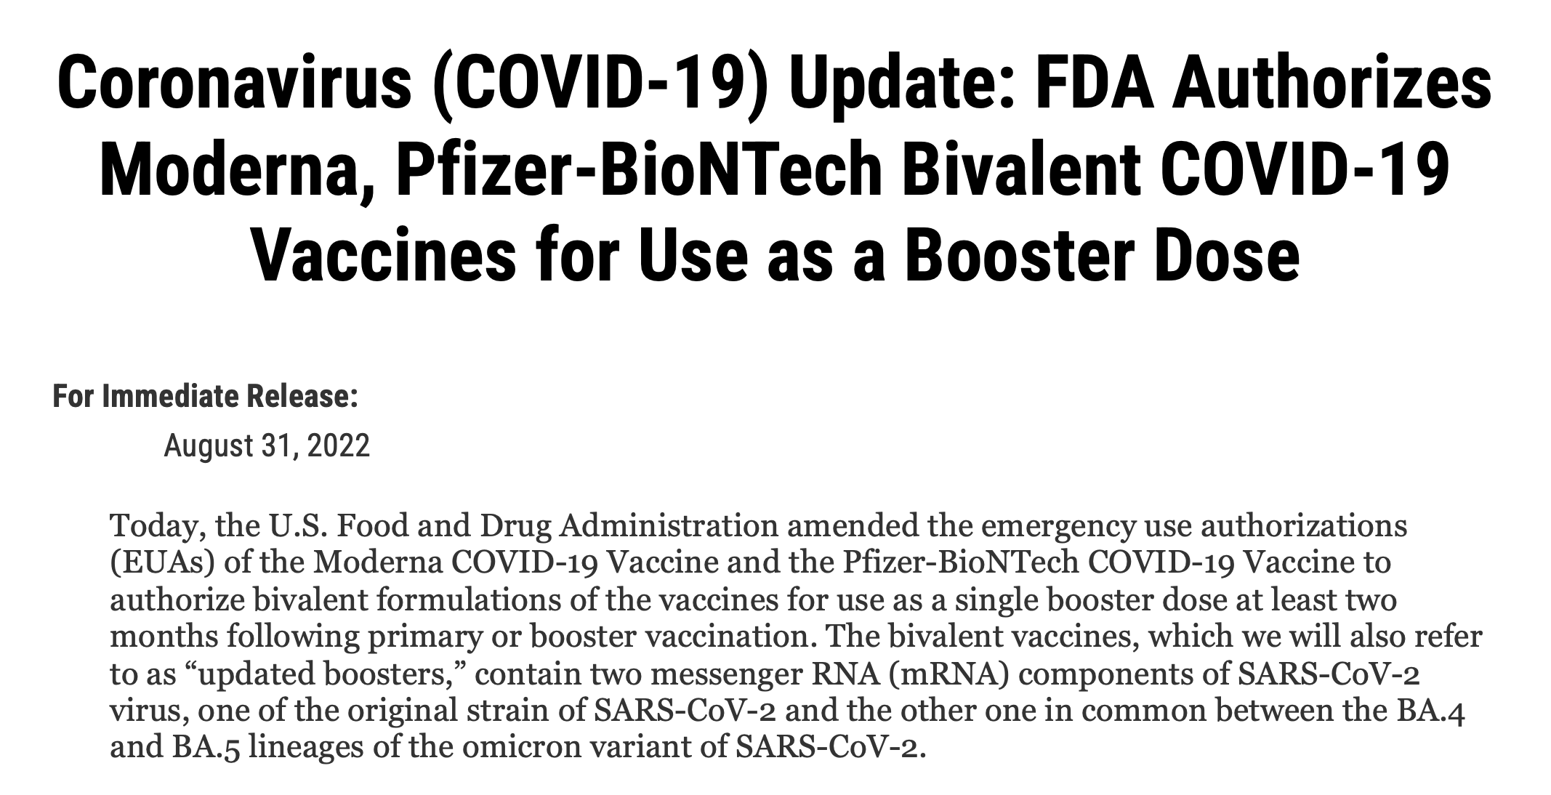

Slide 63
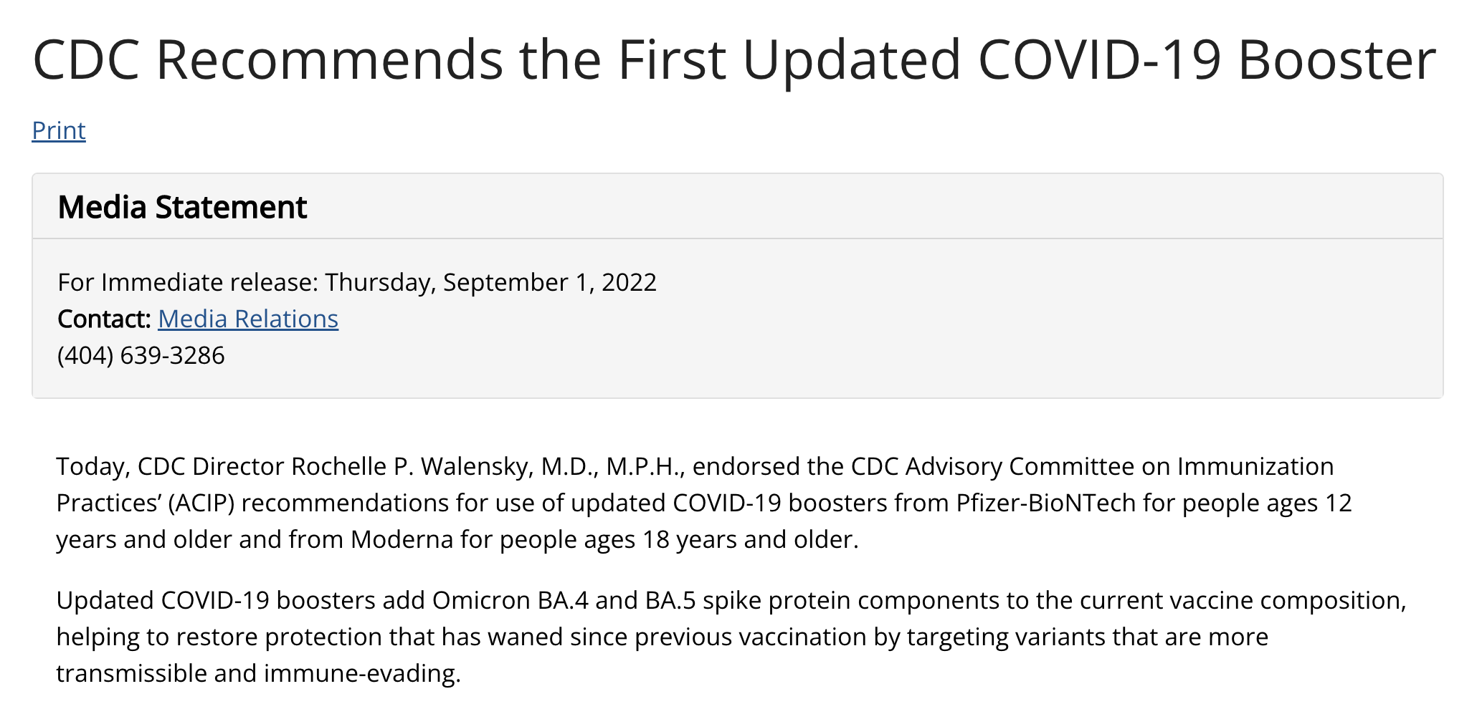

Slide 64
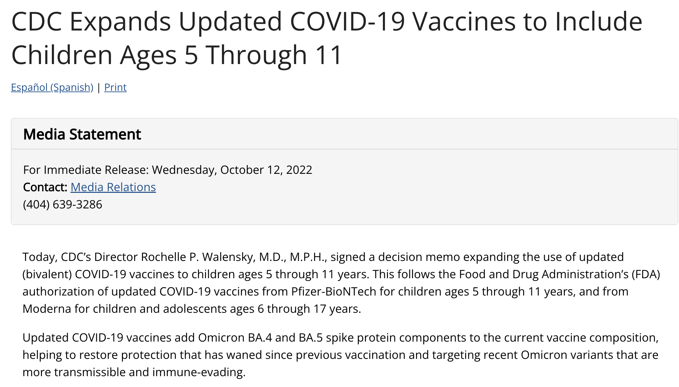

Slide 65
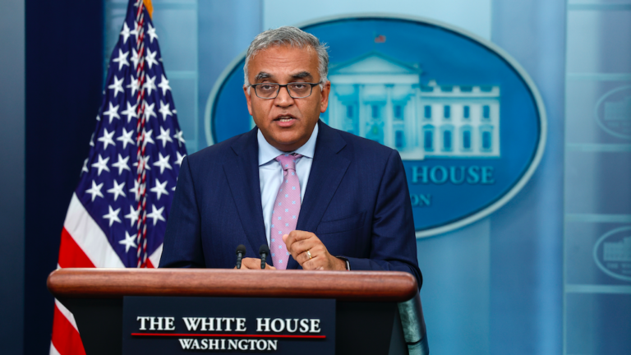
Dr. Ashish Jha
September 2022

Slide 66
At the end of October, 2022, about 4 months after the purchase of 171 million doses of BA.4/BA.5-containing bivalent vaccines, first human data were published

Slide 67
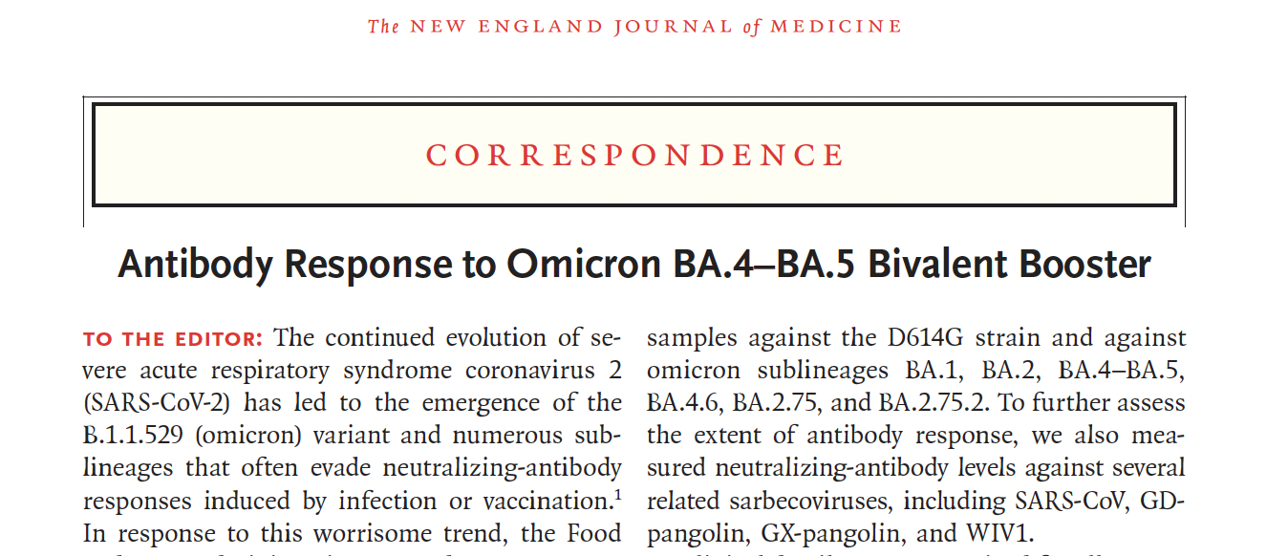
Wang Q, A. Bowen A, R. Valdez, et al, (2023) New England Journal of Medicine DOI: 10.1056/NEJMc2213907

Slide 68
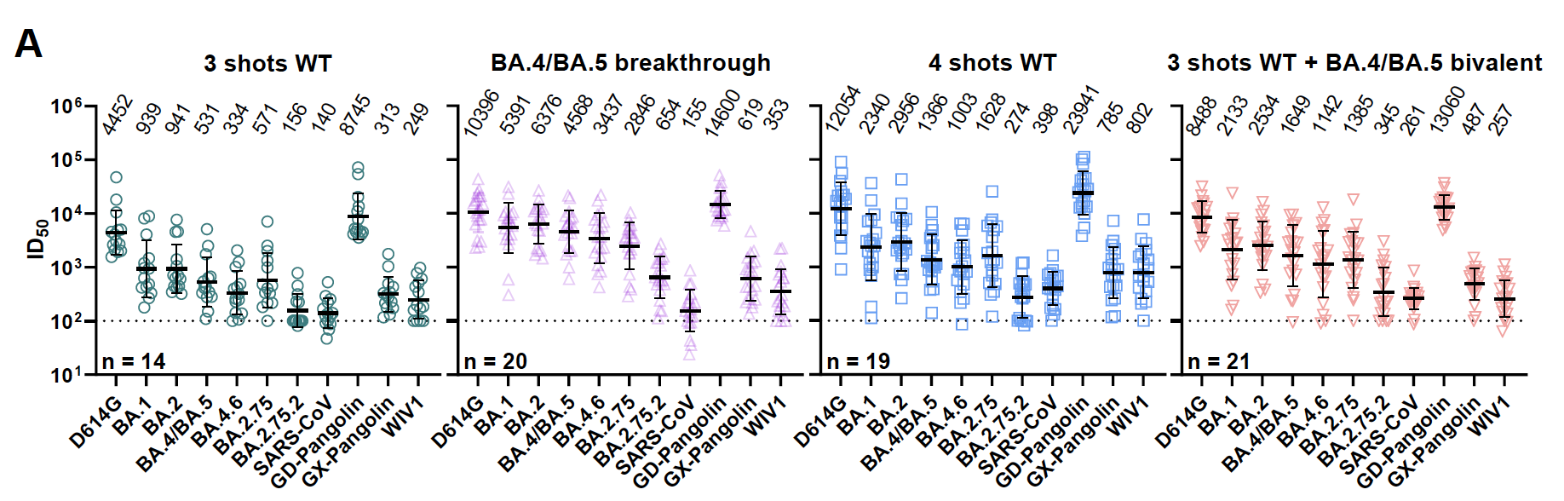
BA.4/BA.5
No differences in titers of BA.4/BA.5-specific neutralizing antibodies after boosting with bivalent vs. monovalent vaccine

Slide 69
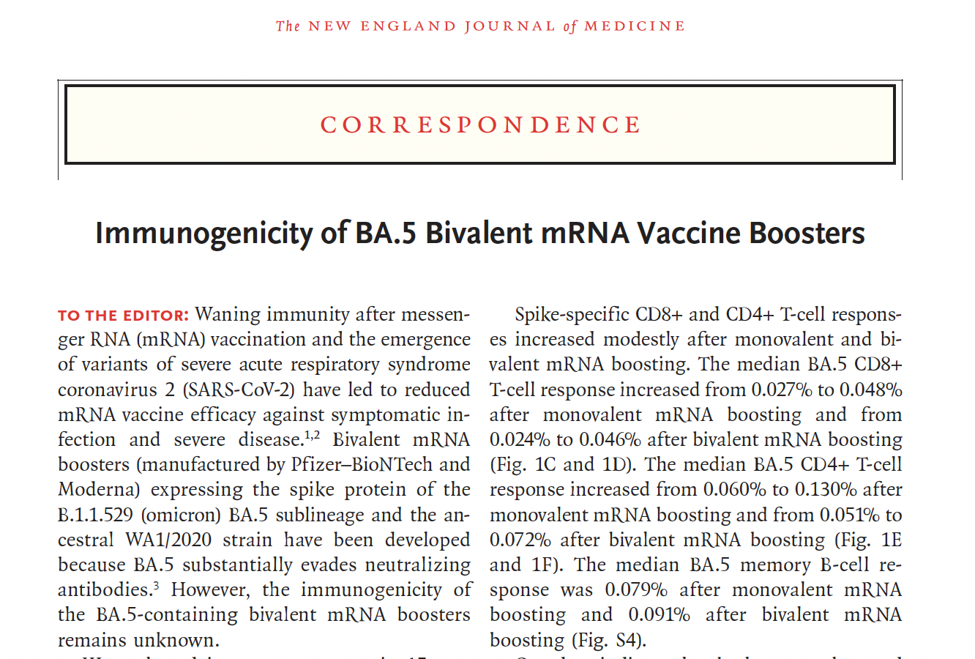
Collier A, J Miller, NP Hachmann, et al, New England Journal of Medicine (2023) DOI: 10.1056/NEJMc2213948

Slide 70
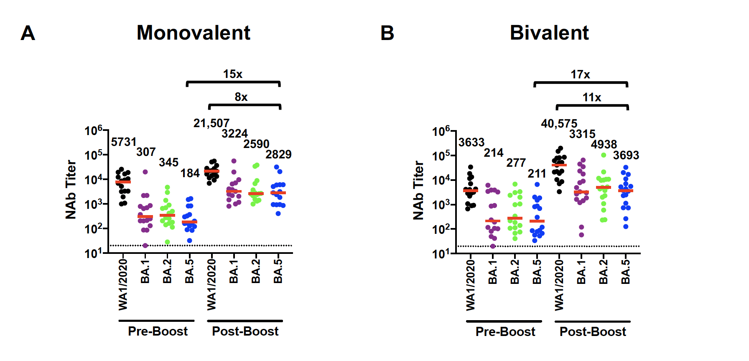
No differences in titer of BA.5-specific neutralizing antibodies after boosting with bivalent vs. monovalent vaccine

Slide 71
Did the bivalent vaccine perform better than the monovalent vaccine in clinical studies?

Slide 72
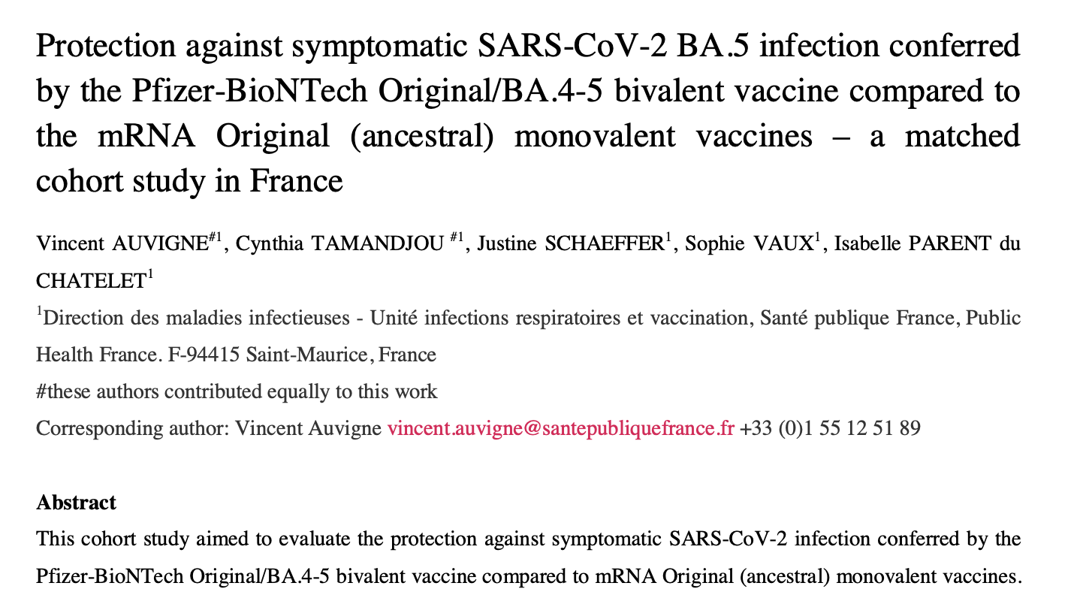

Slide 73
Bivalent BA.4/5-containing booster vaccine against Covid-19
Participants >60 years of age in France received a booster dose containing either (1) the ancestral strain only (50ug) or (2) a bivalent vaccine containing the ancestral strain (25ug) plus omicron BA.4/5 (25ug) in a prospective, randomized trial. Participants were followed for a median period of 77 days.
A total of 136,852 people were included in the analysis.
The bivalent vaccine increased protective efficacy against symptomatic infection by 8 percent.

Slide 74
Why didn’t the inclusion of omicron variant-specific mRNA in the bivalent vaccine result in a dramatic increase in variant-specific neutralizing antibodies?

Slide 75
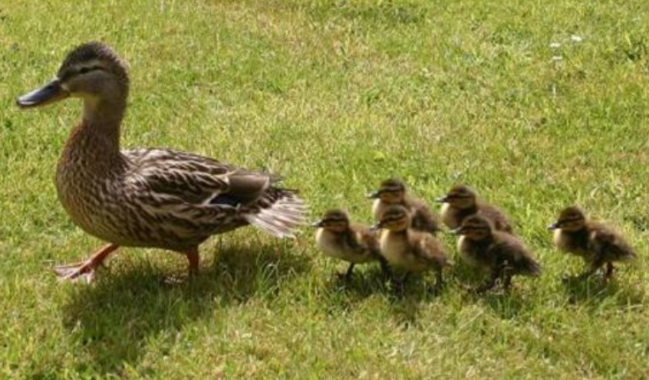
Imprinting

Slide 76
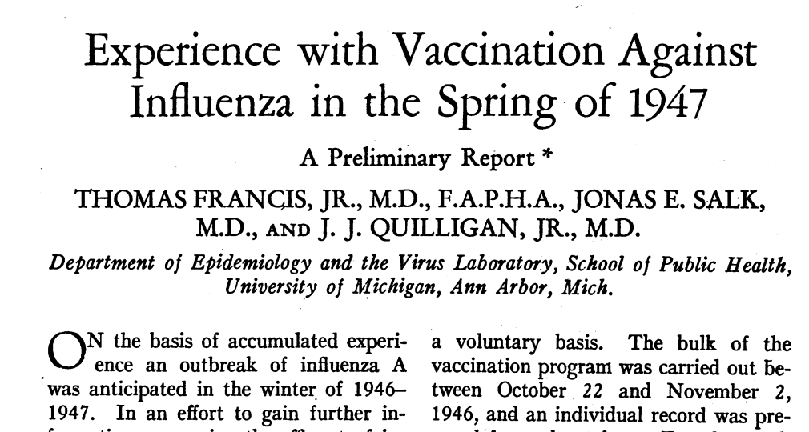
Francis, T., J.E. Salk, J.J. Quilligan, American Journal of Public Health (1947) 37: 1013-1016

Slide 77
Original Antigenic Sin (Imprinting)
Wuhan-1 and omicron variants share epitopes on the SARS-CoV-2 spike protein.
People primed and boosted with Wuhan-1 mRNA, when then boosted with a bivalent vaccine containing both Wuhan-1 and omicron-specific mRNA, will preferentially respond to those shared epitopes.
Imprinting makes it more difficult to respond to novel epitopes on the omicron strain, especially when those two vaccines are given simultaneously in the same vial.

Slide 78
Reason # 4:
Likening SARS-CoV-2 virus to influenza virus

Slide 79
June 15, 2023:
FDA Vaccine Advisory Committee considers updating Covid-19 vaccine

Slide 80
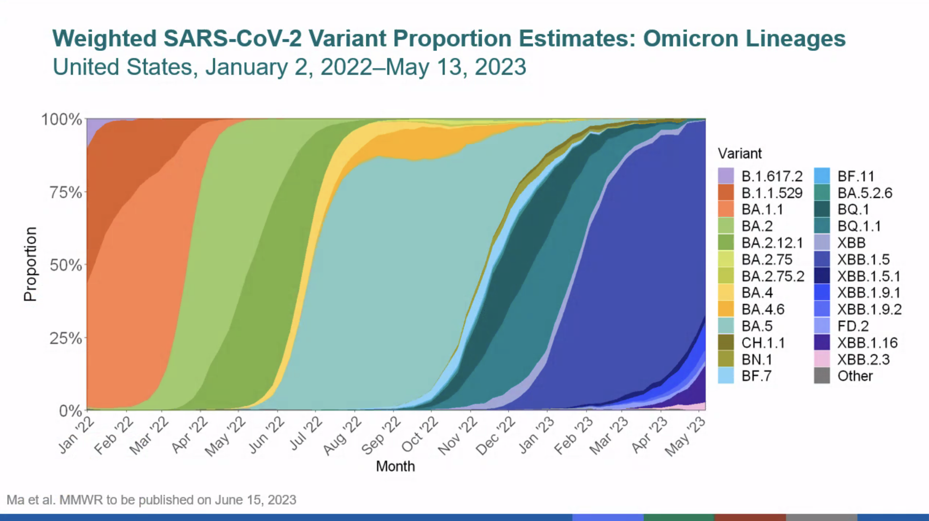

Slide 81
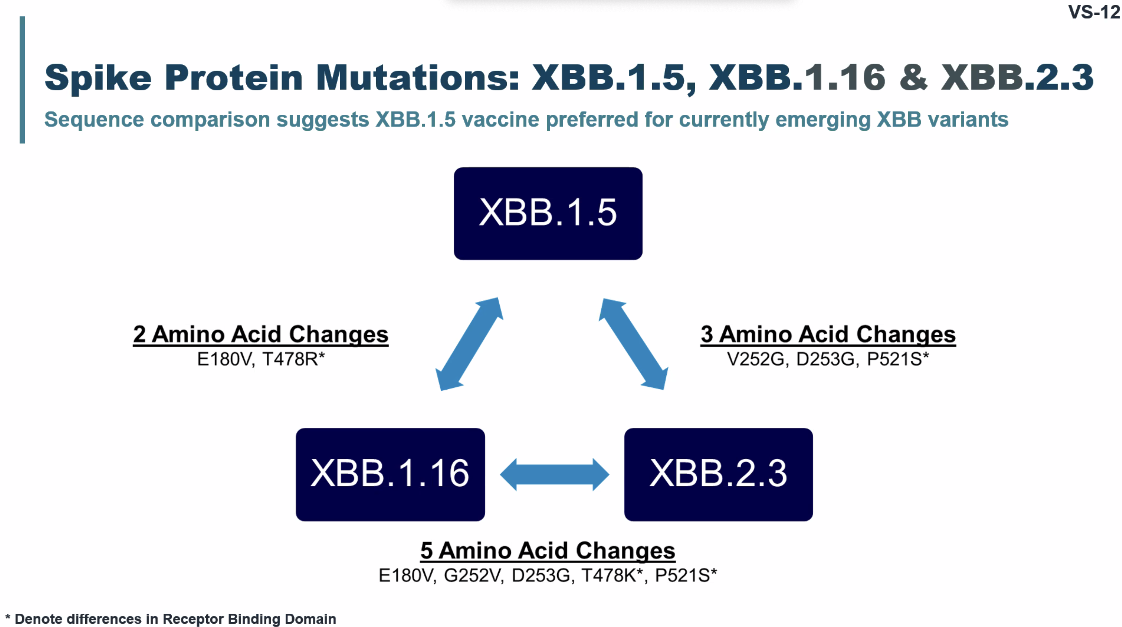

Slide 82
June 15, 2023:
FDA Vaccine Advisory Committee recommends monovalent vaccine containing XBB.1.5 for “2023-2024 campaign”

Slide 83
Influenza vs. Covid-19
Every year, in March, FDA Vaccine Advisory Committee determines strains to be included in a yearly influenza vaccine. Decisions are largely based on strains circulating in countries whose winters precede those in the U.S.
If the committee is wrong, which has happened three times in the past 20 years, protection against severe influenza is poor.
Unlike influenza virus, where vaccination or natural infection the previous doesn’t protect against severe disease the following year, protection against severe Covid-19 has held up in healthy young people.

Slide 84
We are at a different stage of this pandemic

Slide 85
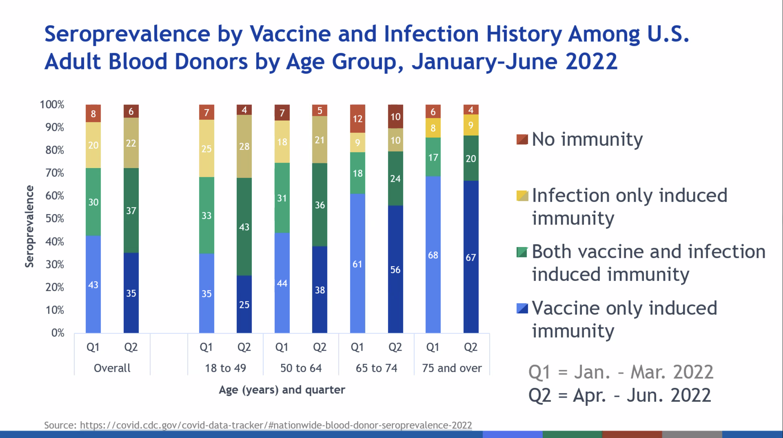

Slide 86
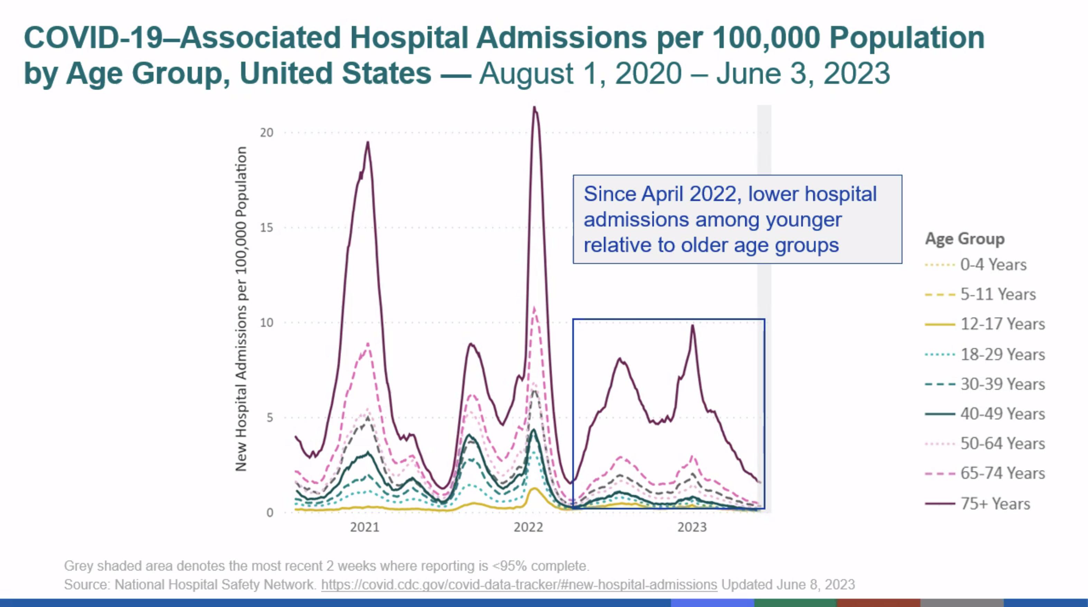

Slide 87
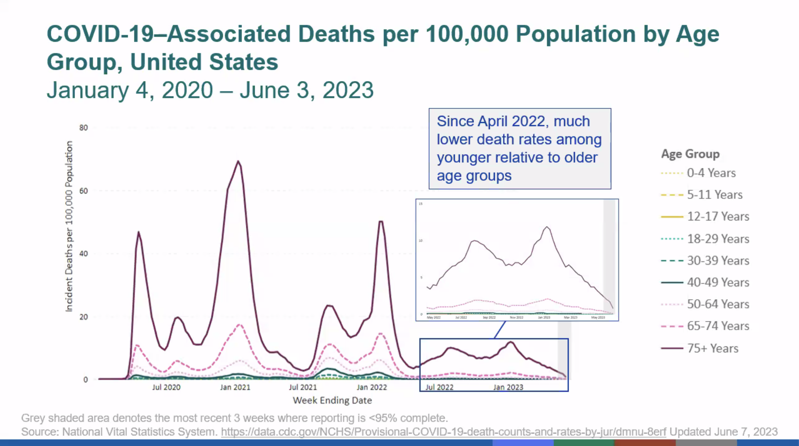

Slide 88
The future of booster dosing
How long does vaccine-induced protection against severe Covid-19 last for otherwise healthy young people?
Right now, the best strategy is a yearly vaccine for those groups at greatest risk of severe illness: 1) the elderly (those greater than 75 years of age), 2) immune compromised persons, 3) people with multiple comorbidities, and 4) pregnant people.
The CDC, in concert with academic immunologists, needs to determine who is at greatest risk moving forward. Then, and only then, will we know who most benefits from vaccination.

Slide 89
Restoring faith in public health agencies
Trust the American public to understand that we learn as we go.
Make it clear that recommendations are based on what we know at the time and that these recommendations might change with more data.
The beauty of science is that it doesn’t lock into an unshakable belief but rather is always evolving, self-critical, and introspective.

Slide 90

Find us online: vaccine.chop.edu

