Slide 1
Building Immunity By Building Community
A Cross Agency Collaboration to Promote Vaccine Confidence with Diverse Communities
Notes:
This project is a collaboration among four organizations - with OHA providing the funding, ORPRN providing project management and outreach support, Boost Oregon providing outreach and content expertise, and OAFP providing provider and community outreach, financial management, and some clinical consulting.

Slide 2
Today’s Objectives
1. Recognize how to develop, launch, and implement successful vaccine confidence workshops or similar projects
2. Identify key components of vaccine confidence events
3. Analyze how to create a logistical structure for program success, implement recruitment and outreach techniques for both community-based organizations and vaccine educators, determine staffing strategies, and scale similar work to fit communities’ needs

Slide 3
How we got here

Slide 4
2020
State’s response centered community-based organizations
Information on health conditions emerged as a need for many of them (disinformation was widespread)
As the vaccines came out, multiple channels needed to share information widely
OAFP has primary care members; Boost Oregon has vaccine confidence educational expertise; ORPRN has project management expertise, credibility in the community and a contractual relationship with OHA
Notes:
Objective a clinician shared that we hadn’t thought of: any opportunity for a clinician to talk to community is an opportunity to build back trust in health care more broadly; that trust took a real beating during the past couple of years.

Slide 5
Goals of Our Project

Slide 6
Project Goals
1. Engage community-based clinicians in the work of pandemic response
2. Build community confidence in the COVID-19 vaccine and in organizations trying to work together to address the pandemic
3. Build connections among CBOs, community clinicians, and the OHA public health division
4. Work with CBOs to develop community-responsive approaches to the education events.
Notes:
Objective a clinician shared that we hadn’t thought of: any opportunity for a clinician to talk to community is an opportunity to build back trust in health care more broadly; that trust took a real beating during the past couple of years.
Building confidence in this vaccine might have a halo or at least preventive effect on other vaccines

Slide 7
Building Immunity By Building Community Project
Project Description:
Oregonians need trusted messengers to help them make informed decisions about the COVID-19 vaccine
We trained clinicians to provide collaborative workshops on the COVID-19 vaccine throughout the state.
Contracted from January 2022 to June 2023
Notes:
Project dates: January 2022 through June 30th, 2023.

Slide 8
Workshop Objectives
Create a safe, comfortable, and fun environment to learn about COVID vaccines without judgment.
Explore the ways that individuals make decisions.
Learn how COVID vaccines work, how they were made, and how they are monitored.
Review COVID vaccine side effects.
Answer community members' questions.
Adjust workshop according to community needs.

Slide 9
How Did We Do It?
Notes:
MEGHAN START
Our goal is to get people talking and thinking critically about the vaccine and their own assumptions about it; not to try and persuade them to get the vaccine. They must persuade themselves. Avoid the righting reflex.
CDC and WHO recommend a MI approach.
Talking with Patients about COVID-19 Vaccination | CDC
Conversations to Build Trust in Vaccination: A training module for health workers. WHO Presentation. May 2017. TrainingModule_ConversationGuide_final.pptx (live.com)
McLure, C, et al. Vaccine Hesitancy: Where We Are and Where We Are Going. Clinical Therapeutics. Volume 39, Issue 8, August 2017, Pages 1550-1562.

Slide 10
Components of BIBC
Working as a multidisciplinary team
Recruiting clinicians
Recruiting community-based organizations
Forming partnerships and facilitating workshops
Follow up and tracking
Notes:
MEGHAN We met biweekly and communicated through email and Teams. We shared documents and work on Google Drive. Once recruitment of CBOs started happening, the three of us doing recruitment met biweekly as well.
Recruit providers
Train the providers
Find interested CBOs
Set an info/intro meeting
Reach out to trained providers
Set up logistics meeting with provider and CBO
Complete workshop
Collect and input surveys
Send evaluation forms to both CBO and providers
Make adjustments to program as needed

Slide 11
Clinician Recruitment and Training
Goal of 20 clinicians
Multiple avenues of recruitment
Training offered 3x live and on-demand afterward
Toolkit and support offered by Boost Oregon
Notes:
MEGHAN Clinicians include physicians, therapists, residents, nurses, and anyone with patient/client-facing experience. Recruitment via newsletter, email, word-of-mouth, website, flyer. Toolkit housed trainings, examples of workshops, facilitation guides, slide decks, etc. There were also several debriefs, and clinicians had the opportunity to ask questions and receive support from Ryan by scheduling or submitting a form request. Incentives for participation included $1,000 stipend and CME. Clinicians were provided all necessary materials and encouraged to tailor them to their comfort and their personal experiences.

Slide 12
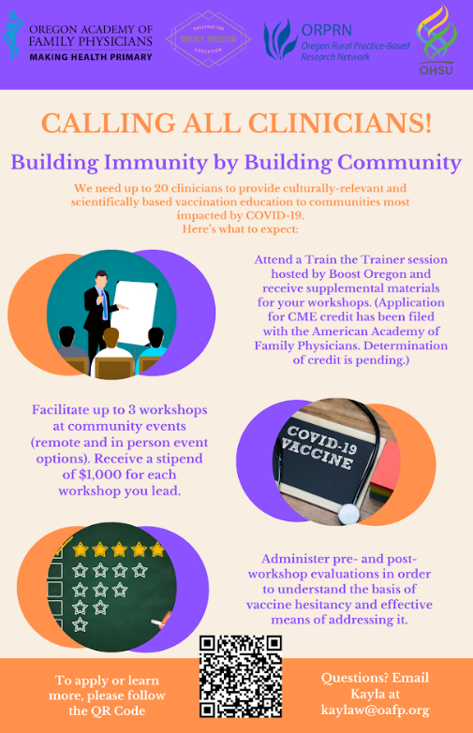
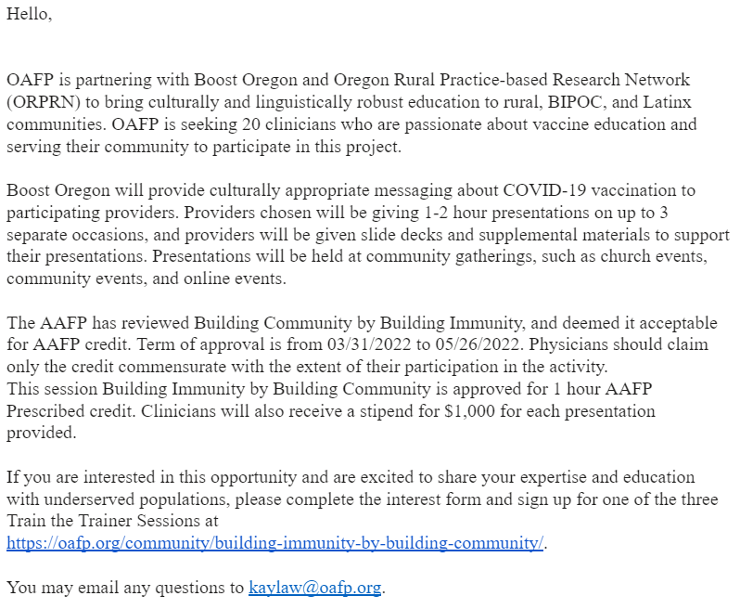
Clinician Recruitment Materials
Notes:
MEGHAN Project, expectations, incentives, and link to applications.

Slide 13
Training Format
1 hour virtual meetings on Zoom, recorded for future reference
2 breakout sessions for participants to practice in pairs
3 total sessions
Notes:
MEGHAN Format
3x 1 hour trainings, recorded, with 2 breakout sessions

Slide 14
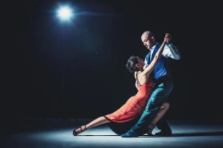
Emphasizing the Approach:
Dancing, Not Wrestling
Notes:
MEGHAN The first part of the trainings were focused heavily on how to approach a workshop. We needed to make it clear that this wasn’t about just educating a group of people with facts; it was about creating a safe atmosphere for mutual respect and collaborative learning. This meant helping connect with the audience.
An MI interview is a give and take. You respond to your patient and move with them as they navigate their own ideas about the vaccine, while gently steering the conversation towards change talk and vaccine confidence.
Also discussed cognitive bias in depth, emphasizing that facts don’t persuade

Slide 15
Practicing Reflective Statements
Reflection: Offer back what the patient has said, or what you think they mean in the form of a statement:
“I don’t want to get that vaccine right now.”
“You’ve got some hesitations.”
Notes:
MEGHAN Breakout room to practice reflections

Slide 16
Break Outs
I want to wait until he’s older. He’s just so small.
You’re worried about side effects, and you also want to protect him from the disease.
I’m letting her decide whether to get it or not.
You want to honor your child’s autonomy and help her learn to make informed decisions about her healthcare.
Notes:
MEGHAN
End with sustain talk. Reflections encourage people to keep talking. Patients are more likely to talk about the last thing you said, so finish with why they want to get the vaccine.
Affirmation. Opening the door for change talk by bringing in the idea of an informed decision.

Slide 17
“Yes, but what about the actual information?”
Least important component
We were training content experts how to communicate
Salient concerns were always changing anyway
Notes:
MEGHAN
asked in 2 trainings “Yes but what about the actual information?”
we had to emphasize that the content was the easy part; with practice in breakout sessions people started to understand that they didn’t need to be experts, they needed to make a connection.
We provided frameworks for debunking and reframing common vaccine myths
Providers were also able to reach out afterwards for any additional questions from their audiences they needed answers to

Slide 18
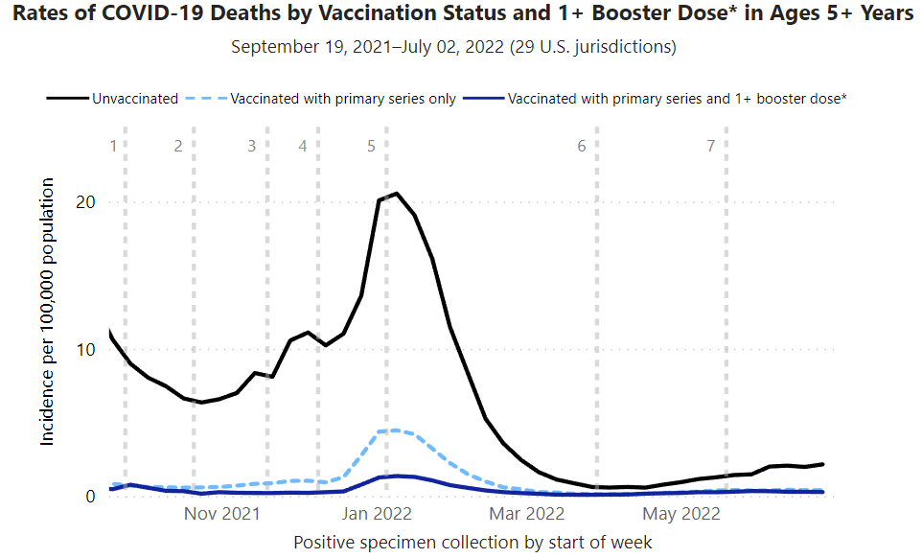
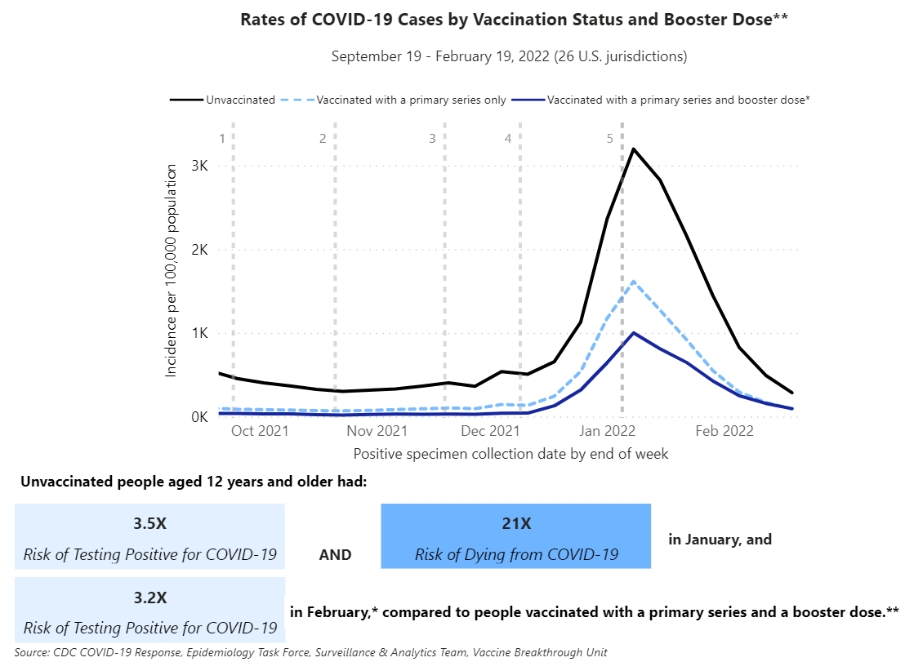
Notes:
MEGHAN
Infographics help reframe audience thinking and debunk myths

Slide 19
Notes:
MEGHAN
Live attenuated: MMR, VAR, rota, OPV, intranasal flu
Inactivated: IPV, hep A, flu, rabies
Part of pathogen: HPV, Hep B, shingles, DTaP, pneumococcal, meningococcal
Genetic code: COVID
Making Vaccines: How Are Vaccines Made? | Children's Hospital of Philadelphia (chop.edu)

Slide 20
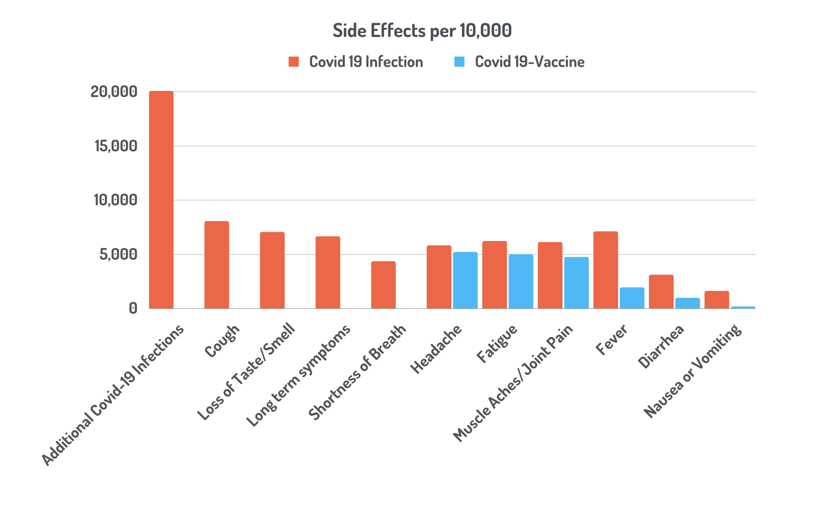
Notes:
MEGHAN
These graphs are designed to reframe the way people think about vaccine side effects

Slide 21
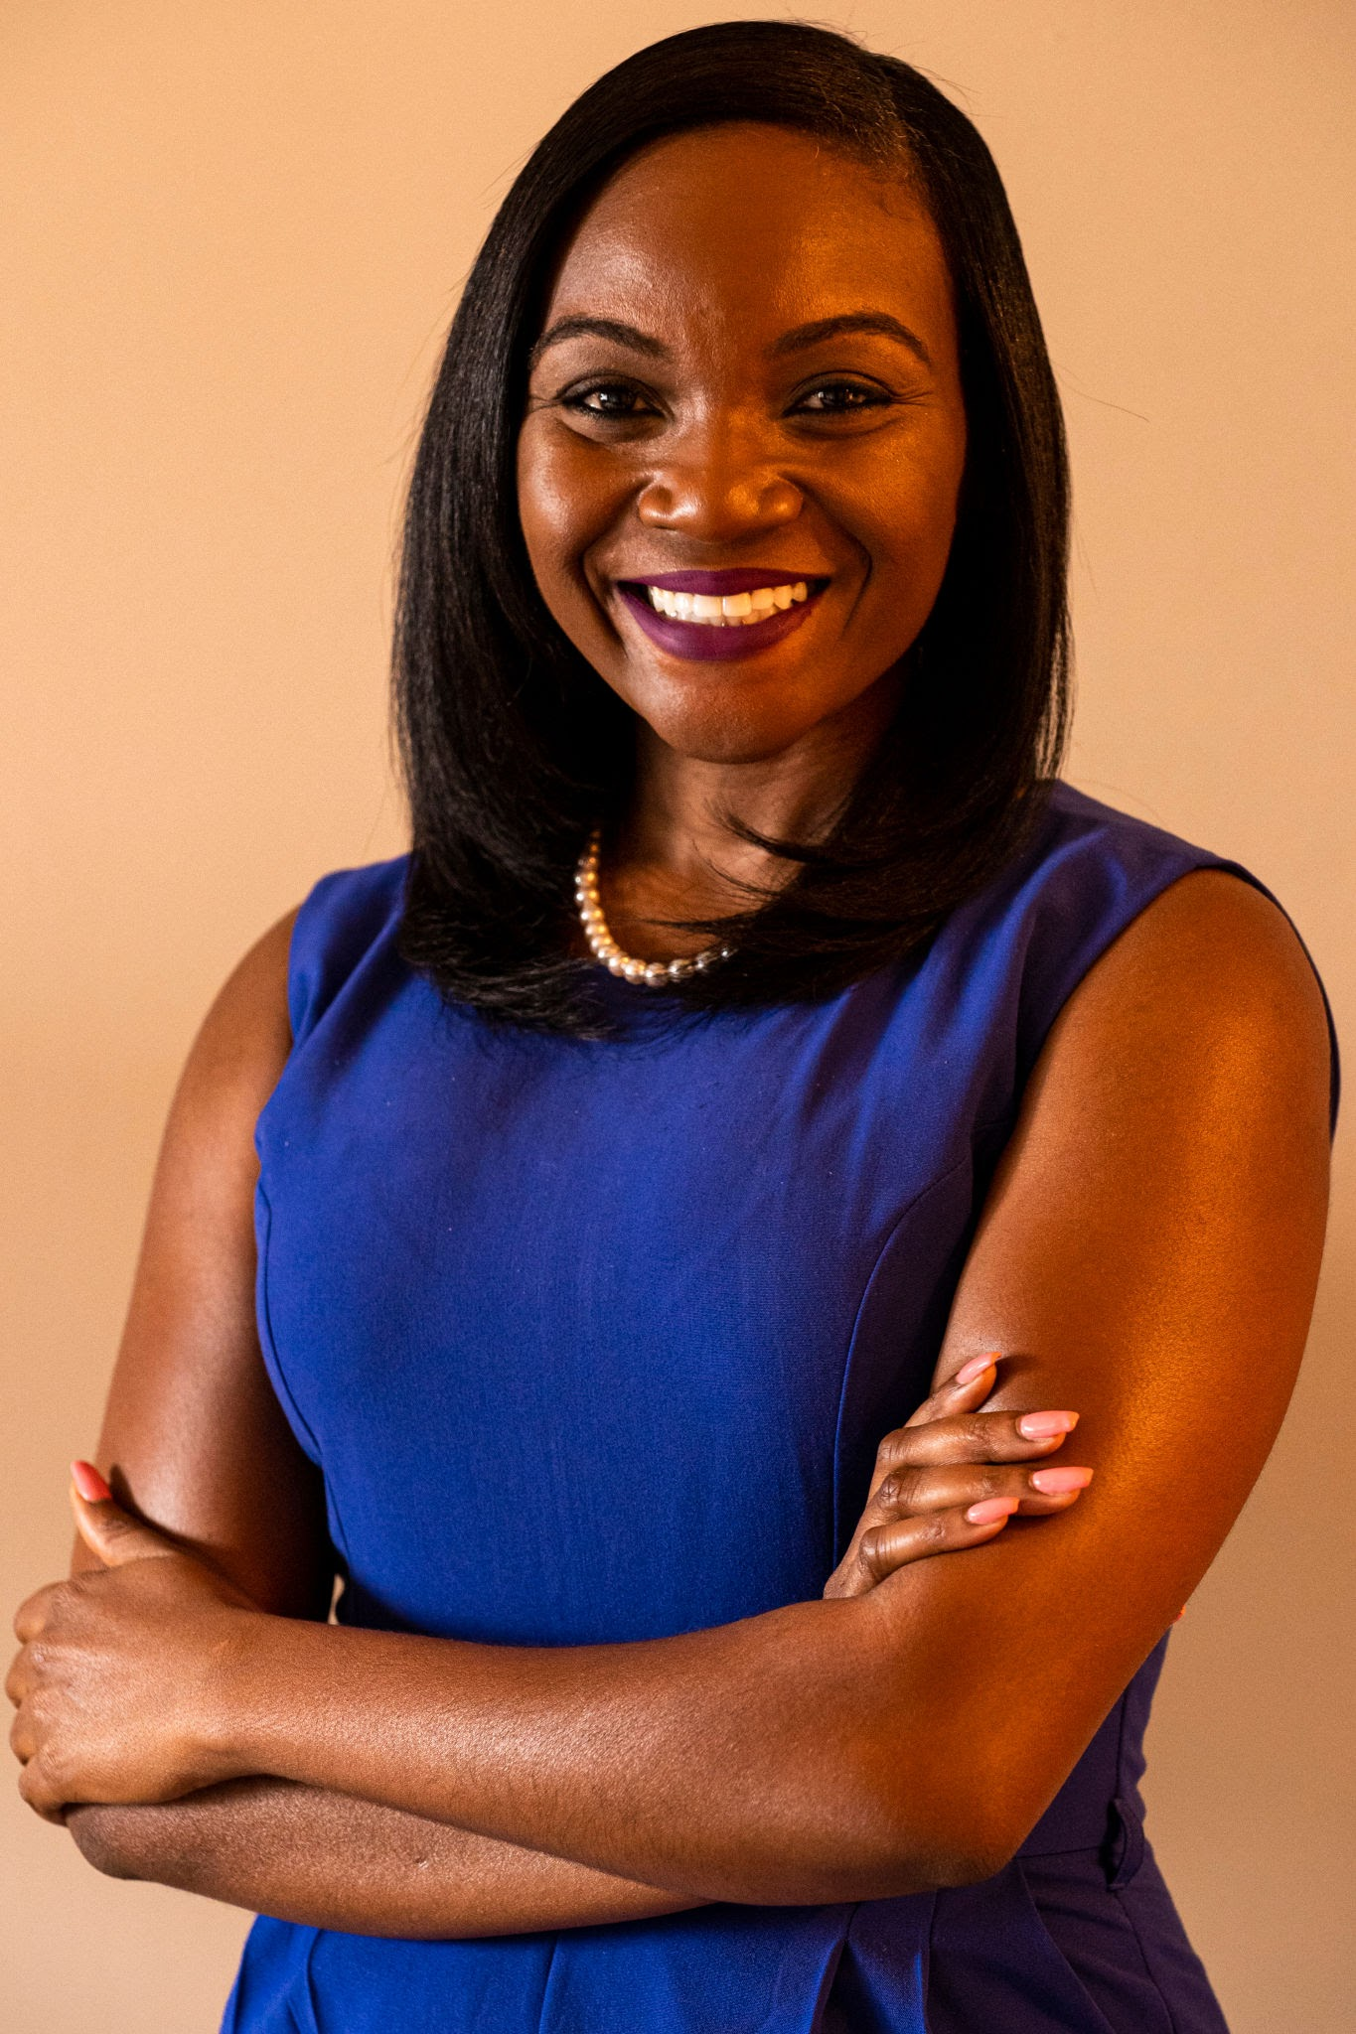
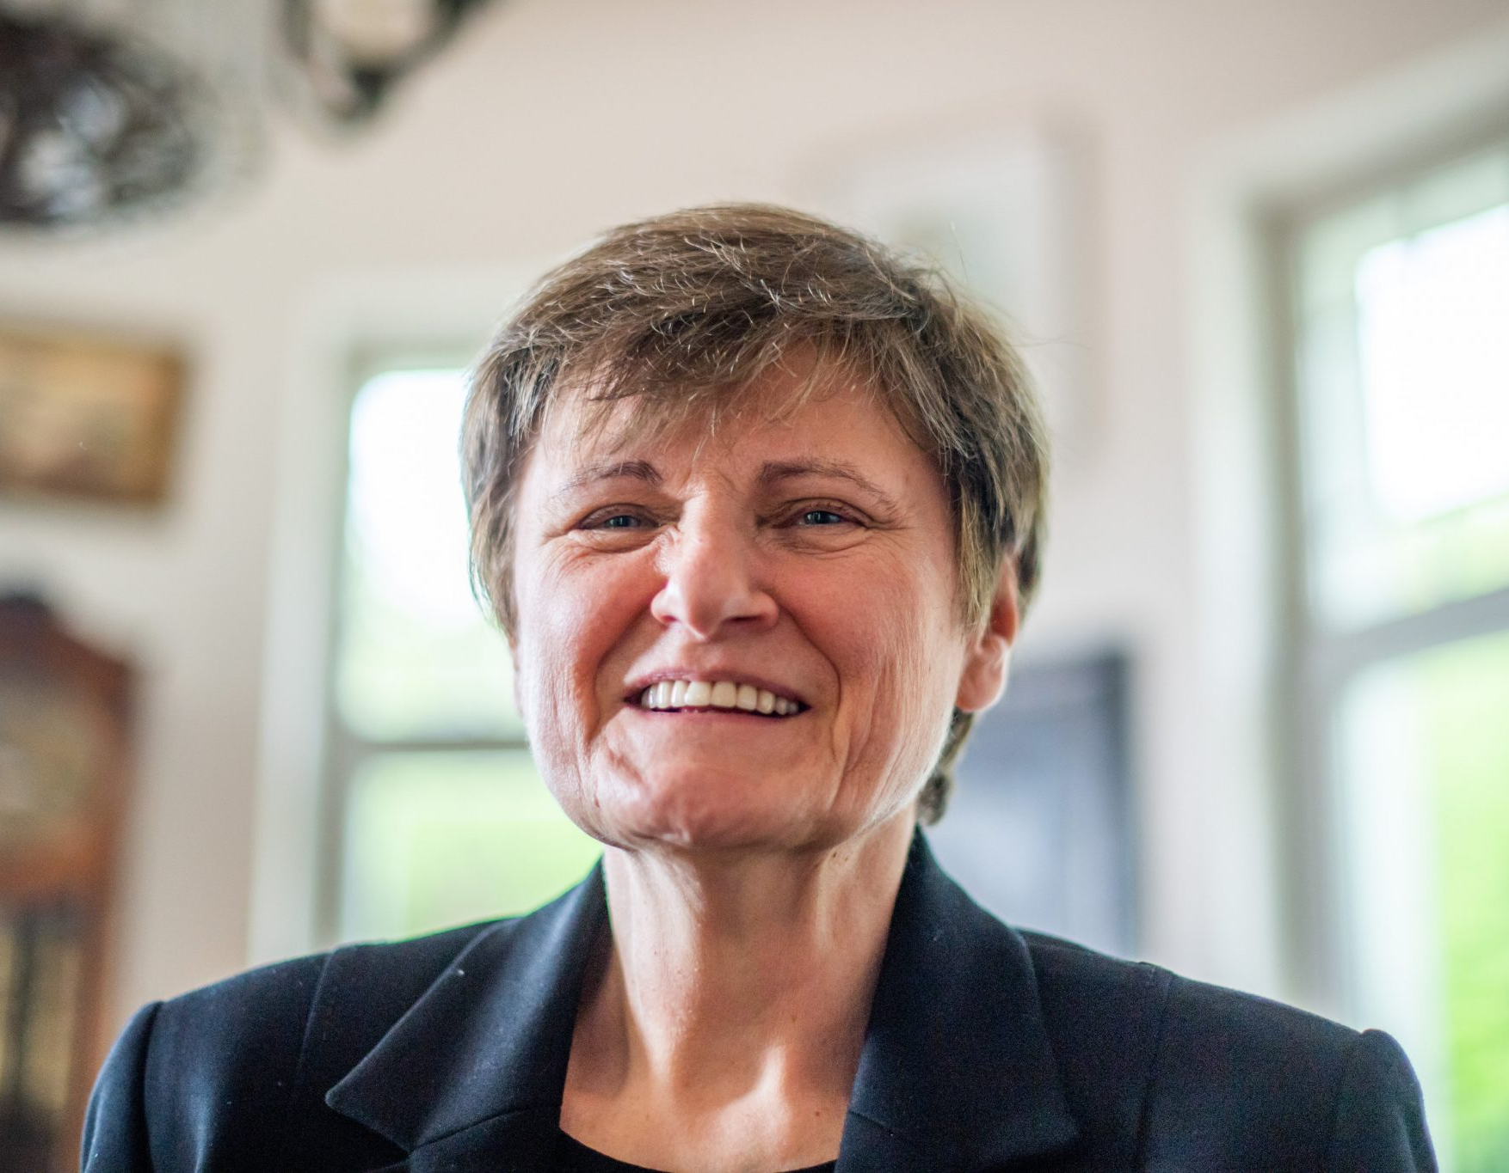
Defining Success: Setting Clear Expectations
Notes:
MEGHAN
I shared the stories of Drs. Katalin Kariko and Kizzmekia Corbett to prepare people for the fact that this work is often challenging and underappreciated, but always helpful

Slide 22
Recruiting Community-Based Organizations
Create a directory
Develop a template and flyer
Email hundreds of potential organizations
Informational meetings
Determine dates
Schedule and pair with a clinician
Logistics Meeting
Notes:
MEGHAN Contacted over 350 CBO’s. Contact 3x before considering it a no. Logistic meetings are about 45 minutes. Info meetings are 15-30 minutes. We provided assistance with translation in languages other than English and had the surveys and flyers translated for events in Vietnamese, Cantonese, and Russian. CBOs could choose between lecture and fireside chat style for presentation.

Slide 23
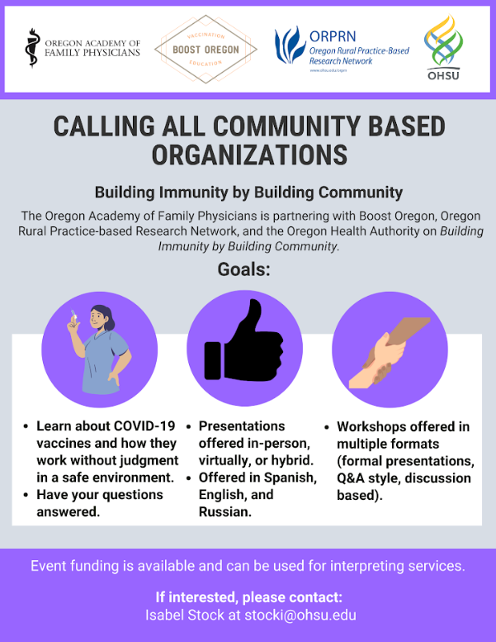
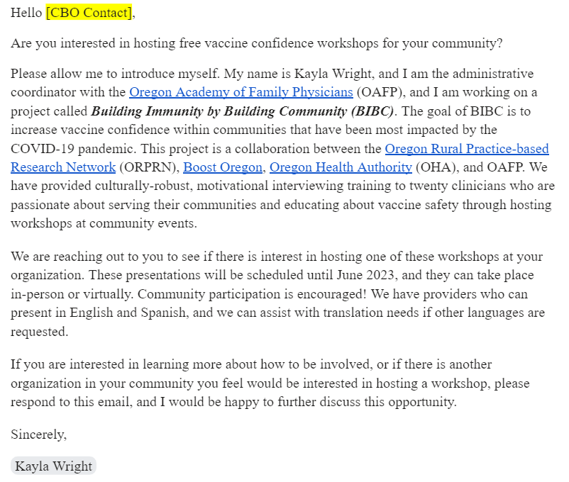
CBO Recruitment Materials
Notes:
MEGHAN We gave a flyer to each CBO that looked like this.

Slide 24
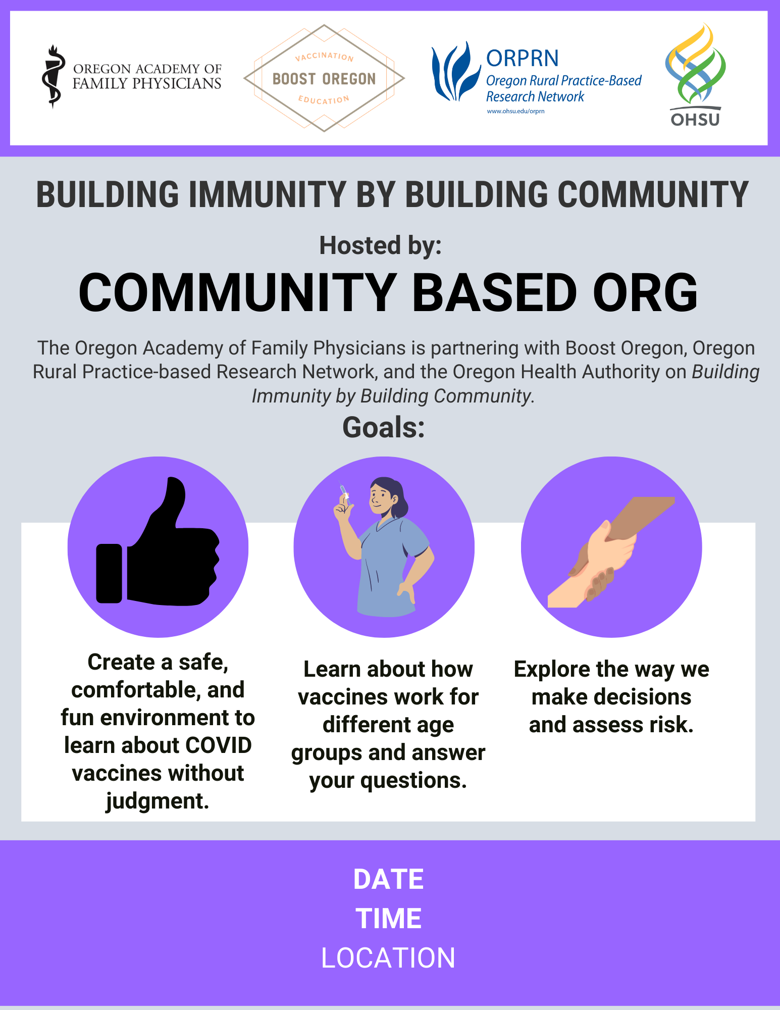
Notes:
MEGHAN This is the flyer we presented to Community Based Org - It was also available in Spanish, Vietnamese, Russian, and Cantonese

Slide 25
Information Tracked
Pre- and post- workshop insights from participants
Provider feedback
Provider questions
CBO feedback
Time and activities of project team
Stipends for clinicians and assistance for CBOs
# of workshops
Lessons learned
Notes:
MEGHAN This project was one that built on the needs of our clinicians and CBOs and was responsive to community needs.

Slide 26
Our Results
Notes:
ISABEL START

Slide 27
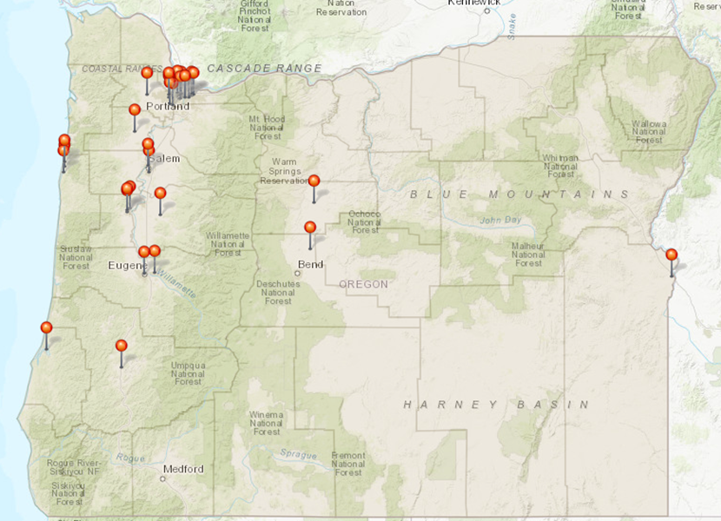
Workshop Locations
Notes:
As Meghan mentioned, approximately 350 community organizations were contacted, and around 80 asked for information. While 54 total were scheduled, only 44 actually took place. There were 10 that cancelled for various reasons, with the most cited reasons being low turnout expectancy or the community expressing that this content is no longer a need for them. We worked with our funder to approve adding 3 additional presentations that included the workshop content but were delivered to providers at a conference or through a webinar.
As you can see from the map, we had a hard time engaging the southern and eastern Oregon communities, however this was not a lack of effort from our team.
We also surveyed 21 of the CBO’s through a feedback form after the workshop. The information we gathered was intended to understand changes we needed to make to the content and the likeliness of the CBO to host a future workshop.

Slide 28
Community-based Organizations
Latino/x, Black or African Somali, Native American, Pacific Islands, elderly, chronic or terminal health, LGBTQIA2S+, houseless, and immigrants
Attendance range: 0 - 30+
Most were held in-person
Overall positive feedback from CBO’s
Future considerations
Notes:
Most of our CBO’s reported serving latino communities, specifically low income. However we had CBO’s representing communities of Black or African Somali, Native Hawaiian, Pacific Island, elderly, those who have chronic or terminal health conditions, LGBTQIA2S+, houseless and immigrants in general.
Attendance ranged anywhere between 0 to 30 or more participants and most were held in-person at the CBO’s primary location but some did host at a restaurant or rented room.
Overall the feedback we received from CBO’s was positive. CBO’s expressed their appreciation for having direct access to healthcare providers and felt like their workshop was successful due to providers being able to meet the cultural and linguistic needs of their community members. CBO’s also expressed that they liked the design of this workshop and that they would be interested in future workshops like this in other topics such as: mental health, substance use and addiction, diabetes and more.

Slide 29
Participant Responses
Notes:
Now let’s take a look at the survey responses from the community participants that attended the workshops. Disclaimer, the data I am going to show you today is only from 17 of our 44 workshops and this is because around March of 2023 we were evaluating the survey data from the first 27 workshops and we discovered that a good amount of participants were leaving the workshops early or not completing a post workshop survey. It was hard to analyze and understand trends in our data without a matching pre and post survey from participants.So after the first 27, we had the clinician speakers who were the ones administering the surveys, to instruct participants to include some type of matching anonymous identifier on each of their surveys. We did not have the speakers or CBO’s count the number of participants at each workshop but we think we had approximately 410 participants given the number of surveys returned. There were approximately 270 participants that attended the first 27 and 140 from the last 17.

Slide 30
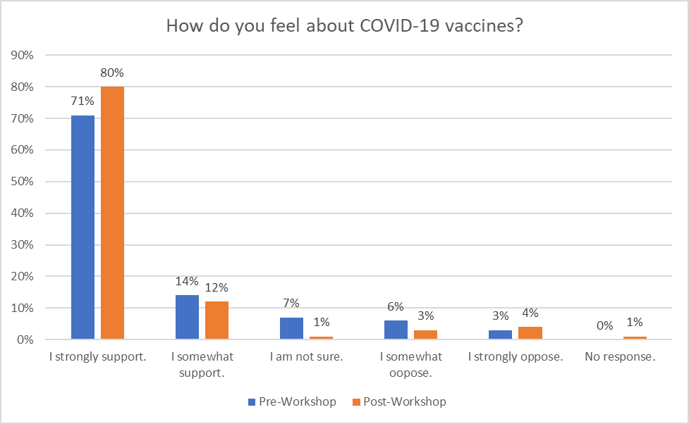
Matching Pre/Post Survey
N= 140
Notes:
This graph illustrates that participant’s feelings regarding COVID-19 vaccines improved as a result of participating in the workshop. 71% participants said that prior to the workshop they strongly support COVID-19 vaccines. After the workshop, more participants said that they strongly supported COVID-19 vaccines (80%).

Slide 31
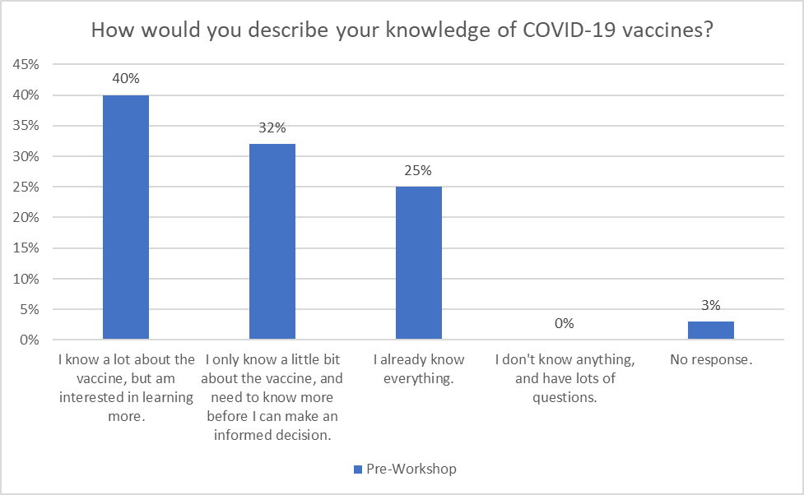
Notes:
In the Pre-workshop question we asked, “How would you describe your knowledge of COVID-19 vaccines? 40% indicated they know alot about the vaccine but are interested in learning more. 32% only knew a little about the vaccine and need more information before making an informed decision, 25% already knew everything, No one responded saying they didn’t know anything and had lots of questions and 3% did not respond.

Slide 32
Notes:
In the post workshop survey we asked, “how would you describe your knowledge of COVId-19 vaccines?” 80% said they learned more about COVID vaccine and got all or most of their questions answered. 9% said they learned more about COVID vaccine but still had some questions, 7% already knew the information that was presented, 1% did not accept the information that was presented and 3% did not respond.

Slide 33
Notes:
We asked the participants their vaccination plan before and after the workshop and these are their responses. 62% responded saying that prior to the workshop they had received a COVID-19 vaccine and booster and 64% responded saying that after the workshop they had received COVID-19 vaccine and booster. Note that several workshops were integrated into vaccine events. 16% said they already took the COVID-19 vaccine and plan to get the booster before the workshop and that changed to 15% after the workshop. 8% indicated in the pre-survey that they took the COVID-19 vaccine but will not get the booster and that changed to 6% in the post workshop survey. 5% indicated in both the pre and post survey that they did not plan to get the COVID vaccine.

Slide 34
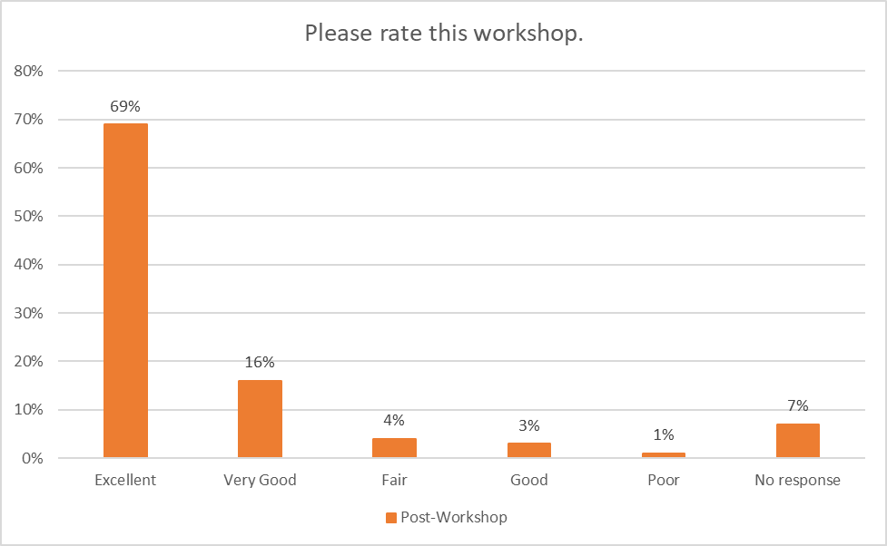
Notes:
Overall, participants indicated that they thought our workshop was excellent.
We also had open-ended questions such as what is/are the reason’s you have chosen not to get the vaccine or booster? With the majority of respondents saying the question was not applicable to them, the most common response was that they were worried about the possibility of unknown side effects or concerned about the safety of the vaccine. Others also indicated that they didn’t feel like they needed to protect themselves from COVID and/or didn’t think COVID was a problem.

Slide 35
Lessons Learned
Accurate and timely data
Lack of specific vaccination rates
Contract timing
“You’re too late”
COVID-19 fatigue
Utilization of funds
Food, childcare, participant incentives
Relationships matter
Notes:
The first lesson we learned, which I think most people in this room probably already know, is that having accurate and timely data is important. What we found though was that communities needed specific data for the populations they serve. For example we worked with a Filipino and Marshallese organization and vaccination data for these populations are grouped within data for Asian American, Pacific Islanders and Native Hawaiian communities. This wasn’t helpful for the organizations because these communities all have different experiences and perspectives related to immunizations and healthcare in general.
The timing of contracting this work is also really important. Putting together a contract like this takes time and we didn’t get this work off the ground until the middle of 2022. We got a lot of feedback from invested partners saying that we were a little late to the party. A lot of CBO’s also chose not to host a workshop because they felt like their community members had COVID information fatigue and had already made up their mind about whether or not to get the vaccine.
I think the area that we got the most feedback was our limitation in how project funds could be utilized. Most CBO’s expressed a desire for childcare, food and other types of incentives that are culturally appropriate and necessary when gathering community members. For example, gathering around food is a cultural norm for many of the communities we worked with so not being able to provide that was a huge limitation to the project.
And lastly, relationships matter. While we have been doing better, historically public health and health care organizations have not been great at engaging with community-based organizations. Investing in relationships with CBO’s, such as establishing trust and credibility, was something our team spent most of our time doing.

Slide 36
Conclusion
Community collaboratives can work
Listen to your community
Invest in relationship building
Boost is open to collaborating on new projects with any interested organizations
Notes:
I think one of the most important things we learned is that community collaborations like BIBC can work and have great capacity to improve health outcomes. Listening to your community and understanding their needs is extremely important in making sure that you have the right people in the room and the resources needed for that particular community. Another very important step is investing in relationships. And what I mean by that is the relationship between public health agencies and community organizations. We could not have done this work without the community organizations and their trust in public health. We need to continue to put effort and prioritizing ways we can bridge the gap between public health, our healthcare systems and the communities throughout Oregon
Lastly, Boost is open to collaboration on new projects so I will pass it back to Meghan to share a little more about that.

Slide 37
Want to Learn More?
Boost Oregon now offers Motivational Interviewing training
Free 1-hour Monthly Sessions
4-6 hour Introductory Training
12-14 hour Comprehensive Training
MI Skills Development with Individual Feedback
3-6 months of Organizational MI Support
Learn more at: https://www.boostoregon.org/motivational-interviewing
Notes:
MEGHAN

Slide 38
www.boostoregon.org
facebook.com/boostoregon
Twitter: @boostoregon
Instagram.com/boostoregon
Notes:
MEGHAN: Check out our website for Parent handouts and educational videos available for you to share for free - Open for Q&A if time allows

