Slide 1
Anatomy of a Vaccine Encounter: Immunization Protocols and Administration Tips
August 8, 2023
Notes:
Greetings everyone,
Thank you for joining Jill and I today for this session. We are happy to be here to present on the Anatomy of a Vaccine Encounter. I am Wendy Neu, my pronouns are she/her and I’m a nurse consultant with the Oregon Immunization Program.
Today, I will cover the anatomy of an Oregon Immunization Program protocol and VAERS. Jill will close the presentation with best practice for vaccine administration and share trusted resources and clinical reference materials.
So let’s get started.

Slide 2
Objectives
Provide an overview of the structure and use of Oregon Immunization Protocols.
Describe what to do after a vaccine error or adverse event occurs.
Review best practices for vaccine administration.
Offer techniques to reduce distress and pain.
Recommend positions for comfort and safety.
Share trusted immunization resources and useful clinical reference materials.
Notes:
The Objectives for our presentation are…

Slide 3
Anatomy of an Immunization Protocol
Notes:
Anatomy is the art of separating the parts of something to discover its structural makeup. Anatomy helps us better understand its purpose.
In this case, our something is an Oregon Immunization Protocol. Let’s do a little dissection of Oregon’s Immunization Protocol and discuss its purpose.
We’ll also discuss when it is important to follow the protocols to the letter vs when you will want to use your best clinical judgement.

Slide 4
What is a Protocol?
Protocol (noun)
pro·​to·​col ˈprō-tə-ˌkȯl -ˌkōl, -ˌkäl, -kəla
. . . 4. A detailed plan of a scientific or medical experiment, treatment, or procedure.
Notes:
When looking up the word protocol in the dictionary, Merriam-Webster offers a few meanings.
The meaning that best supports our use of the word is, ‘A detailed plan for a medical treatment or procedure’, such as giving a vaccine.
Protocols allow us to streamline clinic practices by avoiding the need for a doctor to write many vaccine orders for the patients they see.
Immunization Protocols provide content specific to each immunization and are designed to cover anything you might need when administering a vaccine. Including who should receive a particular vaccine and who should avoid a particular vaccine.

Slide 5
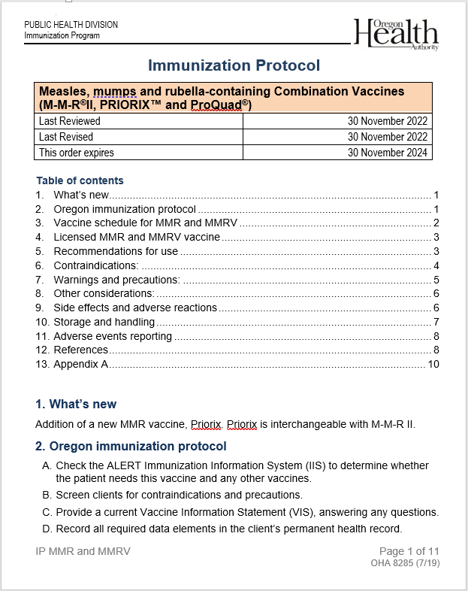
Parts of the protocol
Title block – trade names of vaccines included, date last evaluated (reviewed), date of most recent changes (revised) and expiration date.
What’s new – all the major changes, error corrections, etc.
Notes:
If you’ve been around for awhile, in the Oregon immunization world, you’ve likely noticed the reformatting of the protocols over the last 2-3 years. This was done to offer the user standardized sections. Today, no matter which protocol you open, you will now see a consistent standard flow of sections.
For example, when you open a protocol, you will always see the Title Block at the very top. This holds the trade names for each vaccine listed within the protocol, the date it was last reviewed, the date it was last revised and the date the protocol expires. These protocols have an expiration date on the last day of the month, two years from the date it was issued. This ensures our protocols are looked at every two years, even if there have been no changes to the vaccine.
Section 1 is the ‘What’s New’ section. This is where we will communicate all updated recommendations or changes to each vaccine.
In section 8 you will find ‘Other Considerations’ and it will always follow the ‘Contraindications and Precautions’ section. This standardization allows the user to get familiar with the format, so they know exactly where to go to find the information they need.
If you were with us during the COVID-19 pandemic, you experienced many updates and changes to the COVID-19 Immunization Protocol. Changes and updates to the protocols are something, we recognize, is time consuming for all involved. Not only for us, but also for the user, who is required to review changes and notify or educate the health officer and vaccinating staff of the updates. You have our word that we only update protocols because of changes or recommendations made by the FDA, ACIP or if an error within the protocol is identified and brought to our attention. Often, those errors are noticed by you, the user, and we thank you for bringing any potential errors to our attention.

Slide 6
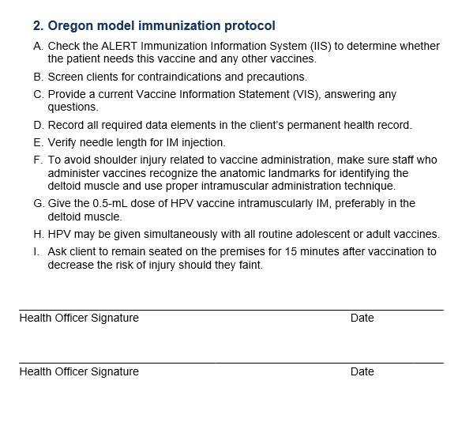
The protocol itself
Notes:
Section 2 is the actual protocol itself. It is a step-by-step process for administering the vaccine.
This is the page that must be signed by your health officer, medical director, or pharmacist.
Many of these steps are the same for all vaccines but they can vary based on specific vaccine recommendations. I’ll touch on a few of the standard protocol items.
Such as, when preparing for a patient visit, your first step will always be to determine whether the patient needs a vaccine. The forecaster in ALERT IIS or your electronic health record can help you decide if the dose is appropriate. If the dose is one of a series, the forecaster can tell you whether the minimum or recommended spacing has been met, if not, it will let you know when the next dose is due.
Step B is the very important next step, it is to screen the patient for contraindications or precautions. One of the most important things to know about giving immunizations, is knowing who NOT to give a vaccine to. Step C reminds the user to always provide a Vaccine Information Statement or VIS to the patient, parent, or guardian, and is standard for vaccine administration prior to providing the vaccine. Also included are reminders about record keeping, appropriate needle length, dosage, and as safe practice, we always want to ask that the patient stay seated on the premises for 15 min after vaccination just in case an adverse reaction occurs, such as fainting or difficulty breathing.

Slide 7
Supporting Information
Vaccine schedule
Licensed vaccines
Recommendations for use
Contraindications
Precautions
Side effects and adverse reactions
Storage and handling
Adverse events reporting
References
Appendix
Notes:
Everything you find on the protocol, after the Health Officer Signature page, is the Supporting Information. This includes the items you see listed on this slide. Just to name a few, you will see the vaccine schedule, recommendations, storage and handling, the references page and any appendices will be at the very end.
This is where you will find specific information and answers to the most common questions vaccinators have about administering vaccines.
You should find everything you need, in these supporting information sections, to administer a vaccine with confidence, safety and best practice.
Supporting information is compiled from a couple of sources. We use ACIP statements published in the MMWR, and we use the vaccine package inserts. On occasion, ACIP recommendations are different than the package insert. When this happens, we defer to ACIP guidance.

Slide 8
When do you need to follow the protocol exactly?
Notes:
So, when DO you need to follow the protocol exactly?
Certain things are non-negotiable. Such as minimum spacing. These time frames are guides that have been determined by super smart people, to achieve the best immunization coverage in an individual.
Contraindications are the most important non-negotiable. Like I mentioned earlier, we want to know who NOT to give a vaccine to. If a contraindication exists, do not administer the vaccine.
How about precautions? Are precautions non-negotiable? Nope, precautions are important though, and if a precaution is present in your patient, the provider should evaluate the patient to determine the risk factors before the vaccine is administered.
Storage and handling guidelines are also non-negotiable. These guidelines allow us to store vaccines in their optimal environment.
Sometimes situations are not clear cut. Your best judgement should always come into play when vaccinating. If something feels off, always choose safety for you patient and seek further information. Here, at the Oregon Immunization Program, we love getting your questions, please, never hesitate to reach us for assistance. We are not available 24/7, but no worries, at the end of our presentation, we will have some additional resources for seeking answers to your vaccine questions if we are unreachable during evenings, weekends or holidays.

Slide 9
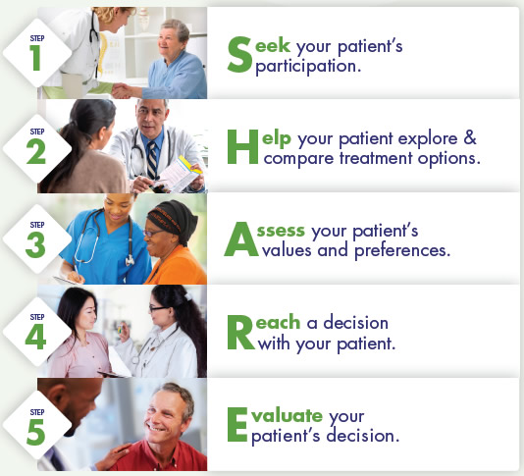
Clinical Judgement and Shared Clinical Decision Making
Notes:
Unlike non-negotiables, not everything is written in stone and that is where Clinical Judgement and Shared Clinical Decision Making enter the scene.
Clinical judgement is vital in ensuring that vaccines are offered when appropriate, while still ensuring patient confidence and safety.
Shared Clinical Decision-Making recommendations are individually based and informed by a decision process between the health care provider and the patient, parent, or guardian.
As the slide shows, you may have heard of the SHARE acronym. It offers these 5 steps when using shared clinical decision-making. By using these steps, the provider and patient should be able to proceed with confidence in the shared decision to vaccinate or maybe not vaccinate.
ACIP has four recommendations for vaccination based on shared clinical decision-making. We’ve recently included these criteria in the four protocols, and you will find them located in Meningococcal B, Hepatitis B, HPV and the Pneumococcal conjugate vaccine.
In this context, the CDC defines a health care provider as a primary care physician, specialist, Physician assistant, nurse practitioner, registered nurse and a pharmacist.
Let me offer an example here of situations you might use Shared Clinical Decision Making. When should an HPV vaccine be offered to a patient over age 26? Is this patient’s condition considered a risk factor? Can pregnant people receive this vaccine? With the guidance from the protocol and using Shared Clinical Decision Making, you and your patient or you and your patient’s parent or guardian should be able to reach an informed and safe decision to vaccinate or not.

Slide 10
Oops
Notes:
What isn’t covered in the protocols? Oops and errors are not covered!
You will not find a response to an oops or an error in the protocols.
Even with the best of intentions, errors are going to happen. Responding to a vaccine administration error depends on many factors and if we captured all the scenarios our protocols would be many pages long.
Depending on what was given, what should have been given, and the patient’s demographics, following an error, you may need to immediately repeat a dose, provide a different vaccine, or do nothing at all.
There are resources offered by CDC for learning how to respond to vaccine administration errors or storage and handling deviations, but again, here in Oregon at the Immunization Program, we love to hear from you. We can help you discover the best solution for Oops and errors in administration, inclluding those dreaded refrigeration issues.

Slide 11
4-day grace period
Notes:
The immunization Grace period…. Those of you familiar with the protocols, may wonder why there is no mention of the 4-day grace period. It has definitely caused some confusion, which is why we leave it out.
The grace period is only to be applied retrospectively, this is used when determining whether a dose, that has already been received, is valid. The grace period is not used prospectively – when scheduling return visits or making appointments.
In rare circumstances, such as when a person is traveling overseas, the 4-day grace period may be used to give a dose a day early to accommodate set travel arrangements.
Remember, it is always preferred to give a vaccine a little late than to give it too soon.

Slide 12
Notes:
Also not included in the protocols are those weirdy-boo situations rarely seen.
Such as, how do I vaccinate conjoined twins? Or how do I vaccinate my patient who has a full body cast?
If it exists, we’ve likely heard it and worked through it with you, but if it rarely comes up, you won’t find it in the protocol.

Slide 13
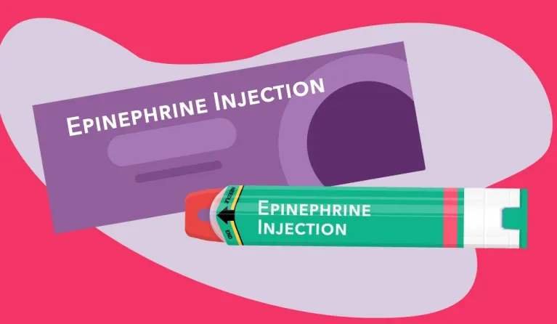
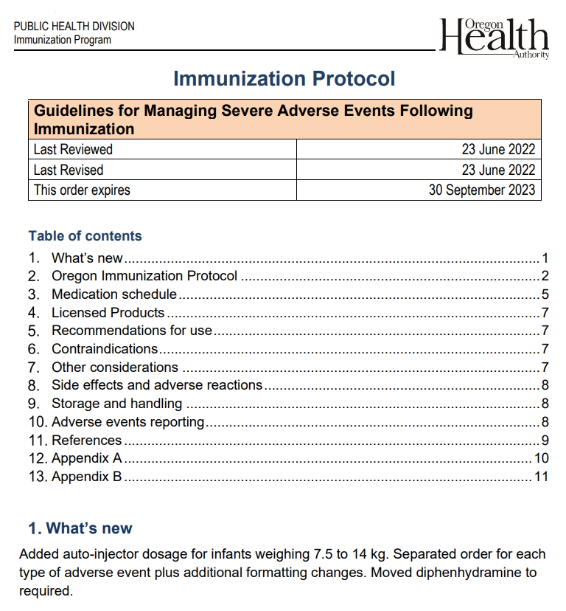
Responding to Severe Adverse Events
Notes:
Lastly, but no less important, the protocols do not include specific instructions for responding to an adverse event following vaccine administration.
Instead, we have a separate protocol for responding to anaphylaxis, hives, and fainting. It is called Guidelines for Managing Severe Adverse Events following Immunization. This protocol can be found at the top of the list of Oregon’s Immunization protocol web page.
It covers the use of epinephrine and Benadryl, plus some guidance to deal with anxious patients who are prone to fainting.

Slide 14
Are Oregon Immunization Protocols Required?
Notes:
The only group currently required to use our protocols are Oregon pharmacists. The Oregon Board of Pharmacy has adopted our protocols as their standard, although this may change in the future.
Any clinic that uses state-supplied vaccine is still required to follow our guidance regarding eligibility and who receives state-supplied vaccines.
In the past, we’ve required local health departments to use our protocols, this requirement has recently changed and now, any clinic is welcome to use the protocols at their discretion.
We’ve heard from people in other states who use Oregon’s protocols for guidance and even other countries, such as Sweden. GO Ducks! Oh wait, wrong crowd, GO Oregon!

Slide 15
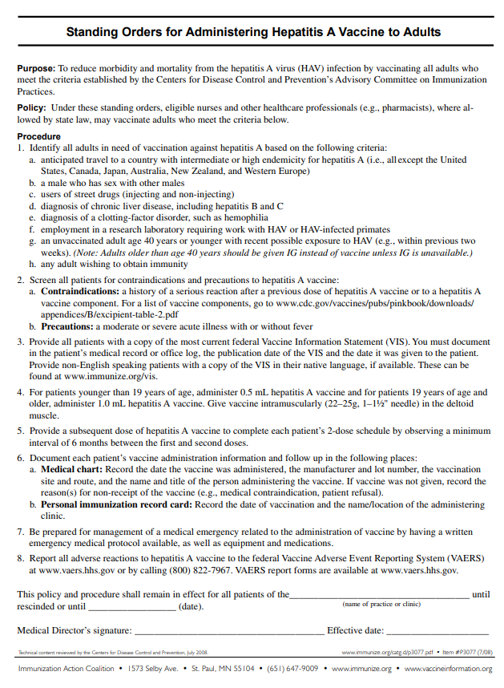
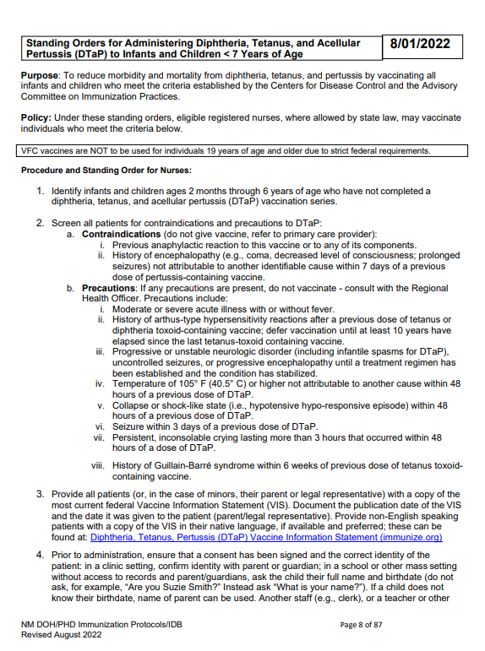
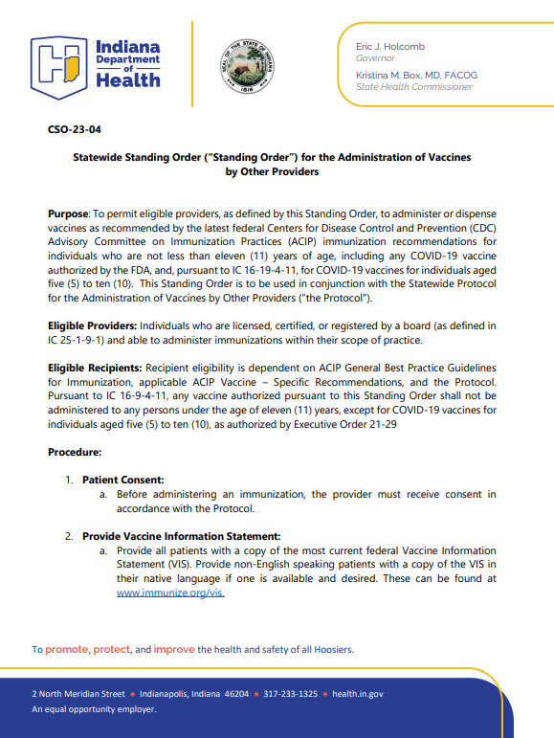
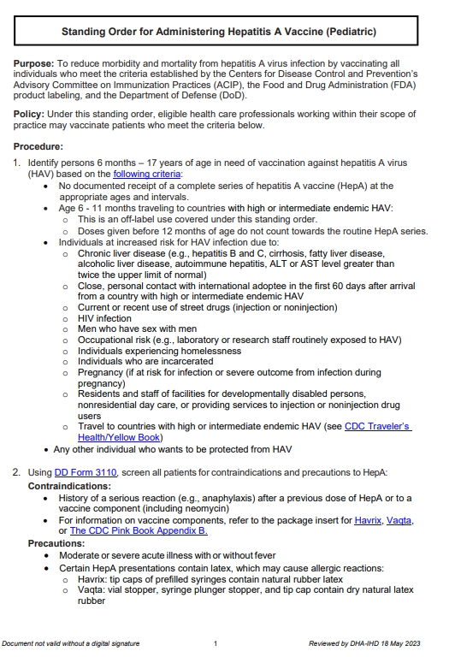
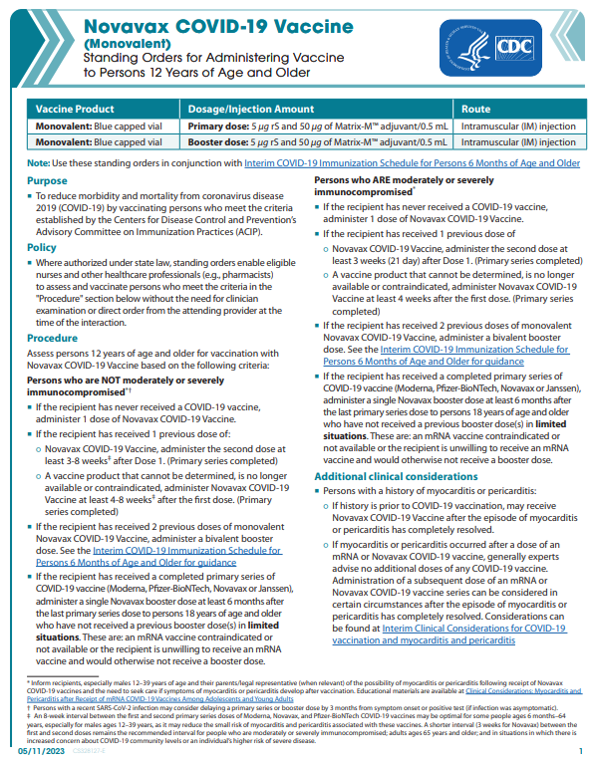
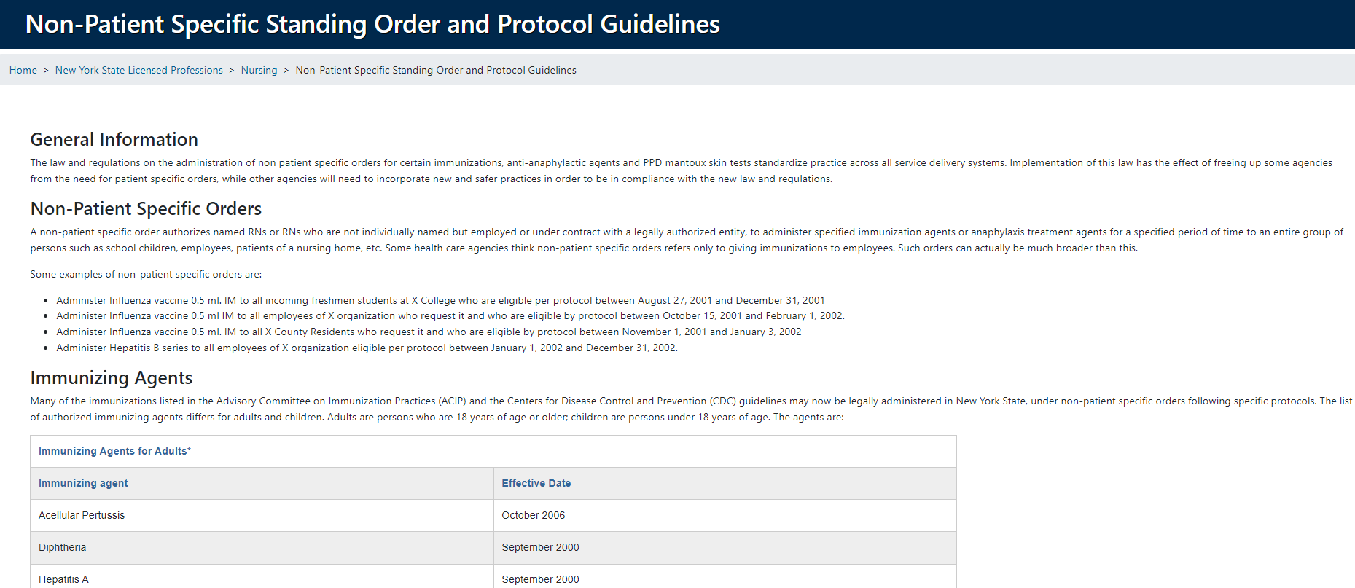
Notes:
As I’ve identified, you are not required to use Oregon’s Immunization Protocols, unless you are providing vaccine in an Oregon pharmacy setting.
Maybe Oregon’s protocols are not a great match for your practice. It’s okay!
Here are some other examples of protocols available that may better fit your immunization program.
You are free to adopt or adapt protocols that make the best sense for your clinic’s program. When determining your perfect fit, remember to keep in mind, the important components I’ve highlighted in previous slides.
If your clinic adopts a particular protocol and makes changes, we recommend removing the organization’s letterhead and replacing with your own. Here in Oregon, we have been known to provide a template in Word format, so you can alter and include your own logo or letterhead.

Slide 16
Notes:
It wouldn’t be a complete Oregon Immunization Protocol discussion without talking about Adverse event reporting and VAERS.
If you’re familiar this will be a great refresher. If you’re not familiar, let me help with that.
VAERS stands for Vaccine Adverse Event Reporting System.
VAERS was established in 1990 and is a national early warning system used to detect possible safety problems in U.S.-licensed vaccines.
VAERS is a passive reporting system, meaning it relies on individuals to submit reports of their vaccine experiences to CDC.
VAERS is not designed to determine if a vaccine caused a health problem but is especially useful for detecting unusual or unexpected patterns of adverse event reporting that might indicate a possible safety problem with a vaccine.
When unusual or unexpected patterns are identified, VAERS provides CDC and FDA with valuable information alerting further work and evaluation is necessary to assess a possible safety concern.

Slide 17
What does VAERS do?
It detects new, unusual or rare adverse events after vaccination
It monitors increases in known adverse events
It identifies potential patient risk factors for types of adverse events
It assesses the safety of newly licensed vaccines
It finds and addresses local or time-related clusters of events that might indicate, for example, problems with a specific batch of vaccine
It recognizes persistent problems with safe usage of vaccines and administration errors
It provides a national safety monitoring system for the U.S. population for response to public health emergencies – much like the large-scale vaccination program we experienced during the COVID pandemic
Douglas Fur (Dug)
Notes:
And to dive even a little deeper into VAERS and what it does, I robbed this slide from another presentation I’ve done. It happened to have a pic of my great big smiley pup Dug and listed are the wonderful things that can result from submitting a VAERS report. Such as…
It detects new, unusual or rare adverse events after vaccination
It monitors increases in known adverse events
It identifies potential patient risk factors for types of adverse events
It assesses the safety of newly licensed vaccines
It finds and addresses local or temporal clusters of events that might indicate, for example, problems with a specific batch of vaccine
It recognizes persistent problems with safe usage of vaccines and administration errors
It provides a national safety monitoring system for the U.S. population for response to public health emergencies – much like the large-scale vaccination program we experienced during the COVID pandemic

Slide 18
11. Adverse events reporting
Notes:
How does this VAERS information pertain to the anatomy of an Oregon Immunization Protocol? Well, Section 11, which is tucked in right before the references section, is where you will find information to access the VAERS system.
Did you know that anyone can report an adverse event to VAERS? If I had an adverse reaction to a vaccine, I could report it myself, or my neighbor, friend or family member can report it for me.
As a result of the National Childhood Vaccine Injury Act of 1986, healthcare providers are required, by law, to report to VAERS, the following information…
Any adverse reaction listed in the VAERS Table of Reportable Events, that occurs within the specified time period after vaccination. Also, health care providers are required to report an adverse event listed by the vaccine manufacturer as a contraindication to further doses of the vaccine.
The link to make a VAERS report and the link to the Table of Reportable Events can be found in section 11 on the protocol and can also be found on the VAERS website.
The Event and Interval from Vaccination box, seen here on the slide, will vary based on each vaccine’s different adverse event reporting criteria.
Safety monitoring in VAERS relies on receiving reports of vaccine adverse events from healthcare professionals. The CDC encourages us to report any clinically significant adverse event that occurs in a patient following a vaccination, even if you are unsure whether a vaccine caused the event. VAERS accepts all reports, including reports of vaccination errors if the health care professional feels the error might pose a safety risk, such as giving a live vaccine to an immunocompromised patient.

Slide 19
Oregon Immunization Program Help Desk
1-800-980-9431
VFC.help@odhsoha.oregon.gov
Wendy Neu, RN, BSN
971-229-9557
wendy.neu@oha.oregon.gov
Jill Johnson, RN, BSN, MEM
971-378-5691
Jill.M.Johnson2@oha.oregon.gov
Notes:
This concludes my portion of the presentation. If you have questions or need assistance don’t hesitate to connect with us here at the Oregon Immunization Program. We truly do love to assist.
I’m happy to turn it over to Jill Johnson who will share her clinical expertise in vaccine administration.

Slide 20
Vaccine Administration Best Practices
Preparation
On-going staff training
Signed Immunization Protocols / Orders
VIS statements
Forecast for vaccines that are due
Screen for contraindications / precautions
Explain which vaccines will be given
Answer questions
Administration
Prepare vaccines in clean, designated area away from patient
Follow aseptic medication preparation practices
Always check expiration dates of vaccine, diluent vials and prefilled syringes
Select new needle and syringe for each injection!
Use combination vaccines when appropriate
Ensure needed supplies are available during administration
After the Vaccines
Monitor patient for adverse reactions
Document vaccines administered
Provide education on management of side effects and when vaccines will be due again

Slide 21
Improving the Vaccination Experience
“Vaccinations are the most common source of procedural pain for healthy children and can be a stressful experience for persons of any age. It has been estimated that up to 25% of adults have a fear of needles, with most needle fears developing during childhood.”
The Pink Book, Epidemiology and Prevention of Vaccine-Preventable Diseases, CDC, 2021

Slide 22
Mitigating pain during vaccination visits should be considered part of good immunization practice.
WHO Position Paper on Reducing Pain at the Time of Vaccination

Slide 23
Suggestions for Managing Stress and Pain
Minimize wait time
Parent / guardian participation
Use of topical local anesthetics or vapocoolants
Inject vaccines:
Rapidly without aspiration
That cause the most pain last
Breastfeed young child during vaccine injections
or give sweet tasting solution if not breastfed
Distraction & breathing techniques

Slide 24
Comfort Positions
For Infants and Toddlers:
Parent/caregiver holds the child on their lap.
Child’s arm goes under parent/caregiver armpit and parent/caregiver holds in secure, hug-like hold ensuring the child’s other arm is held gently but securely.
Child’s feet are anchored between thighs or with other hand.
*For more help with comfort positioning, visit:
Comfort Techniques (CDC Video)
How to Hold Your Child During Vaccination (CDC)
Comfort Positioning During Procedures (CHOP)

Slide 25
Comfort Positions
For Older Children:
Have parent/caregiver hold the child on their lap or have them stand in front of parent/caregiver while they sit.
Parent/caregiver embraces the child during the process and anchors both of the child’s legs between their thighs.
*For more help with comfort positioning, visit:
Comfort Techniques (CDC Video)
How to Hold Your Child During Vaccination (CDC)
Comfort Positioning During Procedures (CHOP)

Slide 26
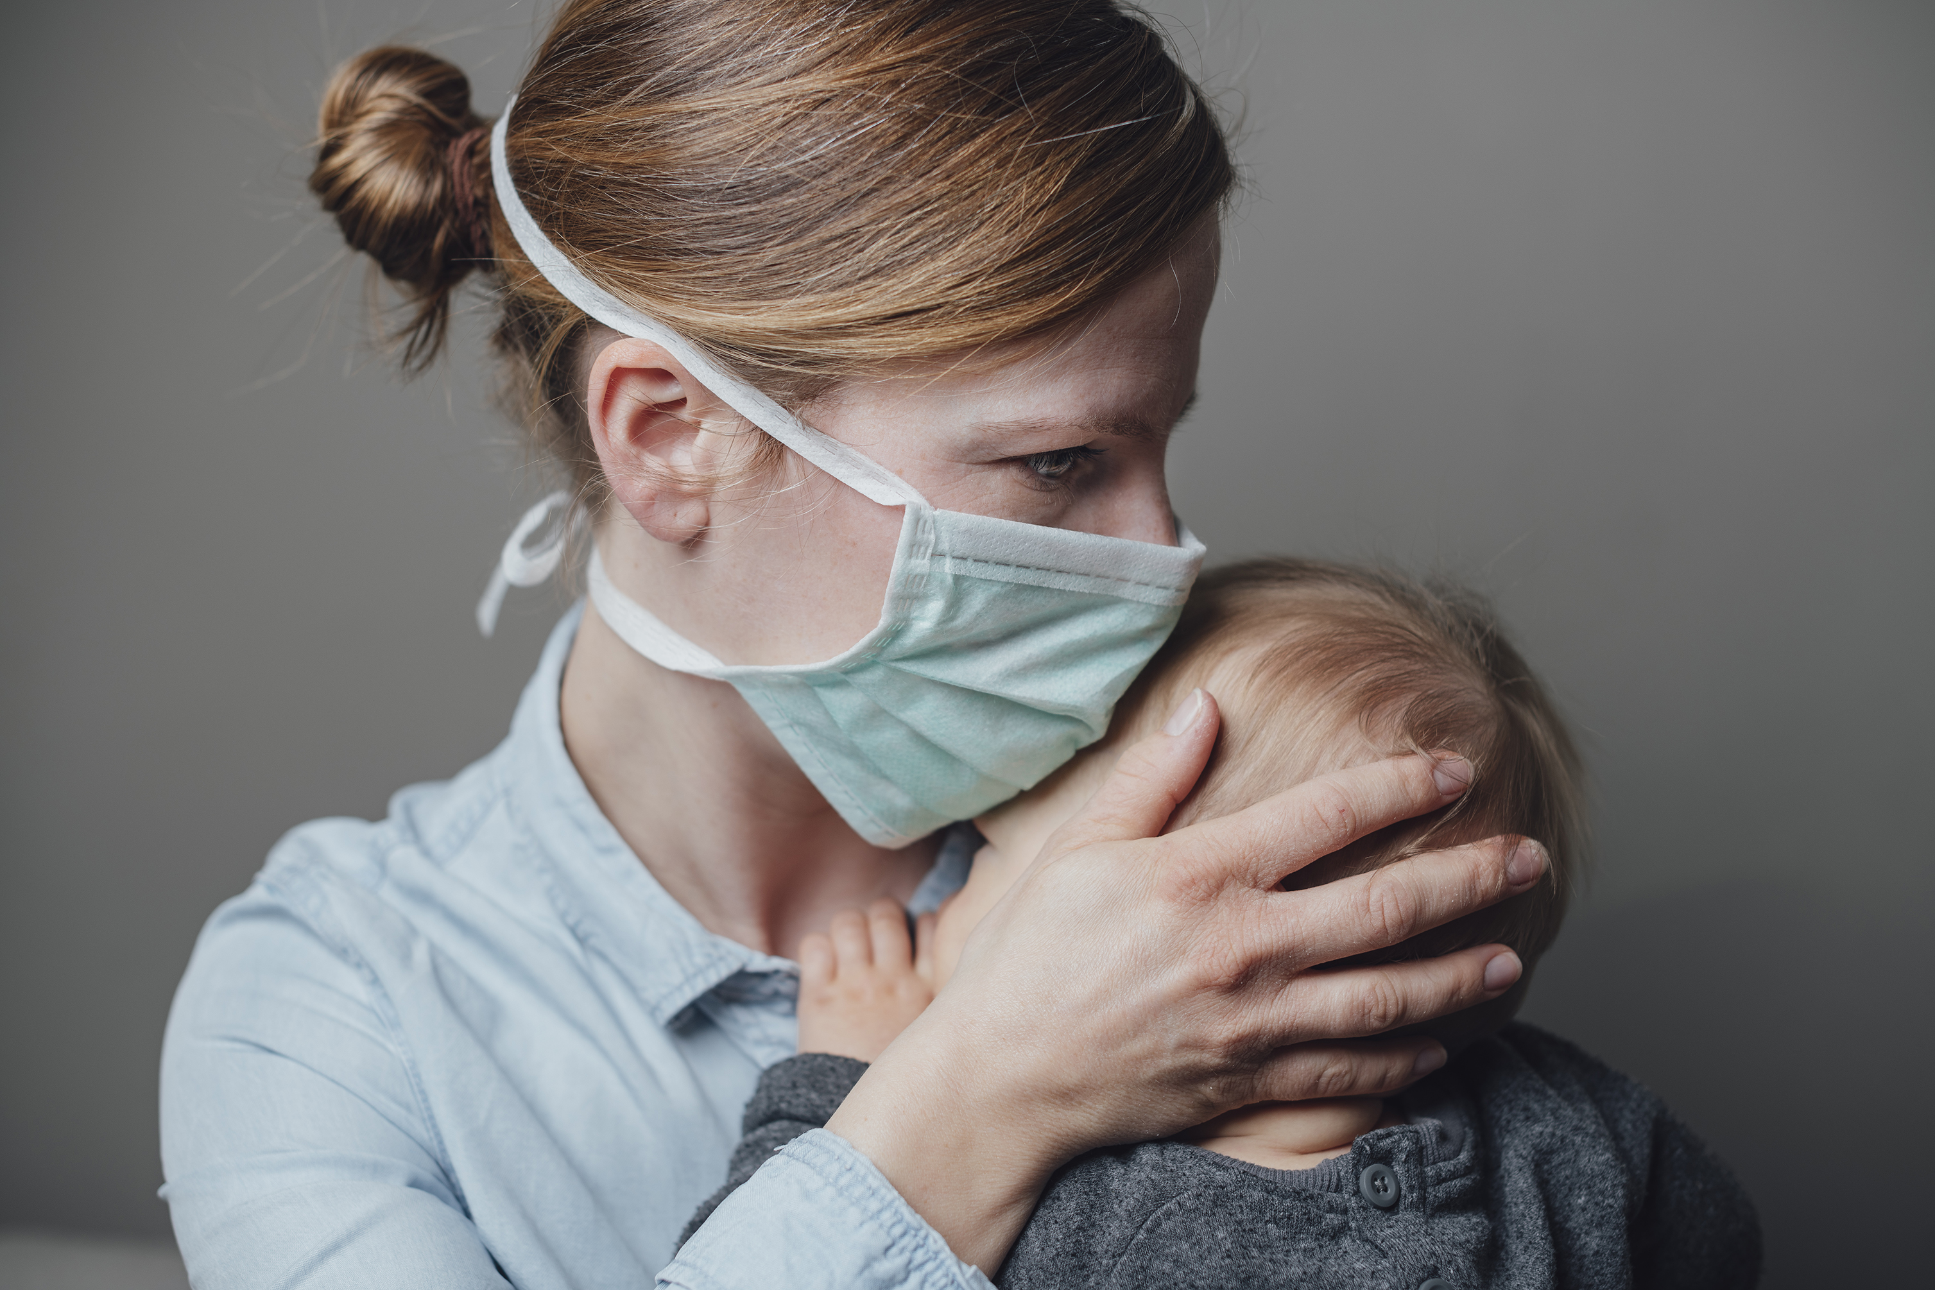
Comfort Positions
Bear Hug
Have parent/caregiver hold the child on their lap facing them, tummy to tummy, while sitting.
If able, child’s arms go under parent/caregiver armpits and legs straddle lap.
Both child and parent/caregiver hug with arms wrapped around each other.
*For more help with comfort positioning, visit:
Comfort Techniques (CDC Video)
How to Hold Your Child During Vaccination (CDC)
Comfort Positioning During Procedures (CHOP)

Slide 27
From CDC’s Administer the Vaccines Webpage

Slide 28
From CDC’s Administer the Vaccines Webpage

Slide 29
From CDC’s Administer the Vaccines Webpage

Slide 30
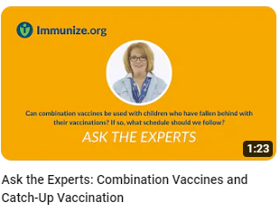
Ask The Experts at Immunize.Org
Ask the Experts Video Series
Visit Immunize.Org

Slide 31
What do you think?
From Ask the Experts at Immunize.Org
Is it okay to draw up vaccines at the beginning
of the shift? If it isn’t, how much in advance can
this be done?
The CDC discourages the practice of prefilling vaccine into syringes, primarily because of the increased possibility of administration and dosing errors.
An exception may be considered when only a single type of vaccine is to be administered during a clinic (e.g. influenza).

Slide 32
What do you think?
From Ask the Experts at Immunize.Org
Do we need to wait for the vaccine to reach
room temperature before we administer it to the patient?
There is no recommendation to wait until a vaccine reaches room temperature before administration. The vaccine should be administered as soon as it is prepared.

Slide 33
What do you think?
From Ask the Experts at Immunize.Org
We frequently see patients who are sick and
are due for vaccinations. Should we administer the vaccines?
A mild illness such as diarrhea or mild upper-respiratory tract infection with or without fever is not a contraindication and vaccines may be given.
A moderate or severe illness is a precaution for administering vaccines as a fever following the vaccine could complicate management of the concurrent illness.
Treatment with antibiotics is not a valid reason to defer vaccination if the child or adult is otherwise well or has only a minor illness.

Slide 34
Resources at Your Fingertips
Help Desk at the Oregon Immunization Program
Email VFC.Help@odhsoha.oregon.gov or call 1-800-980-9431
Centers for Disease Control and Prevention (CDC)
CDC Vaccines & Immunizations
Immunization schedules & information for healthcare providers and parents
CDC Immunization Education & Training
Modules, webinars, videos, job aids for healthcare providers
Immunize.org (www.immunize.org)
CDC funded clinical reference materials, patient handouts, VIS statements,
Ask the Experts (answers to clinical questions about vaccines)
Children’s Hospital of Philadelphia (CHOP)
Vaccine Education Center has reliable information about vaccines for parents and healthcare providers

