Slide 1
Northwest Immunization Conference (NWIC) 2023 Travel Medicine & Vaccines
Tobias Pusch, MD
Providence Infectious Diseases Consultants West
The Travelers Clinic
Portland, Oregon

Slide 2
Disclosures
HIV Speakers Bureau – Gilead Sciences LLC
HIV Advisory Board
- Gilead
- Viiv Healthcare LLC
Advisory Board
- CSL Sequirus Ltd
Contracted research
- Gilead
- Viiv

Slide 3
Outline
Why this talk is important to YOU !
Travel in numbers
Special vaccination considerations
Yellow fever
Rabies
Japanese encephalitis
Dengue
Question Set – optional if time allows

Slide 4
The Pre-Travel Consultation

Slide 5
Increase in Travel
 | Population (Billion) | International Travel Arrivals (Millions)
1950 | 2.5 | 24
1980 | 4.5 | 278
1995 | 5.7 | 528
2007 | 6.6 | 903
2013 | 7.1 | 1087
2019 | 7.74 | 1465
~3-fold population increase
60-fold increase in travel in 70 years

Slide 6
Post-pandemic travel recovery

Slide 7
Travel Medicine - Considerations
longer-term travel or migration country to another country increasing rapidly
1975 | 40 Million
2000 | 175 Million

Slide 8
Travel Medicine - Considerations
Most international destinations are to Europe
Fastest growing travel destination Asia and East Africa
Most short term: pleasure / vacation
VFR (Visiting Friends and Relatives)
Special relevance
Leisure | ~50%
VFR | 30%
Business | 15%
Other | 5%

Slide 9
Special Populations – VFR’s (Visiting Friends and Relatives)
“an immigrant, ethnically and racially distinct from the majority population of the country of residence (usually higher income), who returns to his/her homeland (usually lower income) to visit friends and relatives”
Expands to family

Slide 10
Special Populations – VFR’s
More frequent travel
Greater morbidity and mortality than natives of their adopted country
US & Canadian population:
12% are foreign born and comprise 38% of overseas travelers
Returning “home” exposes to pathogens that are generally absent in adopted countries
Higher numbers of imported cholera and other diarrheal illnesses, TB, helminthic diseases

Slide 11
Special Populations – VFR’s
Travel to more remote locations
Much higher rate of non-”western style accomodations”
Lack of risk awareness & believe of “immunity”
Inadequate medications use (chloroquine in SE Asia) or counterfeit drugs
Lower rates of pre-travel visits / Language barrier

Slide 12
Travel can be (is) hazardous
50% of all travelers will develop a health problem
8% will seek physician advice
5% will be confined to a bed for at least 1 day
1% will be incapacitated during or after travel
0.3% will be hospitalized (abroad or home)
0.05% will require evacuation
0.001% will die during travel

Slide 13
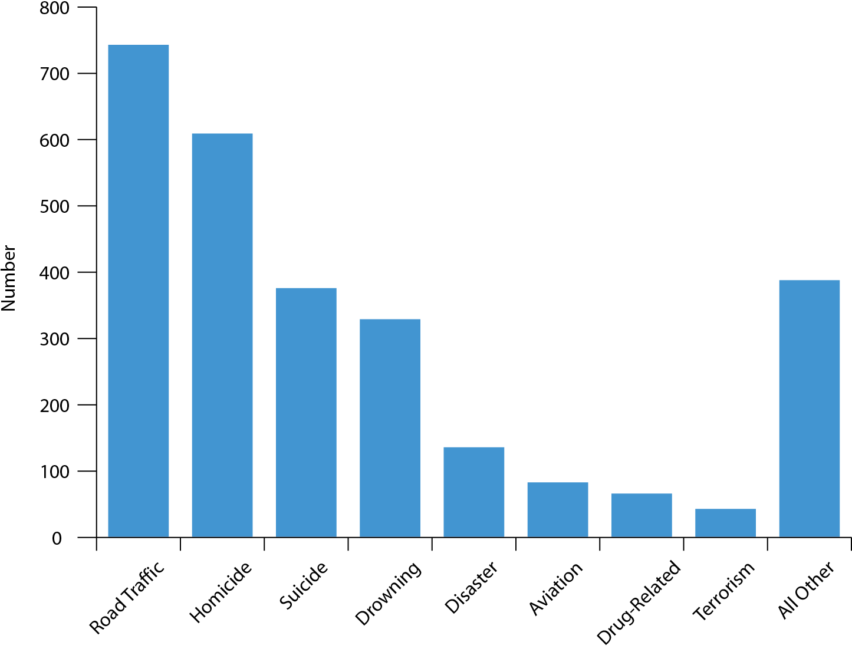
Fatalities abroad 2009-2011

Slide 14
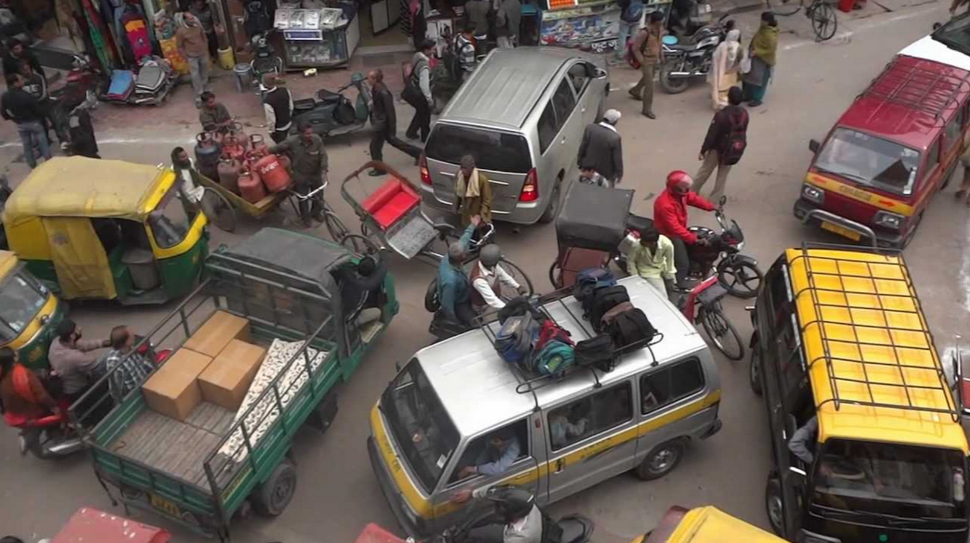
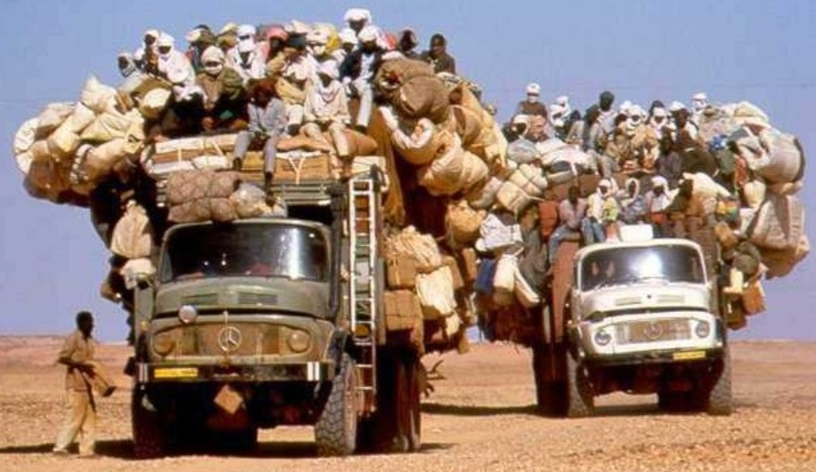
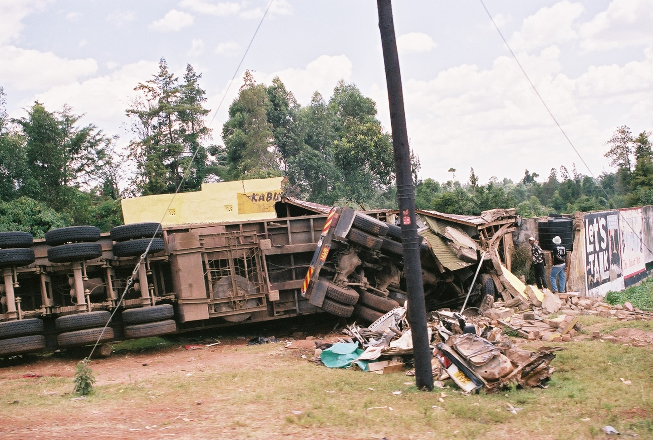
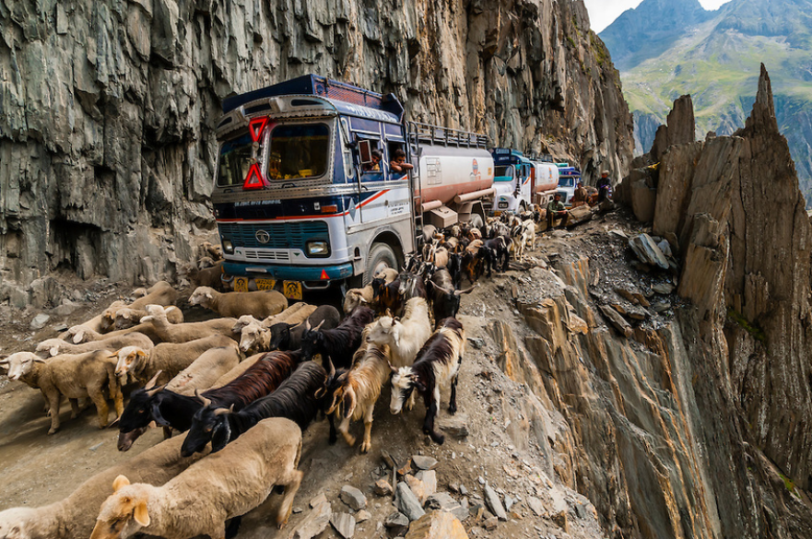

Slide 15
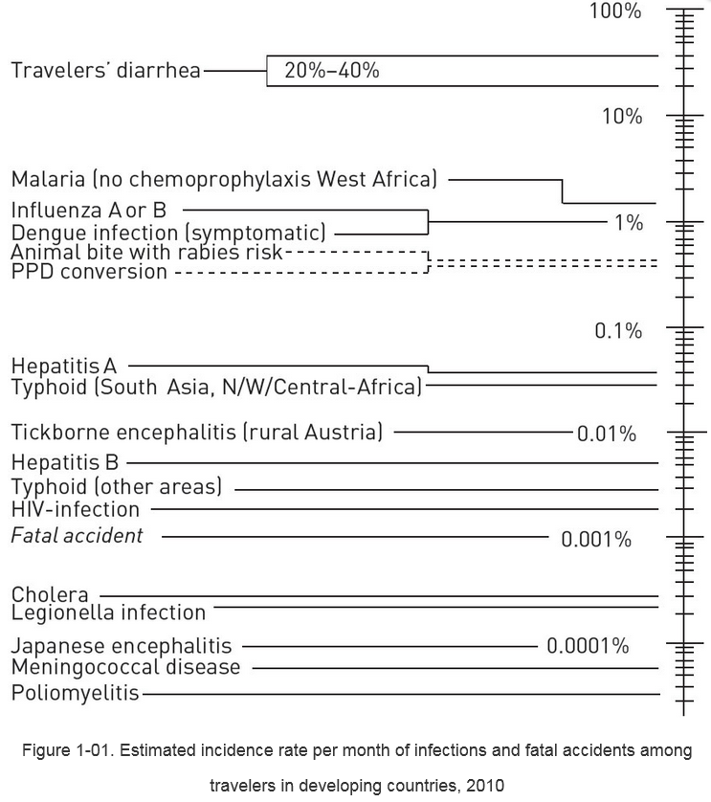
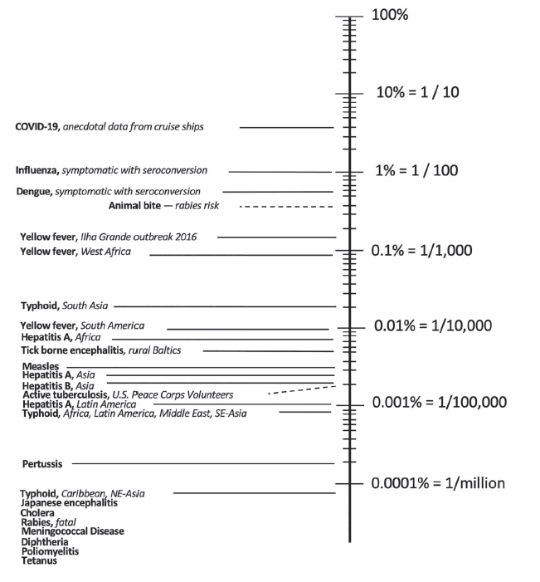
Geosentinel Surveilance Network
Steffen R., et all. JTM June 2023
Limitations: Precise risk for specific diseases difficult to estimate, challenge determining nominator & denominators. True Incidence Rate / Risk ???
Notes:
aggregate data and studies.
GeoSentinel & EuroTravNet -clinic-based global surveillance systems that track diseases among travellers in their destination country and upon return. GeoSentinel comprises 71 clinics worldwide. Clinical information is collected by physicians and entered into a database which is maintained by the U.S. CDC. By nature, GeoSentinel is unable to provide denominator data; thus, no incidence rates are generated, but it offers valuable data on proportionate morbidity.
→ do not consider variations in risk behaviors, destination, season, duration of travel, or general style of travel.

Slide 16
Relative Incidences of Health Problems During Travel in a Developing Country

Slide 17
Relative Incidences of Health Problems During Travel in a Developing Country

Slide 18
Vaccines

Slide 19
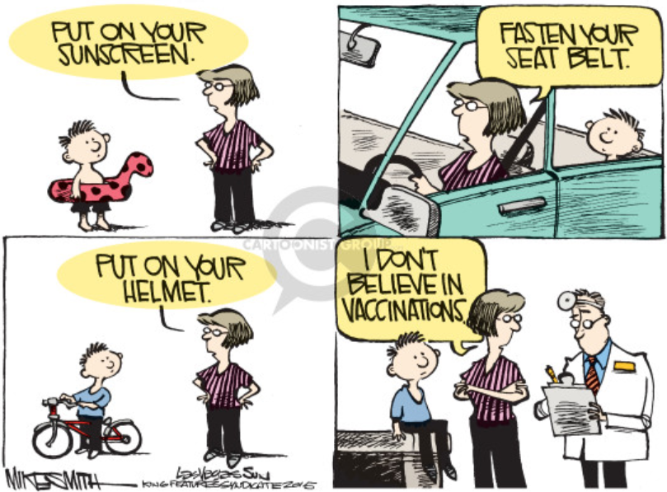

Slide 20
Three “R’s” of Travel Vaccinations
ROUTINE
Childhood, adulthood by ACIP / CDC vaccine calendar
REQUIRED
Crossing international borders
RECOMMENDED
By risk of infection
Notes:
Categories may overlap. Vaccine availability varies by country

Slide 21
Routine Vaccines – most / all countries
Tetanus, diphteria, pertussis
Haemophilus influenzae type B
Polio
MMR
Hepatitis B
Influenza
Covid
Pneumococcus
Herpes zoster

Slide 22
Required Vaccines
Yellow fever
Required by International Health regulations (IHR) 2005
Meningococcal meningitis
Special circumstances
Covid
Polio

Slide 23
Recommended
Hepatitis A & B
Typhoid (Salmonella typhi, paratyphi)
Cholera
Polio
Meningococcal meningitis
Japanese encephalitis
Rabies
Tick-borne encephalitis

Slide 24
Routine Vaccines – some countries
Hepatitis A
Meningococcus
Tickborne encephalitis

Slide 25
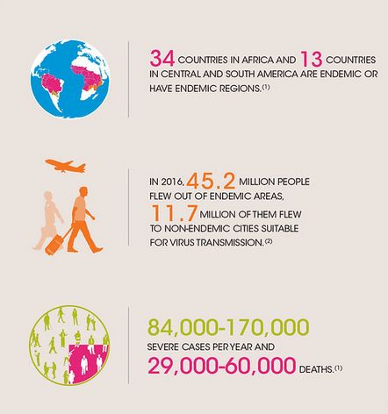
Yellow Fever (YF)
Flavivirus; single stranded RNA genome replicating in cytoplasm
7 genotypes (two in SA and five in Africa
Current vaccines cover ALL genotypes
Vector: Aedes mosquitos
CDC

Slide 26
Geographic Distribution of Yellow Fever
10fold greater risk in Africa on average

Slide 27
Yellow Fever
Incubation: 3-6 days
Asymtomatic to Nonspecific flu symptoms
May progress to jaundice, hemorrhagic fever and death
Approximately 12% of infected will develop more severe form
Case fatality: 30-60% for severe disease
Copyright: Sanofi Pasteur

Slide 28
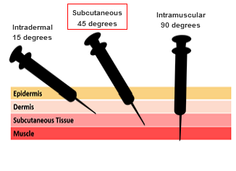
Yellow fever vaccine (YF-vax)
Lack of antivirals emphasizes vaccination / prevention strategy
17D strain
Live, attenuated; passaged in chicken eggs
only licensed vaccine in US
Highly immunogenic
Generally safe
Common and rare vaccine-associated adverse events require:
knowledge of contraindications in specific groups
Determine travelers risk to justify vaccination
Specialized YF clinic certification
Notes:
Complete ICVP (International Certificate of Vaccination or Prophylaxis) – becomes valid 10d after vaccination and is valid for Life. 80% of vaccinees have neutralizing Ab within 10d, 99% within 30 days.

Slide 29
YF Vax – Severe Vaccine adverse events (YEL-AVD & YEL-AND)
2 rare forms that only occur in first time vaccinees.
Viscerotropic
Onset 2 to 8 days following vaccination (range up to 56 days)
Progression to multi-organ failure; 50% mortality
Incidence 0.8/100K (3 to 5 cases / million doses); 2.2 in people >60 years
Neurotropic
Onset 4 to 27 days following vaccination
Encephalitis (infection), Guillain-Barre / demyelination (autoimmune)
Mortality <5%
Incidence 0.3/100K (Risk ~ 5 cases / million doses); 1.2 in people >60 years
Notes:
Yellow fever vaccine-associated neurologic disease (YEL-AND) and viscerotropic disease (YEL-AVD)
Anaphylaxis risk 1.3 cases / million doses.

Slide 30
Contraindication
Thymus disorders, Immunomodulators, active malignancies, age <6 yrs (encephalitis risk)
Relative
Age >60 ➔ increased risk for both viscerotropic and neurotropic dz
Optional issuance of Medical Waiver
Deferral of travel
Contraindications for Administering Yellow Fever Vaccine
Need An Expert Opinion? Call 1-800-CDC-INFO (232-4636)

Slide 31
Rabies in Travel
Education will avoid getting bitten by a rabid animal
If bitten, prevention with appropriate immunoprophylaxis
Pre-exposure immunization and subsequent boosting
Post-exposure vaccine and immunoglobulin

Slide 32
Yearly fatalities from Rabies in Travelers…?
3500
350
35
3.5
0
Between 1990 and 2019, 83 cases of rabies have been recorded among travellers, 3.5 cases annually in the 2004 to 2019 period.

Slide 33
What is the reasons for rabies mortality?
Extensive, high risk bites?
No post-exposure prophylaxis (PEP) or not in time?
Ineffective PEP?
Did not seek PEP?

Slide 34
Answer
Death occurs because traveler did not seek PEP !!!
Education issue
False perceptions
Animal did not look ill
Provoked attack
Dog was a puppy
No rabies at location
Presumed minor exposure
Medical expenses

Slide 35
PEP access problem?
Not reported
➔ Death occurs due to lack of accessing PEP or inadequate PEP received (one case reported only; Goa/India 1997 – no HRIG given)

Slide 36
Rabies exposure risk
Poor data
Estimates from survey data 3 to 30 per 1000 travelers (0.003 – 0.03)
34% sought PEP (% adequate ???)
Much lower estimates in large, retrospective individual studies at 14%*
Rabies diagnoses: zero
How is discrepancy explained?
Animal did not have rabies / bite not leading to disease (20-40% of rabid proven animal do not result in encephalitis)
Innocuous exposure – lick to intact skin, minor scratch
Notes:
200 Million travelers to SEA yearly – theoretical bite exposures ~600K; yet only 2 reported cases !!!
Rabies does not go into blood, but stays in subcu tissue / muscle and might stay there for a long time.

Slide 37
Education
Pre-travel visit is where rabies is prevented
Existence or rabies at destination
Vaccine strategies – pre- vs post-exposure
Bite avoidance
What do you do after being bitten
Where to get HRIG / vaccine

Slide 38
Exposure type treatment is sought for
Dog 60%
Monkey 25%
Cat 10%
Bat 1%

Slide 39
Fatal Rabies Cases in Travelers 1990-2012
85% dogs
5% bats
8% unknown
None from monkeys

Slide 40
Vaccine strategy – PrEP vs PEP
Pre-exposure rabies immunization is an advantage
Person with PrEP who was boosted after exposure has never died of rabies (never published)
Rabies vaccine widely available; HRIG is not
Con:
high price in US (>$400)
Multiple injections

Slide 41
Rabies Vaccine – PrEP and PEP
RabAvert (Bavarian Nordic)
Inactivated; Chick embryo cell vaccine
Imovax (Sanofi)
Inactivated; human diploid cell vaccine
Preservative and Latex free
PrEP
Since 2018 (WHO) and 2022 (CDC) a two shot series is sufficient for short term immunity (~3 years)
PEP
4 shot series (days #0,3,7,14)

Slide 42
Personal opinion
It is justifiable as a ‘life-time investment’ with no more boosters needed to broadly recommend rabies preexposure prophylaxis (PrEP) to travellers with destinations in the 116 countries, territories and jurisdictions identified as moderate to high risk.

Slide 43
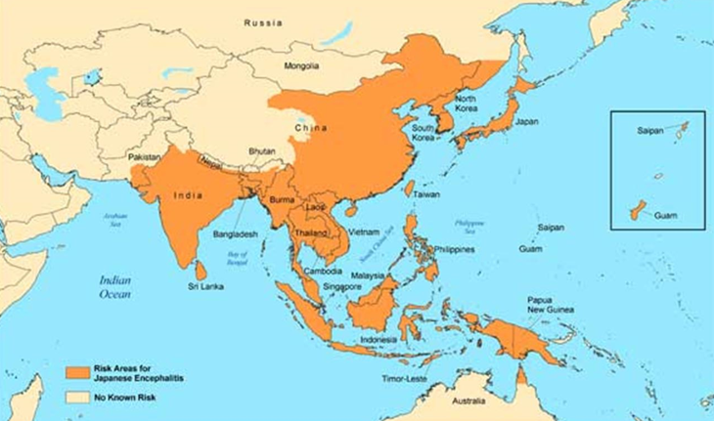
Japanese Encephalitis

Slide 44
Japanese encephalitis
www.encephalitis.info
Endemic in 24 countries in Asia
Incubation 5-15d
Fever 2-3d, HA, vomiting, encephalitis
Low viremia in humans – unable to transmit disease
Most common viral encephalitis in Asia

Slide 45
Japanese encephalitis
Transmission
Dusk to dawn-biting Culex mosquito – exophilic (ecologically independent from humans) and zoophilic (animal preference) in rural Asia
Risk of infection
Not well defined. Estimate 1/5,000 to < 1 per million travelers per week stay in endemic area
Risk correlates with rural exposure but may occur in short beach vacations.

Slide 46
Japanese encephalitis
1871 First recognized in Japan
- estimated 15K death / yr
1924 Japan outbreak
1949 Korean outbreak
1969-70 Thailand – Chiang Mai outbreak
1980 Thailand peak 2500cases/yr
1990 Thailand – Chiang Mai vaccine campaign
2000 Thailand – 500 cases/yr ➔ JE vaccine SA14142 enters pediatric vaccine calendar
2015 Thailand – 12 cases/year

Slide 47
Japanese encephalitis
Ixiaro
routine schedule Day # 0 and Day #28 (may give #21 earliest)
One dose not an option (Schuler Vaccine 2009) - ineffective
Rapid schedule (Day #0 and Day #7) non-inferior to conventional schedule option at up to 2 months (Jelinek JTM 2015) – now approved in US
follow up study showed efficacy of rapid schedule at one year
(Cramer JTM 2016)

Slide 48
Japanese Encephalitis – accelerated
Ixiaro – inactivated, vero-cell culture derived
routine schedule Day # 0 and Day #28 (may give #21 earliest)
One dose NOT an option (Schuler Vaccine 2009) - ineffective
Rapid schedule (Day #0 & Day #7) non-inferior to conventional schedule option at up to 2 months (Jelinek JTM 2015) – now approved in US
follow up study showed efficacy of rapid schedule at one year
(Cramer JTM 2016)

Slide 49
Dengue

Slide 50
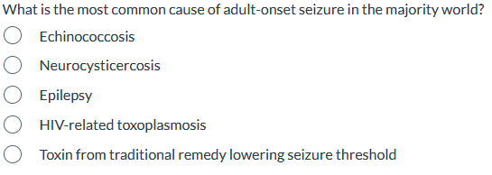
The Diversity of Travel Medicine Question #1

Slide 51
The Diversity of Travel Medicine Question #1 - Answer
✓

Slide 52
Question #2
Travelers visiting friends and relatives (VFR’s) account for what percentage of travel from the US?
1-5%
10-20%
40-50%
60-70%

Slide 53
Question #2 - Answer
✓

Slide 54
Question #3

Slide 55
Question #3 – Answer
✓

Slide 56
Thanks for listening !

